Slide 1
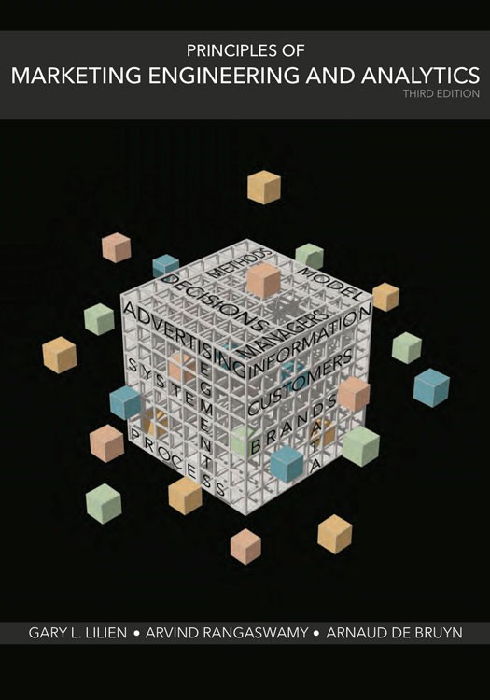
Marketing Engineering & Analytics
Introduction
Data Analytics and Marketing Analytics
Key Concepts Behind Marketing Analytics
Models and Modelling
https://minderchen.cikeys.com/marketing/
Notes:
In this session you will want to describe:
1 Course structure and operation
2 The philosophy of learning-by-doing.
3 Definition, value, and uses of models.
4 Software overview and operation.
To start the class you might show them the Allegro.xls Sheet one shows a typical dumb spreadsheet and management will be unhappy with declining profits in a market with increasing sales and stable market share.
What to do? Reduce costs, of course. And that should be looked at—and reduced costs go to the bottom line. What about increasing price?
Raising/lowering advertising? Raising/lowering selling effort?
As a typical spreadsheet, these (marketing) activities result in direct gains and losses on the spreadsheet—increasing price is good but cutting advertising and selling effort is bad. This is how accountants view marketers who want to do the opposite most times—and this highlights two different views of the world.
Why don’t marketers agree with the accounting and finance folks? Because they believe that the firm’s sales/market share will be affected negatively by price increases and by decreases in advertising and selling efforts. Yet the spreadsheet doesn’t say so. They need a vocabulary to communicate their beliefs.
Look at sheet 2—it is a smart spreadsheet. Here, we have included a simple, multiplicative (constant elasticity) model that specifically links what management/marketing believes about the marketplace to market share. Management needs to provide specific answers to three questions (elasticities) to calibrate the model. Then, changes in price, advertising and selling effort directly affect share.
So, you can ask “what if” questions about raising and lowering price, advertising, etc. Note the effect on profits. They may go up—but often at the expense of market share! What should the goals of the company be? And what is the best the firm can do?
Here you can introduce Solver as a tool that will require that the user specify an objective (Profit? Profit with a market-share constraint? A combination of the two? Maximize market share subject to a minimum return? Return on average/incremental marketing dollar expenditures?). And Solver will do the job—but many questions will be raised in the meantime, such as:
How do we know the model is right? (It is better than the dumb spreadsheet, though—right?)
What should our goals be? (Makes you discuss and specify them or Solver won’t run.)
How can we improve the model? (What data do we need and how should we collect it? Historical? Survey? Field experiment?)
Even before the lecture begins, this discussion illustrates several important points:
Firms use models all the time, even if they are not made explicit.
Models force you to be explicit about goals and the explicit relationship between those goals and the specific marketing activities under question.
Students and executives have the software on their desks now (Excel or another spreadsheet) both to build simple models and to explore the policy implications of their assumptions about the marketplace.

Slide 2
OBJECTIVES
Learn Specific Analytical
Tools and their Value
for Improving Marketing
Decisions
Learn About Different Decision
Areas* in Marketing
Learn Concepts and
Analytical Frameworks
Used in Marketing
Learn to interpret Analytical Results, and Link them to Business Performance
Learn How to Address Organizational Issues in Implementing Analytical Results
Become a Better Consumer (user) of
Marketing Analytics
* https://www.smartinsights.com/digital-marketing-strategy/customer-segmentation-targeting/segmentation-targeting-and-positioning/

Slide 3
Definition of Marketing (营销)
1. Introduction to marketing analytics
Marketing is the activity, set of institutions, and processes for creating, communicating, delivering, and exchanging offerings that have value for customers, clients, partners, and society at large. (AMA 2017)
Notes:
朱光潛曾說：「學校教育，只有兩個重要的功用：第一是啟發興趣，其次就是指點門徑。」
朱光潛說：「念講義看課本，免不掉若干拘束，想藉此培養興趣，頗是難事。」
「打開課本如何想像、如何驚奇、如何探索」

Slide 4
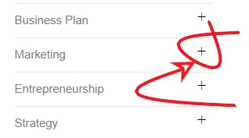
Resources
May need to try a different browser.
** https://www.consuunt.com/marketing/
Market Research & Big Data
Market Segmentation
RFM Model
AIO Model
Barnum Effect
Marketing Strategy
Branding
Marketing Storytelling
Content Marketing
Push and Pull Marketing
Unique Selling Proposition
Psychographics
Customer Insight
Customer Experience
RATER Model
Customer Pain Points
Loyalty Ladder
AIDA Model
Sales Funnel
DAGMAR Model
RACE Planning
Marketing to Generation Z
4P Marketing Mix
4C Marketing Model
7P Marketing Mix
Augmented Product
Product Mix
Marketing Templates

Slide 5
Allegro Case and Solver:
Optional Take Home Assignment bonus points (2 points)
Meet your first Marketing Decision Model
Allegro_smart_sheet.pdf
Allegro_smart_sheet.xls
technical_note_solver.pdf
Additional References:
Data Analysis & Using Solver Excel 2013 Beginners Tutorial - YouTube
Define and solve a problem by using Solver (microsoft.com)
Excel_Techniques.pptx (mit.edu) & lec02_diet.xlsx (live.com)
Optimization Methods in Management Science | Sloan School of Management | MIT OpenCourseWare

Slide 6
Allegro Case Questions
Question 1: Using the Simple Sheet, what happens when Allegro cuts advertising and selling effort to 0$ and raises price to $500/unit? Comment.
Question 2: Repeat exercise 1 using the Smart Sheet.
Question 3: Using the Smart Sheet, what is the profit maximizing level of advertising, selling effort and price? (Hint: Requires Solver) Would you recommend the firm implement this policy? Why or why not?
Question 4: What if the firm's goal was not to maximize profit, but to maximize market share while maintaining profit at no lower than last year's level. (Hint: Requires Solver—and be sure to start with a feasible level of profit). Compare this policy to the one you found in question.
Question 5: Comment on the strengths and limitations of a response function approach (Smart sheet) like this in practice.

Slide 7
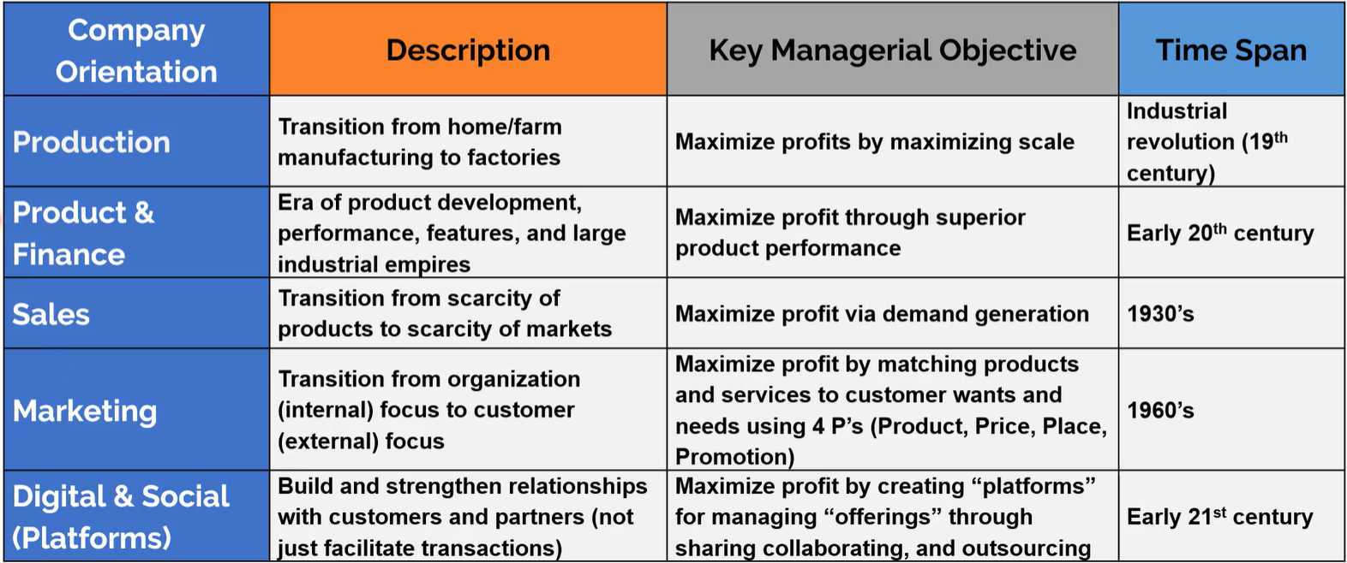

The Evolution of marketing – 2/16 start from here

Slide 8
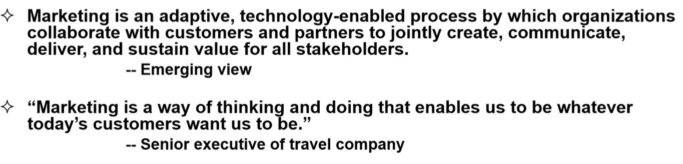
Emerging Concepts of Marketing
Customer-Centric
Find/design/deliver the right offerings for customers
How to collect and analyze customer data? ➔ Customer Analytics (**link) vs. Market Analytics

Slide 9
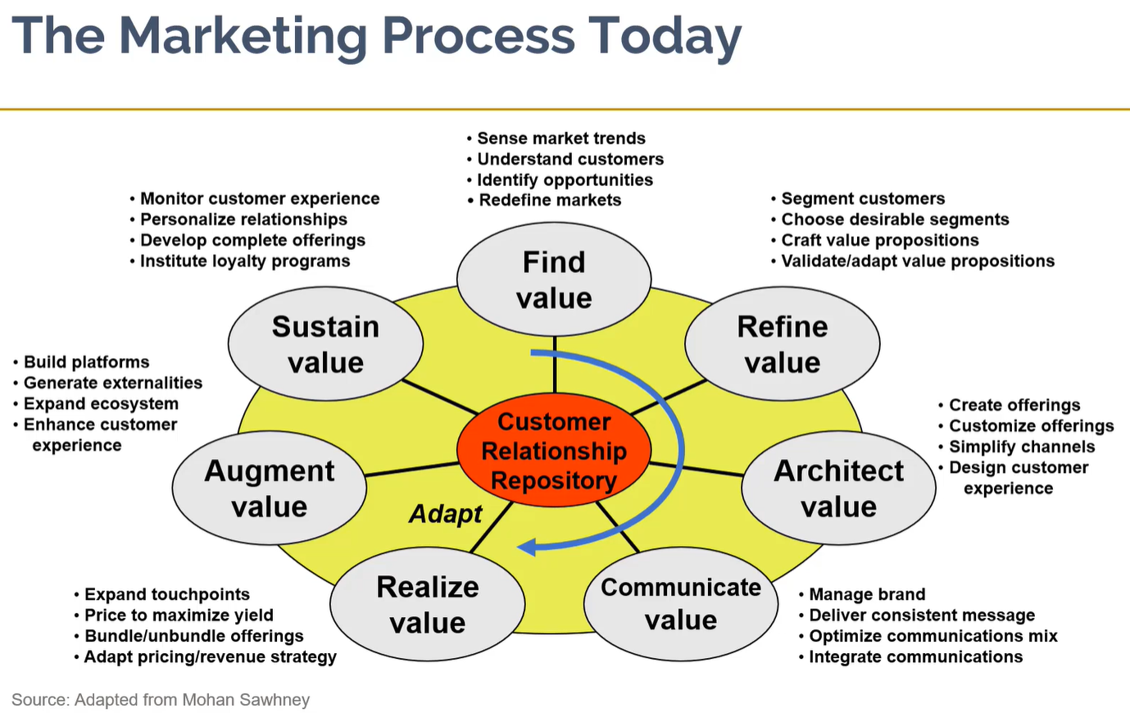
Marketing Process: discovering, creating and delivering value.
①
②
提高；增大；加强
(See also video)

Slide 10
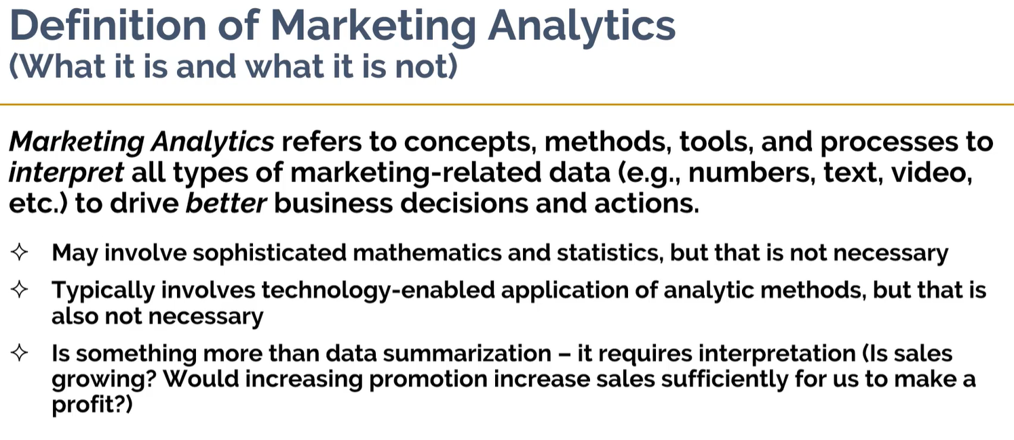
Science of Better Decisions

Slide 11
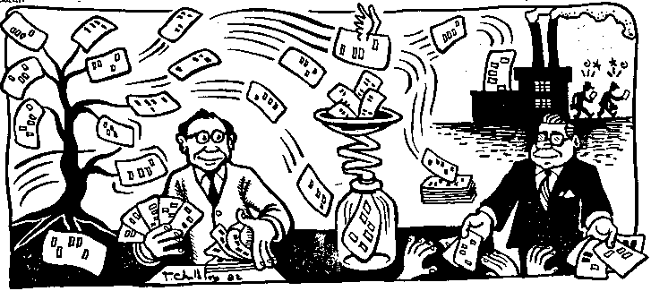
Information/Decision Life Cycle
Information is processed data that is organized, meaningful, and useful.
Information
Characteristics of Information as Resources
Expandable: Information explosion*
Compressible: Sorting, categorizing, filtering, aggregating, summarizing**, and consolidating.
Substitutable:
Transportable
Diffusive: Spreading (sharing) and leaking (Security & privacy)
Sharable
Data
Decision
Action
Intelligence: Gather information
Design: Create alternatives
Choice: Select an optimal/good enough solution
http://minderchen.cikeys.com/wp-content/uploads/reading/InformationResource.pdf

Slide 12
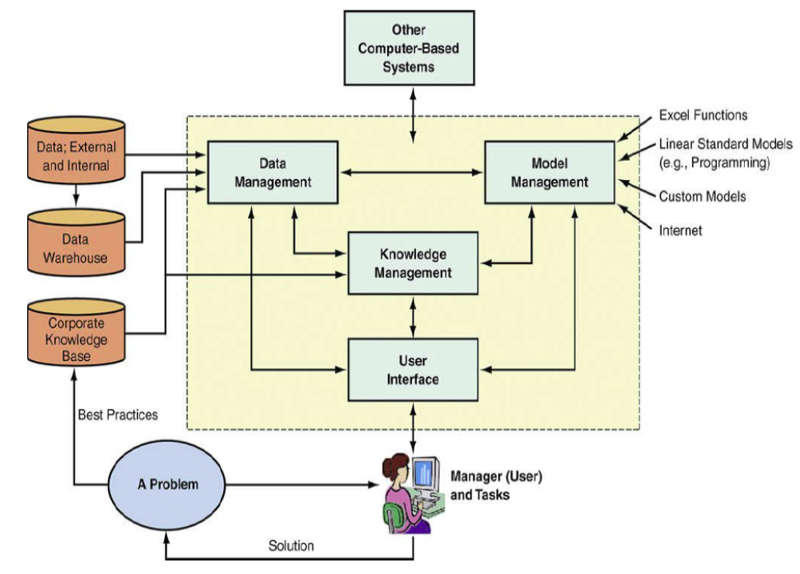
Decision Support Systems (DSS) Framework
Data
Analytics
Models
Excel functions-based models
Statistical models
Mathematical models
Machine learning models
Domain specific models such as models supporting specific marketing decision makings.
Data
Base
Model
Base
User Interface
Data
Visualization
Source: (Link)

Slide 13
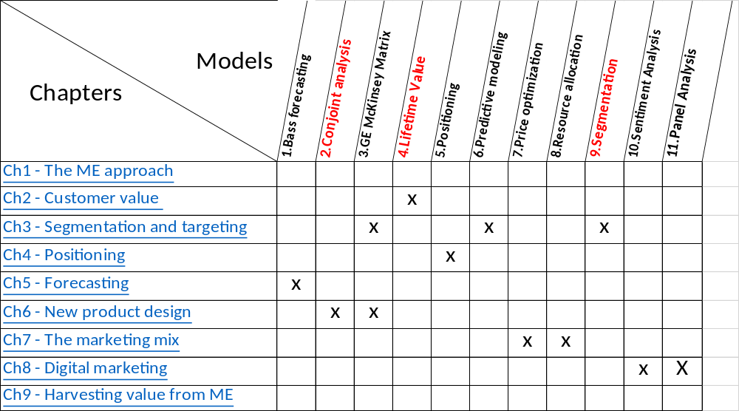

Slide 14
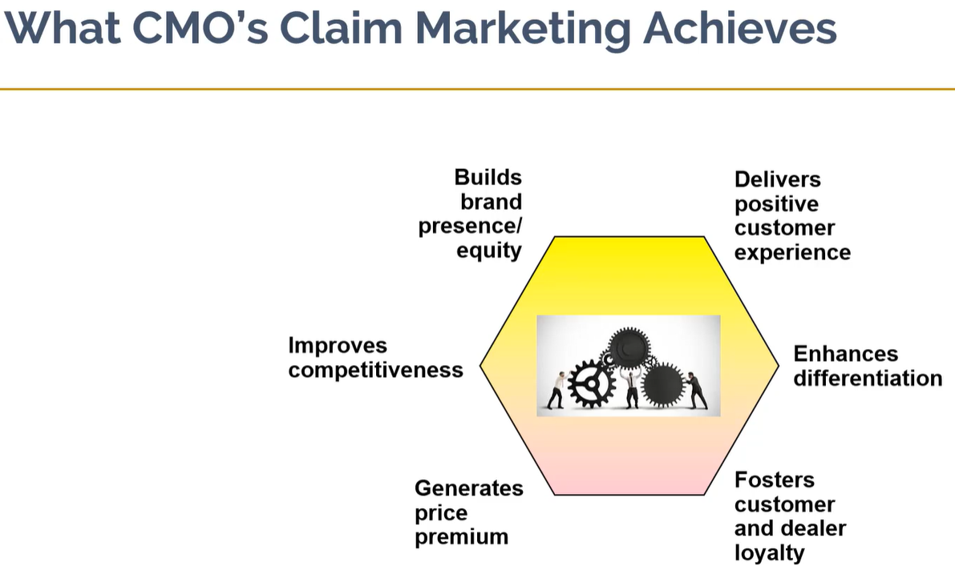

Slide 15
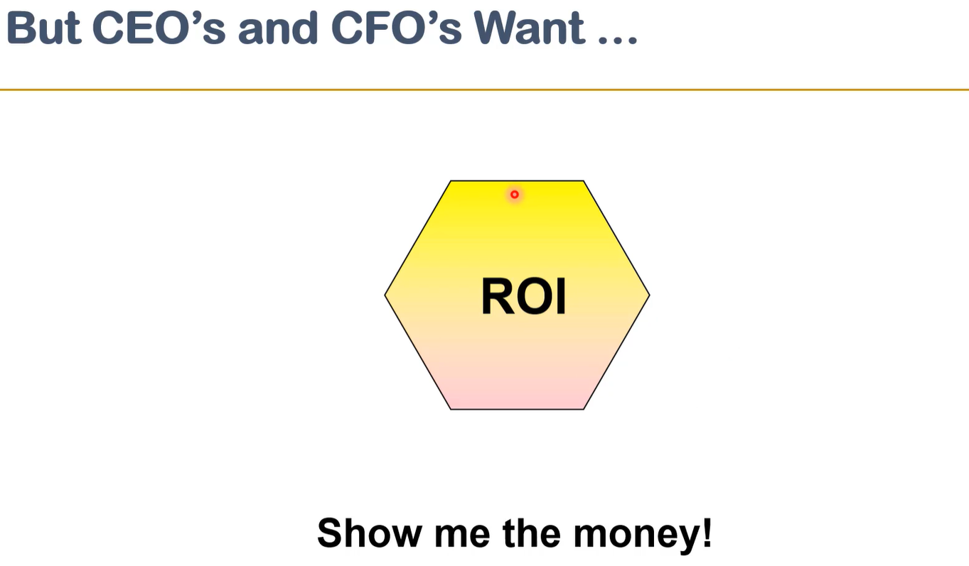

Slide 16
C8 - Digital Marketing ➔
C2 - Customer Value
C3 - Segmentation and Targeting
C4 - Positioning
C5 - Forecasting
C6 - New Product Design
C7 - The Marketing Mix
C8 - Digital Marketing
C3
C2
C3
C5
一样米养百样人
C4, C6
宋 欧阳修 《归田录》卷一：
“和傅説之羹，实难调於众口。”
商王武丁举傅說为相。
元 邓玉宾 《粉蝶儿》套曲：
“羊羹虽美，众口难调。”
C7
(link)
Notes:
This visual from Dave Chaffey of Smart Insights in his book Digital Marketing: Strategy. Implementation and practice shows how Segmentation, Targeting and Positioning apply to digital marketing strategy. Figure 4.15

Slide 17


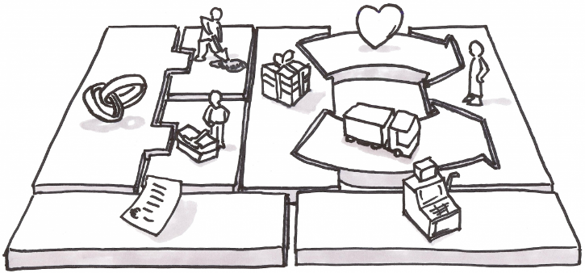















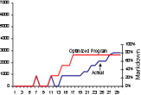
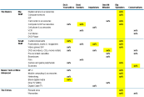

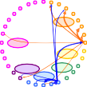
Embed Customer/Marketing Analytics into Decision Processes
Who are my target customers, what, where and why do they buy, and who else looks like them?
What do I offer them, through which channels, and how often?
How do I get my consumers/ customers to buy more products?
How do we become more relevant beyond the transaction?
Strategic Segmentation & Profiling
Marketing Analytics & Optimization
Space Analytics & Optimization
Customer Experience Analytics
25
%
%
%
Experimental Designs Financial & Statistical Analyses Predictive Modeling
Macro/Micro Adjacencies
Brand Dissatisfiers & Drivers Net Satisfaction Impact Treatment Contribution
Economic
20
15
Net Impact to Overall Interaction
6
5
4
3
2
5.99
10%
Pricing Analytics &
Optimization
3.81
3.56
5%
on ¹ 0
1.43
Psychographic
Placement & Banner Ads
0
1.47
0.45 0 ⁰ ⁰
Consumption
0%
6 8 10 12 14 16 18 20 22 24
Aware Consider Purchase Deliver & Learn Support &
Install Repair
Customer Interaction
Micro/Tactical Segment Basket Analysis
Zone Pricing, & Price Elasticity Promotional Pricing Relationship-based Pricing
Promotional Analytics & Optimization
Assortment Analytics & Optimization
Customer Loyalty Analytics
Store Basket
Eye & Ear
Medicated Foot Sanitary Protection
Medicated
Hair ^{Men’s Grooming}
^{Medicated} Bath / Deo / Talc
Brand Advocacy & Net Promoter Accumulation/Redemption Analyses
Skin
Baby
Personal Care Electrical
Personal
Care
Haircare
Complementary vs Substitutes`
Online Basket
Dietary / Health
Foods
Vitamins
First Aid / Non Medical
OTC
Loyalty Driver & Value Analyses
18.0%
15.6%
Discoun
Mercha
ts & Reba
nt Tie-Ins
tes
Paper Goods / Cotton
16.0%
14.0%
12.0%
10.0%
8.0%
6.0%
4.0%
2.0%
0.0%
$25.00
Avg. Margin $ per Transaction
Dispensary Health & Wellness
Oral
Affinity Rate
^{12.9%} 12.7%
11.0%
$20.00
Contact Ctr Basket
Loyalty Points Promo
Family Planning
Health & Fitness Equipment
Skin & Hare Facial
Care
Depilatories _{Store vs}
8.4%
8.1%
$15.00
Homecare
General Merchandise
Hand / Body /
5.4%
$10.00
Home
Food & Sundries
Cosmetics
Non Demo
Demo
Services & Concession
Gift Confectionary
Long Tail
2.1% $5.00
Copyright © 2011 Accenture All Rights Reserved.
Fashion
$-
27
Sundries
A B C D E F G H
^{Beverages} Snacks / Biscuits ^{Choc / Candies / Countlines}

Slide 18
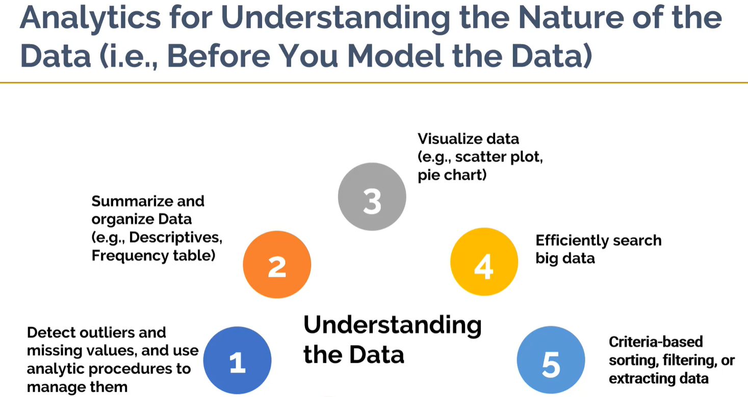
Exploratory Data Analysis (link)
** Exploratory Data Analysis | US EPA

Slide 19
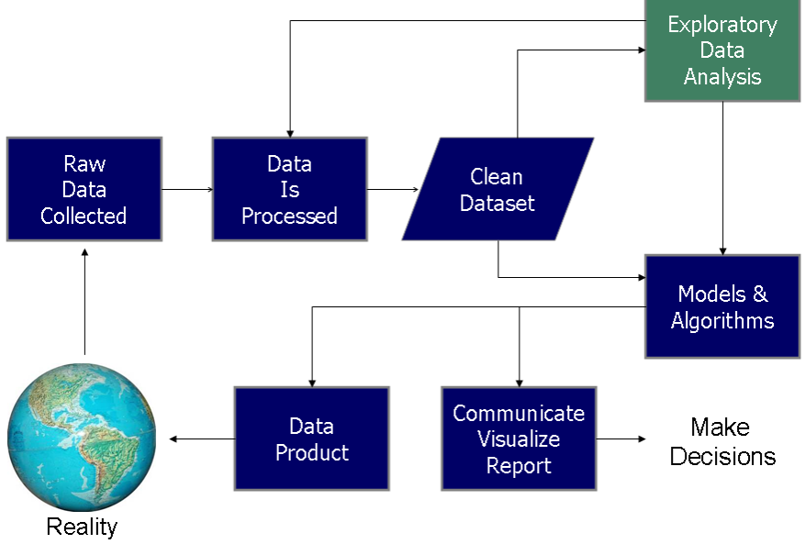
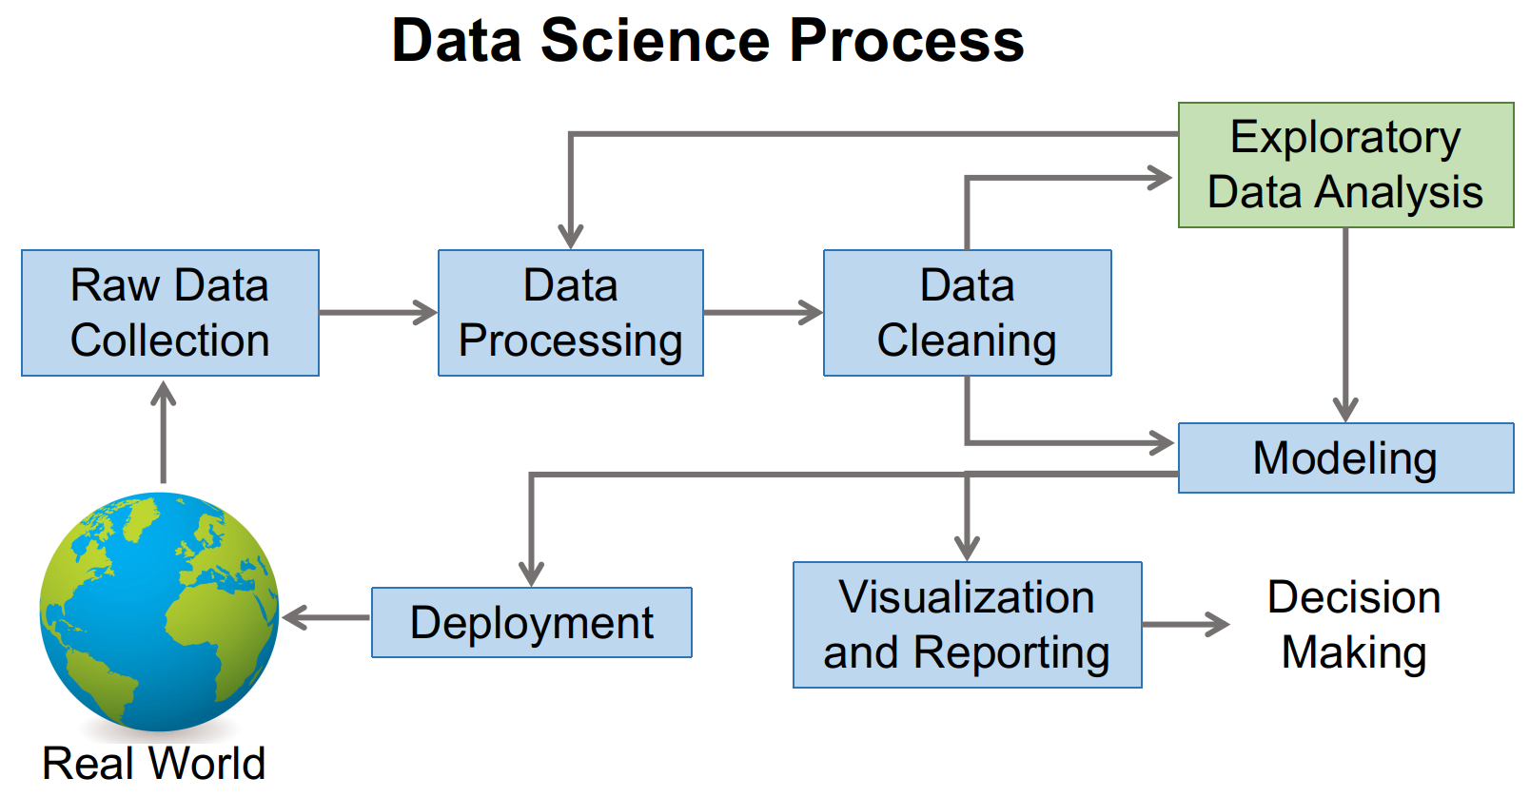
The Role of Exploratory Data Analysis in Data Science Process
Use the Analysis ToolPak to perform complex data analysis (microsoft.com), but it is a basic tool for simple tasks.
Exploratory Data Analysis

Slide 20
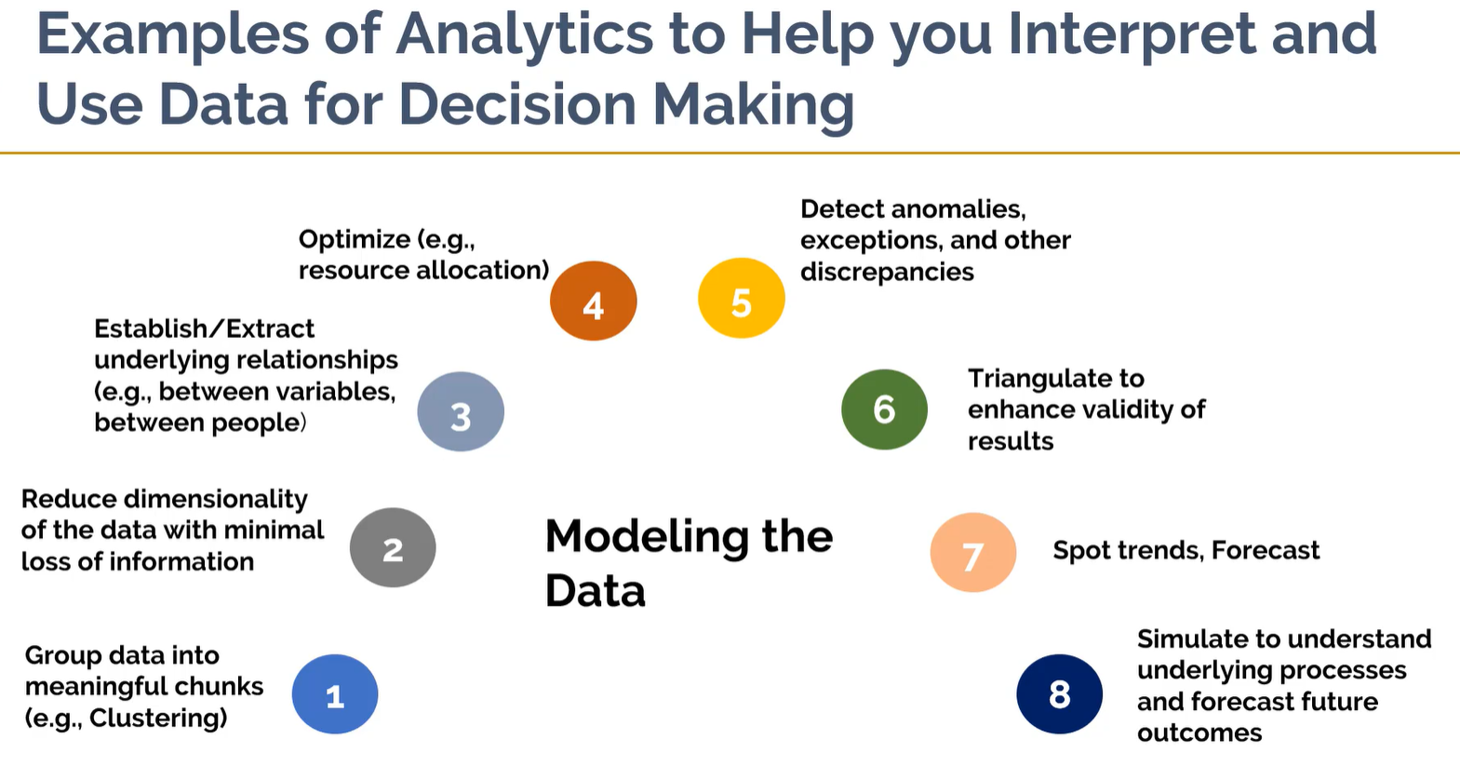



优化
异常检测
效度
数据降维
Modeling to obtain insights
聚类分析
Triangulation refers to the use of multiple sources of data or multiple approaches to analyzing data to enhance the credibility of a research study.
Notes:
Around 22m Introduction to Marketing Analytics

Slide 21
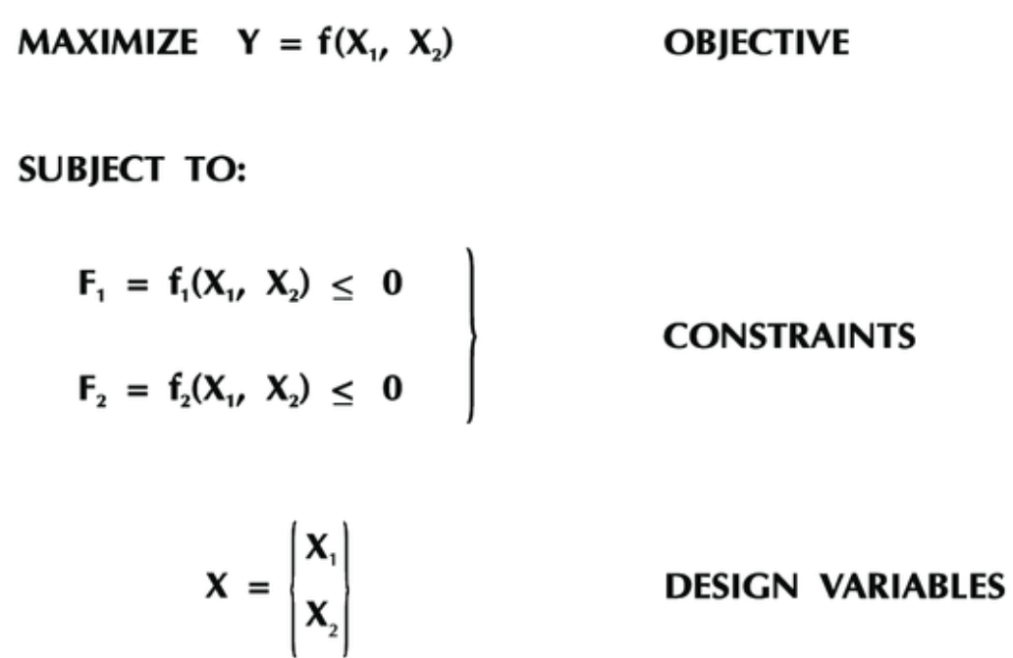
Optimization Problems and Solver (Excel Add-in)
Solver is a program that solves linear and nonlinear optimization problems with or without constraints.
3 basic components of a decision model: decision variables, constraints, and an objective function.
Optimization problem.
Find Maxum or Minimum value of Y
Find values of Design Variables X₁ and X₂ that maximize or minimize Y under the constraints F₁ and F₂
x1 and x2 are subjected to conditions F1 and F2
Find
(Decision Variables)

Slide 22
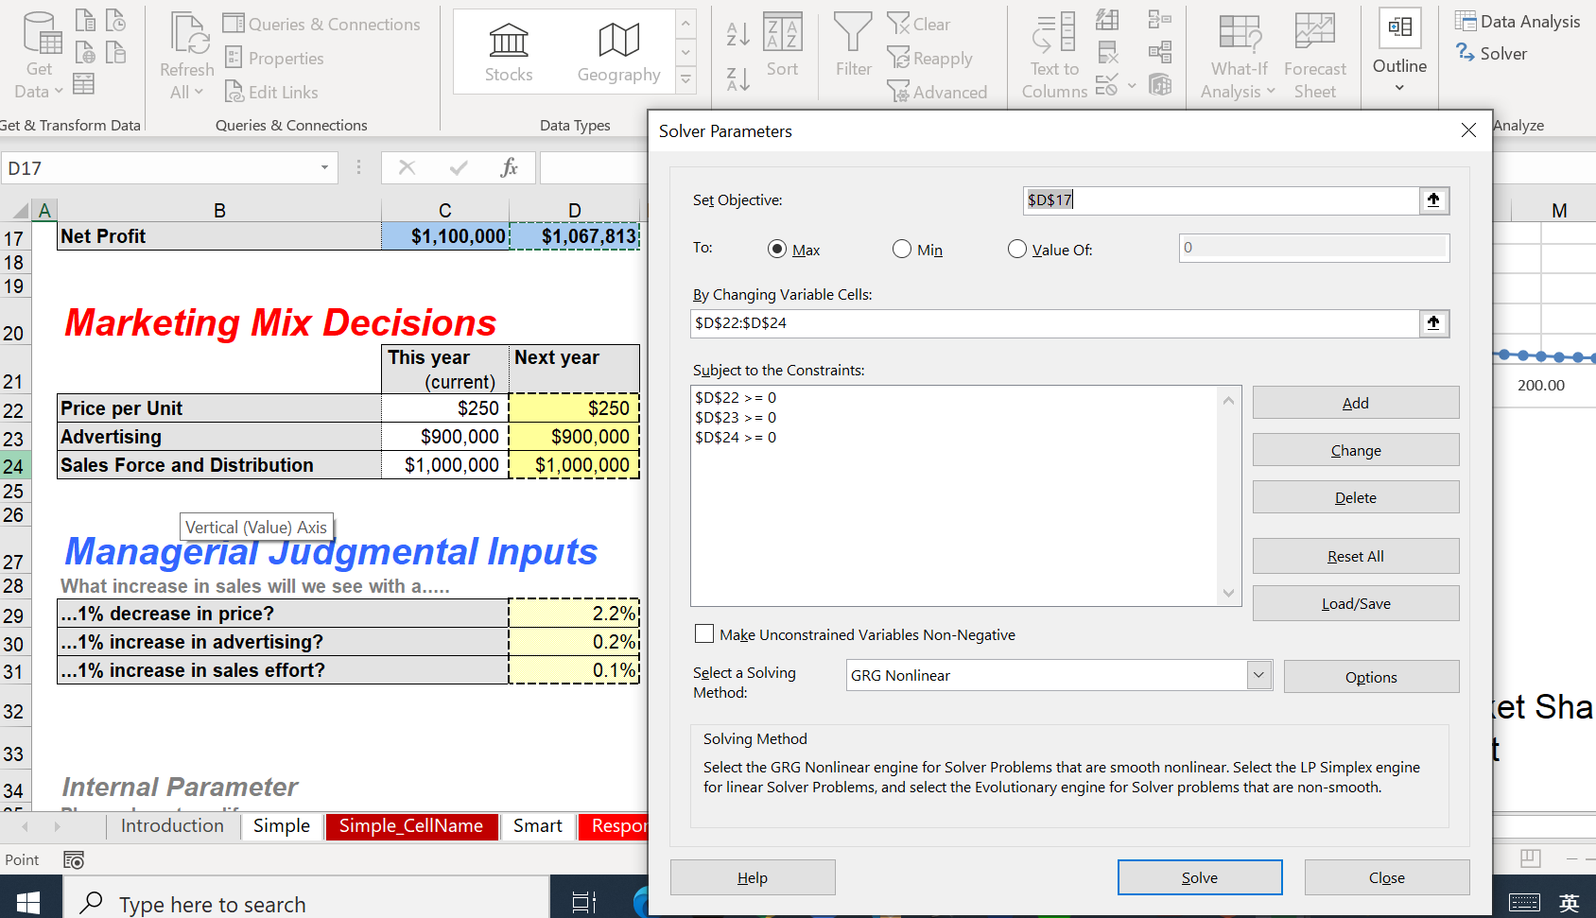
allegro_smart_sheet_v3.xlsx ➔ Smart Worksheet

Slide 23
Introduction to Excel Solver
There are 4 steps on how to use SOLVER to solve a Linear Programming (LP)
  The key to solving an LP on a spreadsheet is:
    Set up a spreadsheet that tracks everything of interest (e.g. costs, profits, resource usage)
Identify the cell that contains the value of your objective function as the ➔ Target Cell
Identify the decision variables that can be varied, called ➔ Changing (Variable) Cells
Identify the constraints and enter them into the program to tell SOLVER to solve the problem under these constraints
  At this point, the optimal solution to our problem will be placed on the spreadsheet, with its value in the target cell
MIT Open Course Optimization Methods in Management Science | Sloan School of Management | MIT OpenCourseWare
Excel_Techniques.pptx (mit.edu) + Excel_Solver.xlsx (live.com)

Slide 24
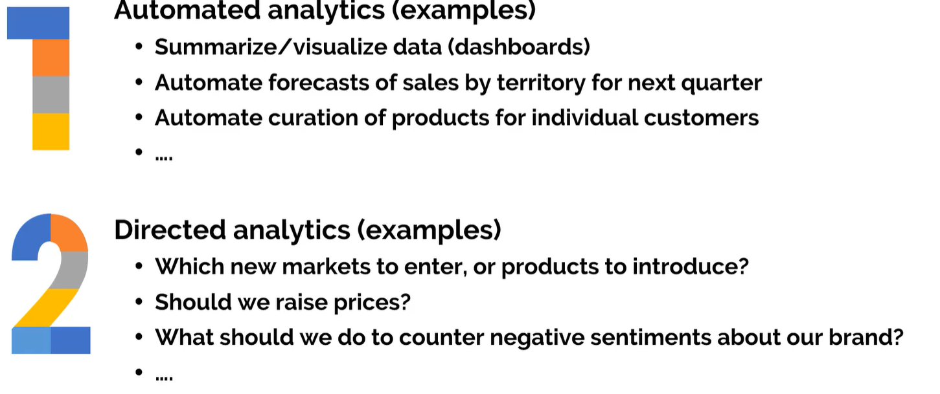
2. Two types of analytics
Similar to
Recommendation
Systems
➔Involved human decision making and judgements
*Product curation is the process of creating unique product collections that appeal to specific demographics or niche customer bases. Product curation leverages customer segmentation data and other personalization techniques to drive engagement and increase sales.

Slide 25
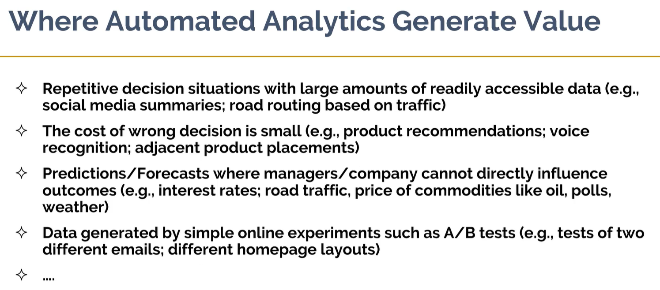
Descriptive analytics➔ Digital Dashboard

Slide 26
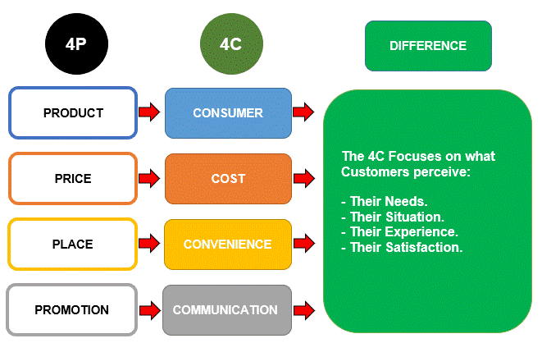
The 4C Method vs the 4P Marketing Mix
Their Needs
Their Situation
Their Perceptions
Their Experience
Their Satisfaction
Traditional 4P Marketing Mix uses the Business perspective, while the 4Cs are more focused on the Customer Experience.
https://www.consuunt.com/4c-marketing-model/

Slide 27
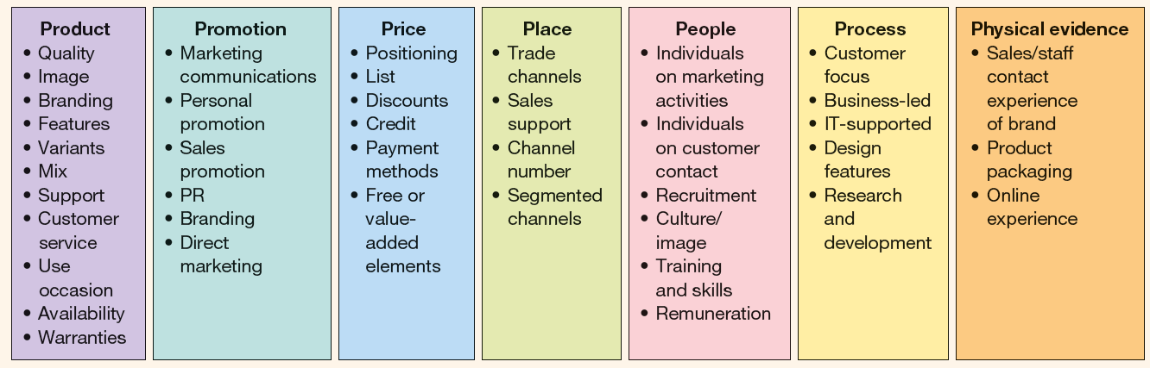
Using the Internet to vary the marketing mix: 7 Ps
Digital Marketing: Strategy, Implementation and Practice, p. 250
https://www.davechaffey.com/digital-marketing-glossary/e-marketing-mix/
https://garshadma.com/wp-content/uploads/2020/07/dave-cheffy-digital-marketing-strategy.pdf
https://www.smartinsights.com/wp-content/uploads/2013/12/7psmarketing-mix-model-600x288.png
Notes:
https://garshadma.com/wp-content/uploads/2020/07/dave-cheffy-digital-marketing-strategy.pdf
Digital Marketing: Strategy, Implementation and Practice

Slide 28
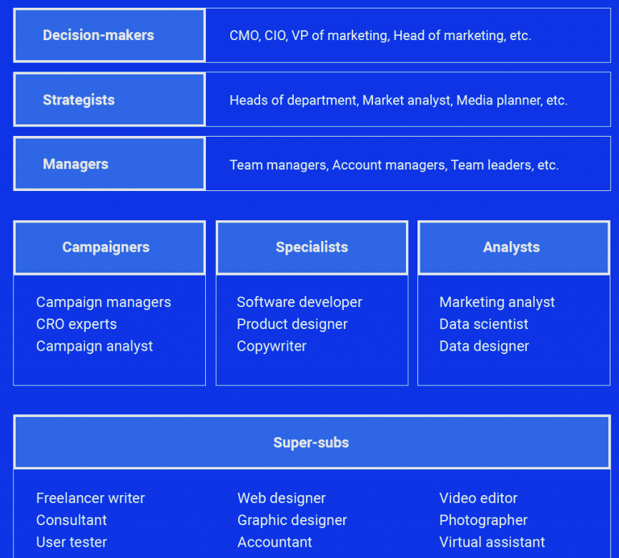
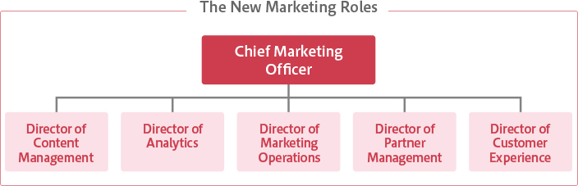
https://www.ventureharbour.com/marketing-mix/
Prof. Mohan Sawhney on the future CMO

Slide 29

Typical Decisions Made by
Marketing Managers
Segmentation
Budgets
Campaign Effectiveness
Marketing Mix
Targeting
Market Size
Sales channels
Market Share
Positioning
Pricing Policy
Portfolio Management
Advertising Design
Notes:
The marketing manager faces a bewildering set of challenges….

Slide 30


Typical Consequences of Marketing Decisions
Resource Allocation
for marketing actions
Marketing
Strategies
Marketing
Mix
Observed Market
Outputs
?
Website
CRM
New Alliances
Brand Advertising
Sales Promotions
Click-throughs?
Satisfaction?
Sales?
Loyalty?
Inventory turns?
Decisions
Objectives under Constraints
ROI?
Sales?
Profits?
Share?
Translate into
Breakeven point
[Costco case]
Notes:
…and while making those decisions, the marketing manager often has great difficulty justifying the marketing investments.
It is worthwhile discussing with the class if and when marketing is a cost to the firm or an investment. If it is an investment, how should it be justified?
Costco
美國好市多（Costco）是個神奇的賣場！當所有公司都在追求毛利率逐年成長之際，好市多只賺6.5%的毛利率，卻能給員工高於沃爾瑪的薪水及福利，很多高階主管都從低層做起，一待就是30個年頭，美國《財富》雜誌（Fortune）形容，這家公司的企業文化就像「邪教組織」，員工一進來就死忠付出，不想再離開。 對於好市多不以賣東西賺錢，而是以會員賺錢，帶給小米創辦人雷軍很大的震撼，他在一場論壇上也提到，好市多的商業模式給他在經營小米上有很大的啟發。
陸媒虎嗅網報導，雷軍曾在演講中表示，好市多任何一個商品只掙1%到14%，他們控制毛利率只想「賺少一點」，平均毛利率只有6.5%，這和很多企業的想法非常不一樣。
「美國一家大型連鎖超市，只需要6.5%的毛利率就能打平，這是多麼了不起啊！」雷軍指出，好市多只鎖定美國中產階級的5000萬人，要掏出這些人口袋裡一半的錢，只服務於精準的客戶群；而且賣場裡只有3500種商品，每件商品都是老闆精挑細選、自己用過的，不僅便宜品質又好，希望顧客不用看價錢，直接挑了就走。
「大家一定好奇毛利率只有6.5%怎麼生存？員工怎麼漲工資？股東怎麼拿回報？」雷軍一句話破解「羊毛出在羊身上」，他認為，好市多獲利超級穩定靠兩大祕器，一是發行信用卡，信用卡收益佔總獲利的1/3，還有接近70%的營業利益來自會員費的收入。
報導指出，雷軍表示，當我們整天都在想怎麼不斷地提高毛利率的時候，是不是進入了一個怪圈，導致在中國市場上買到的東西越來越貴，怎麼解決這個問題呢？他最後建言，必須下功夫做全產業鏈的整合，唯有這個大膽的創新才有機會把成本控制在合理的範疇。
https://www.chinatimes.com/realtimenews/20220212003127-260410?chdtv

Slide 31

Usual Approach➔
Seat-of-the-Pants (凭经验的; 凭感觉的，凭本能的)
Marketing Decisions
Notes:
Also called experience-based marketing.
The problem with seat of the pants decision making is that sometimes you might be caught with your pants down.
Seat-of-the-pants decision making is not bad in itself – the question is whether it is enough for today’s competitive environment?
Origin of the expression – seat-of-the-pants
Before airplanes had sophisticated instruments and flight control systems, and even today, planes are piloted by feel. Pilots can feel the reactions of the plane in response to their actions at the controls. Being the largest point of contact between pilot and plane, most of the feel or feedback comes through the seat of the pants.
If you are "flying by the seat of your pants" you are responding to the feedback received.

Slide 32

Data Mining Approach???
Marketing Data Overload (超载)
Notes:
However, when you have sophisticated instruments (data), why fly by the seat of the pants? Today’s pilots have adapted to flying using instruments. Marketers must use data to navigate in today’s competitive environments and to justify their “expenses” as investments.

Slide 33

Data ≠ Insights for Action
Notes:
Clearly, data are not a complete solution—we often have too much data of the wrong kind and, even if we have the “right” data, can we find it?

Slide 34

Develop the Right Balance Through Marketing Engineering
Marketing Engineering
Notes:
Marketing analytics or marketing engineering aims to blend the best information available from “hard data” with whatever information is available through judgment and experience to lead to better decisions.

Slide 35
Money Ball 点球成金
Peter: You’ve spent your life in baseball and I don’t have a very traditional view of the game….They’re still asking the wrong questions. People who run baseball teams still think in terms of buying players.．．．The goal shouldn’t be to buy players, what you want to buy is wins. To buy wins, you buy runs. …Once you begin to pull at that string, your understanding of the world might begin to unravel.
* https://www.youtube.com/watch?v=rMObWsKaIls Moneyball (Breaking Biases)
彼得利用大数据分析, 用自己创造的公式，挖掘出一些被严重低估价值的球员https://www.youtube.com/watch?v=Nq1oyuvNBpQ
https://movie.douban.com/subject/3023164/
Notes:
片子以“缺钱”做开头，Oakland Athletics棒球队因为财务困难，不得不放弃三个明星队员，职业经理人Billy去跟大老板要钱，大老板说自己无能为力，要Billy用现有的钱做能做的事。Billy为了补缺，到处奔走。在一次谈判上，Billy本来信心十足的要买走一个队员，却因为一个一脸稚气的小胖对老板的一个提示而失败。 事后，气愤的Billy跑去找小胖当面对峙，“Who are you? What do you do?” 小胖被Billy强大的气场彻底打败，吓的连连道歉。小胖是个非常出彩的角色，憨憨的面容，胖胖的身材，外加一个绝顶聪明的脑袋瓜（耶鲁大学经济学专业毕业）。最后，Billy没能买走球员，却买走了小胖。小胖用自己创造的公式，挖掘出一些被严重低估价值的球员（这些人或者年龄很大，或者身体有恙，或者打球姿势诡异，或者个人生活混乱）。小胖的方法，就是组建一支理论上能赢且Billy负担得起的球队。
队员都买好了，教练却不相信这些“老弱病残怪”能成事，于是弃之不用。结果Oakland连连溃败，比分垫底，惊动了大老板。Billy和小胖坐在大老板面前，Billy气定神闲，告诉大老板他相信小胖的算法。小胖说如果能够让他们布置的球员上场，Oakland会7连胜。面对教练的阻挠，Billy和小胖联手摆局，瞒天过海，把教练御用的队员卖给其他球队。教练哑巴吃黄连，只能硬着头皮派剩下的队员上场，没想到从此Oakland如有神助，先是实现了小胖预测的7连胜，继而打破了扬基队的记录，实现了20连胜。这时电影院里群情激昂，似乎大家都准备好了Oakland在淘汰赛上创造奇迹，取得冠军。如果真的这么演，那么就太落俗套了。还好导演没让我失望，Oakland在第一场淘汰赛上就输了。
落败淘汰赛，Billy情绪低落，却在这时收到了Boston Red Sox老板的邀请，以天价$12,500,000聘请其做经理人。接受了这个邀请，Billy就不会再为钱发愁，而可以彻底摆脱中年危机。片中对Billy中年危机的描述，润物细无声，笔墨不重，却勾画得有血有肉的，44岁，高中学历，婚姻失败，老婆改嫁，事业低迷，连12岁的女儿都担心他会不会失业。一个有趣的细节，Billy去前妻家里接女儿，前妻住的是豪宅，新的男人身材很瘦，连Billy球队的金牌球员的名字都叫错，估计是IT业的富豪。Billy坐在沙发上等女儿，跟新的男人和前妻进行了几句简短的对话，面对这两个人，自己是失败的，气氛自然尴尬无比，可以想象，每次接女儿，这种场景都会重演。如果Billy接受这笔钱，就可以一洗之前的“屈辱”，不但个人生活有了保障，还能在新的球队自由发挥，不再被金钱束手束脚。但是Billy没有接受，意料之中又意料之外。离开自己带了几十年的球队不容易，离开自己一直居住的加州不容易，最重要的是离开自己可爱懂事的女儿不容易。当钱的问题终于解决，才发现事情的关键并不是钱，说白了，一个人的成就感并不能用钱来衡量。
如果真要把这部电影当成励志片，它告诉我的并不是“努力就能创造奇迹”，而是人要有勇气作出改变。Billy一直拒绝跟球员亲近，理由是如果投入太多情感，想炒人的时候会下不了手，可却在40几岁的时候，放下了这些防御，主动跟球员沟通，为他们加油打气。在遇到小胖之前，Billy一辈子都在听老一辈人的经验之谈，十八九岁的时候，听了这帮人的游说，放弃了全奖的斯坦福，直接加盟了职业联赛，结果十年也没出成绩，到后来当上经理人，也要听这帮人的建议来买卖队员经营球队，可却在40几岁的时候，选择力排众议，听一个25岁年轻人的建议。如果相信，就要拿出勇气改变。这就是我所学到的。

Slide 36
Trends in Software Supported
Decision Making
Marketing managers have high-powered personal computers connected to networks, 7/24, everywhere.
There are over 400 million installed copies of Microsoft Excel (Business Week, July 13, 2006).
Volume of marketing data is exploding (e.g., 500 Terabytes of transaction data at Wal-Mart).
Firms are reengineering marketing for the information age , e.g., Using Customer Relationship Management (CRM) systems.
Faster Faster Faster !!!!
Notes:
From e-marketer, March 7, 2007:
The amount of information created and replicated in 2007 (255 exabytes) will be greater, for the first time, than available storage capacity (246 exabytes), according to a new study by IDC commissioned by storage maker EMC.

Slide 37
Different Types of Data Analytics and
Their Competitive Implications
Competitive Advantage
Optimization
What’s the best that can happen (to our objectives)?
Predictive modeling
What will happen next (if we do this)?
Forecasting/extrapolation
What if these trends continue? (time series data)
Analytic Capabilities
Statistical analysis
Why is this happening? (dependent variables ➔ independent variables)
Alerts
What actions are needed? (Exception management)
Query/drill down
Where exactly is the problem?
Ad hoc reports
How many, how often, where?
Standard reports
What happened?
Insights/Intelligence
Source: Adapted from Tom Davenport
Notes:
Most organizations start from the lower left portion of this chart. It will be useful to ask the class to “help you” find examples they know of or have heard of the different levels represented here.

Slide 38
Climbing the Ladder of Marketing Analytic Capabilities
Real-time analysis
Develop flexible and dynamic offers and prices
Predictive modeling
Learn to anticipate and prepare for the future
Campaign management
Become efficient and effective in marketing spend
Event triggers
Develop process and response capabilities
Segmentation
Treat different customers differently
Customer database
Get enterprise customer data into one place
Notes:
This is another way to think about the hierarchy of possible information support…again, it will be useful to work with the class to identify some examples here.

Slide 39

What Wal-Mart did on 9/11
Within a few hours of the 9/11 attacks, sales of flags and other patriotic items started skyrocketing.
On Sept 11, the 2,700 Wal-Mart stores sold over 100,000 flags (compared to 6,400 the previous year on that day), and over 200,000 on Sept 12th.
Detecting these increases, Wal-Mart locked up all the supplies it could find before its competitors (like Kmart) could react. ➔ Event Trigger (Alert)
Real-time tracking and analysis helped cope with a demand surge.
Notes:
Wal-Mart has developed a culture of analytics to support decisions made by its managers, not just in supply chain and logistics, but in all areas of marketing, merchandising, and operations.

Slide 40
Analytics Begins at the Top in Companies that Navigate via Analytics
Berry Berach at Sara Lee
“In God we trust; all others bring data” (quoting W. Edwards Deming).
Gary Loveman at Harrah’s
“Do we think, or do we know?”
“There are three ways to get fired at Harrah’s – for stealing, sexual harassment, or instituting a program without first running an experiment.”
Jeff Bezos at Amazon
“We never throw away data”
David Kearns at Xerox
“Do you have evidence to support that hypothesis?”
Notes:
Of course, not everyone is convinced by data supported management. Even though most managers would admit that the small sample size that characterizes personal observation is problematic, nonetheless, information acquired in a personal way often feels richer and closer to real knowledge than do data from a data base (similar to Tversky’s notion of case data and base rate data). Stories typically trump data in the normal scheme of organizational decision making -- the real challenge is to take data, combine that with judgment, and transform the result into a story.

Slide 41
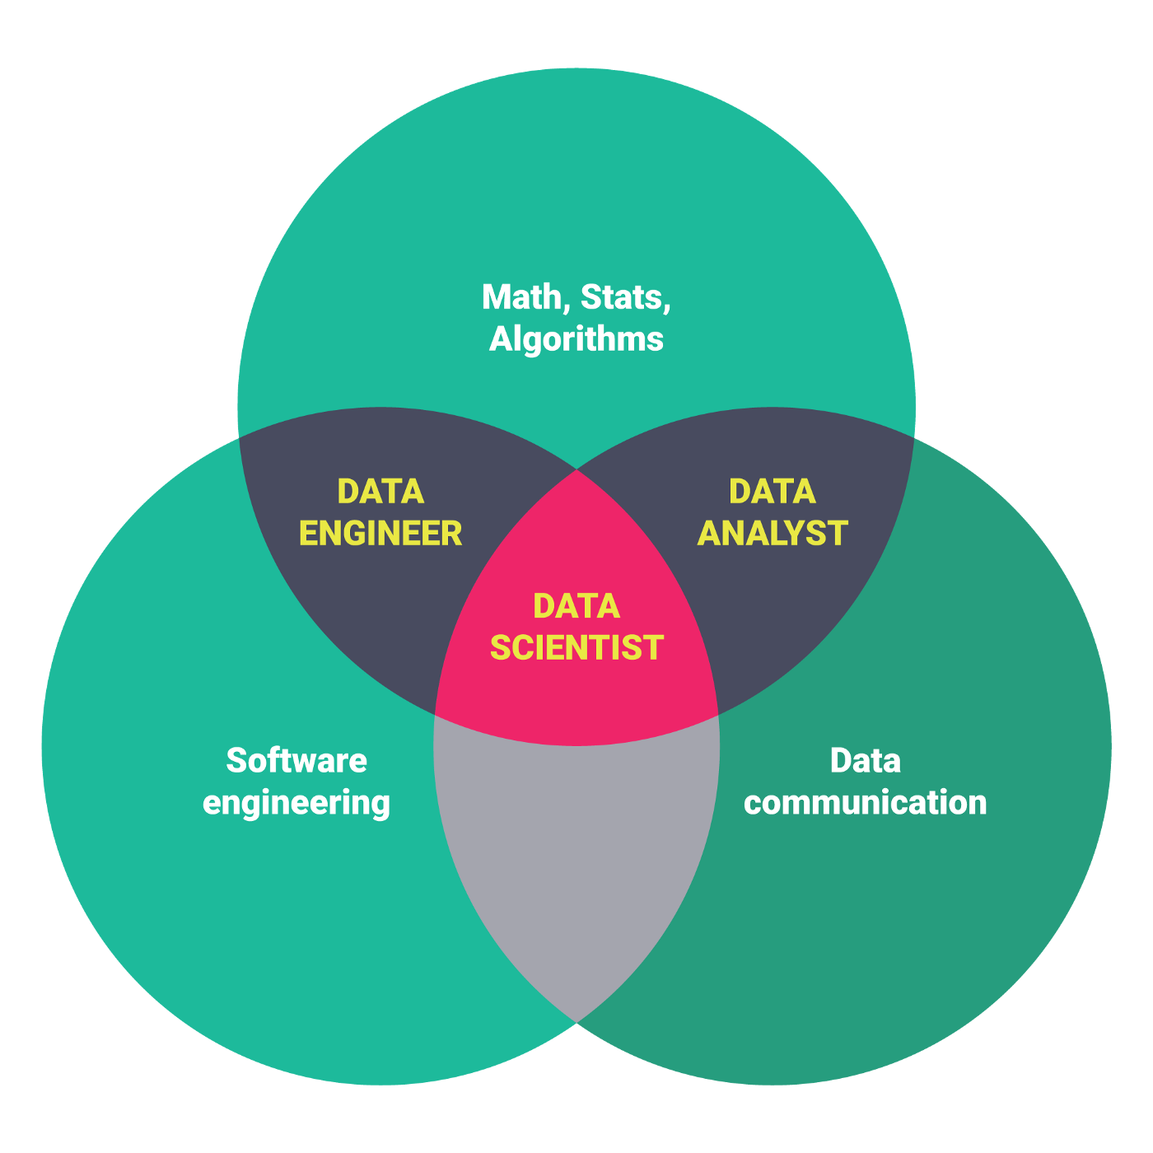

Data Analyst, Data Engineer, Data Scientist
https://medium.com/@anjaliksahar/data-based-job-roles-data-analyst-data-engineer-data-scientist-and-machine-learning-engineer-bac3e44ae539

Slide 42
Characteristics of an Analytic Leader
Communicates well with others.
Sets the expectation that decisions will be based on data and analysis.
Hires smart people, and gives them credit for being smart.
Leads by example, using data and analysis in decision making.
Sets strategy and performance expectations.
Looks for incremental achievements.
Demonstrates persistence over time.
Builds an analytical ecosystem of industry leaders, external analytical suppliers and business partners.
Works along multiple fronts with a portfolio of projects.
Knows the limits of analytics.
** https://www.sas.com/content/dam/SAS/bp_de/doc/factsheet/imm-fs-marketing-analytics-how-why-and-whats-next.pdf

Slide 43

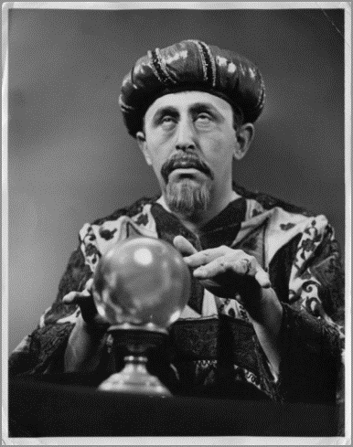
How do managers make decisions?
Facts
“I know for a fact it will work…”
Intuition
“I have the feeling it would work…”
Reasoning
“In theory, it should work…”
Experience / Practice
“It has worked before…”
Notes:
The first three options are not really practical or acceptable. The world is uncertain, decisions have high stakes, so facts/intuition/reasoning is not enough or cannot be used. Need to be dismissed in some form or another.
This is why experiences managers are paid more – they are assumed to have gathered superior experience, hence capable of making better decisions.

Slide 44
Decision-making process
Experience
Individual mental models
(self, colleagues, others)
Practices
Collective mental models
(common rules, ratios)
Error/Biases
in decision-making?

Slide 45

Decision-making process
Common rule, promotional spending: budget allocated in proportion of market shares
Example:
Market Share Spending
Region A 30% 43%
Region B 40% . 57%
100%
But what if?
Market Share Spending
Region A 0% ?
Region B 100% ?
Is the rule good enough? If not, why not change it?
Notes:
First step of this slide is to explain the rule and the rationale, explain why it worked well (ex., defend market shares where they are high).
Second step is to show that, pushed to its limits, this rule is stupid, since all promotional budget would be spent where there is nothing to win, and nothing where growth potential is important.
Why not changing the rule?
Huge uncertainty, managers don’t know what would happen, because the company never tried a different approach.
They have no incentive to try something different because they have no idea what they’re missing
If they try something different and something goes wrong, their job is in jeopardy.
If they follow the rule, they are “safe”. They followed the rule.

Slide 46
Benefits of response models
Issue: Is company getting the best efficiency and effectiveness on its promotional spending across US markets?
Approach: Used market response analysis and resource allocation to conclude that Heinz:
  was misallocating spending
  could substantially reduce overall spending without sacrificing national market share.
Results: Reduced promotional spending 40% AND increased market share from 34% to 37%.
Notes:
As a result… Heinz changed its policy, and achieved great results.
The following slides are other examples of added value.

Slide 47

Benefits of response models
Issue: Running out of good sites for typical full-service Marriott hotels.
Approach: Conjoint analysis to determine customer preferences, critical information for hotel design.
Results – Courtyard by Marriott:
  Fastest growing moderately priced hotel chain in the United States
  Sales over $1 billion with occupancy rate above industry average
  Market share improved by +4%
  Created new segment with 5 clone chains

Slide 48

Benefits of response models
Issue: Sales force size expanding approximately 10% per year: was size and allocation the best?
Approach: Used resource allocation to determine the optimum sales force size and allocation across products and markets.
Results: Implementation increased profits $24M/year: more than 12% over plan.
A pioneer in healthcare
The world's largest biotech company
We have been committed to improving lives since the company was founded in 1896 in Basel, Switzerland. Today, Roche creates innovative medicines and diagnostic tests that help millions of patients globally.
https://www.roche.com/about.htm

Slide 49

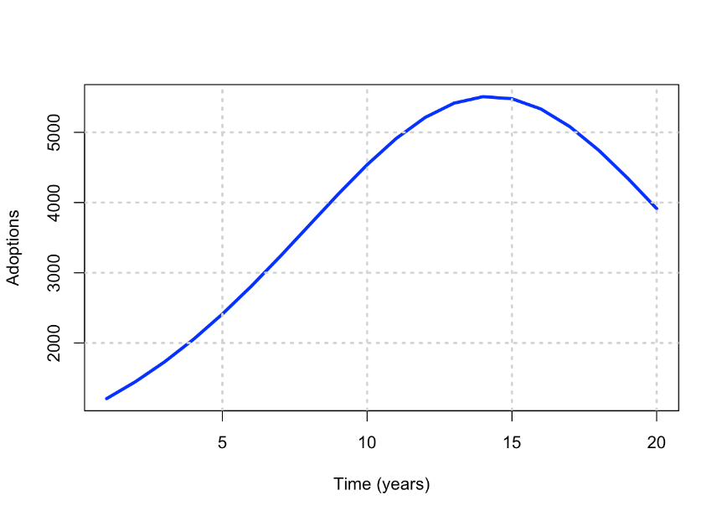
Benefits of response models
Issue: Forecasting the time path of sales of DirecTV, before introduction.
Approach: Used Bass diffusion model.
  Market size estimate from customer survey.
  Diffusion parameters estimated from managerial judgments and analogous products (cable TV).
Results:
  Five-year forecasts made 3 years before launch were, on average, +16% above old forecasts.
  (growth was going to be larger than anticipated)
  Forecast justified earlier launch of a satellite for expanded transmission capability.

Slide 50

Benefits of response models
Issue: Exelon wanted to differentiate itself from other second-tier companies.
Approach: Used positioning analysis to determine that:
  Customer preferences were more associated with the characteristics and offerings of second tier companies, especially price.
  Analysis identified opportunity for re-position towards more customer focus, reliability, and value.
Results: New advertising campaign with the revised theme increased customer awareness by 45% in 3 months.
AMERICA'S LEADING ENERGY PROVIDER
https://www.exeloncorp.com/company/about-exelon

Slide 51

Benefits of response models
Issue: Soliciting donors is expensive, and donors are more and more sensitive to wise spending of donation money.
Approach: Used customer choice model to identify best potential donors, based on past data, and solicit only those donors who are likely to be profitable.
Results: In the first year of implementation, number of solicitations decreased by -40%, while donation amounts increased overall by +9%.

Slide 52

Marketing Analytics Increased Marketing Campaign Effectiveness at Grainger
Issue: Small business customer revenue growth flat after several years of double-digit growth.
Approach: New segmentation and targeting models with “link” to full universe of customers.
Results:
  Integrated data base marketing program added over $100 million to sales, reduced costs by well over $100 million.
  Net profit increase: over $200 million.
https://www.grainger.com/

Slide 53

Use of Marketing Analytics Improved Marketing Productivity at Pfizer
Issue: Pfizer was considering splitting its sales force into two product-specialized sales forces to target effort on 15 products in 80 target segments.
Approach: Used ReAllocator to determine optimal size of sales force and optimal deployment.
Results: 6% profit gain by maintaining current sales force size / structure and re-deployed effort to products and markets based on model recommendations.
See page 8 for REAllocator at https://www.enginius.biz/resources/technical_notes/technical_note_allocation.pdf

Slide 54
Small Models Example:
Trial/Repeat Model
Share = % Aware x
% Available x
% Try x
% Repeat (Usage Rate)
** https://marketing-dictionary.org/a/atr/
Notes:
We also show the value of simple models through a trial-repeat model framework.
These overheads illustrate that:
Managers may have a holistic judgment (15% share in this actual example) about what market share will be, but that decomposing that judgment via a model shows the manager a key inconsistency with the 8% based on simple multiplication.
The dynamics of the process (early triers are usually more likely to become regular customers than later triers) lead to an overshoot phenomenon, while time series extrapolation leads to foolishly optimistic forecasts.

Slide 55
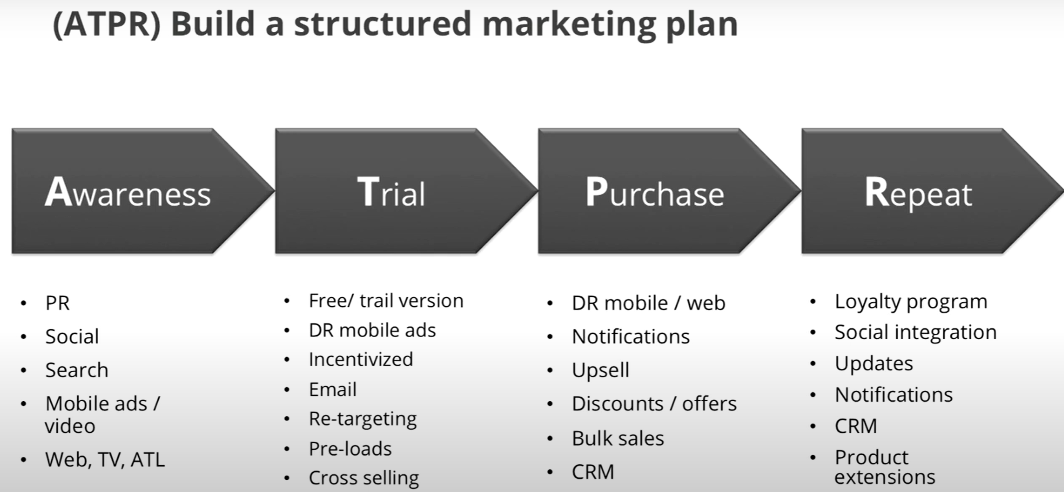

Trial/Repeat Model
Target Population
Aware?
50%
Available?
80%
Try?
40%
Purchase/Repeat?
2012 - Google Play: Marketing 101 for Developers - YouTube
50%
Market Share
=
?

Slide 56
Model Diagnostics
Trial
hi
low
The model shows that the same share result can be caused by low trial/ high repeat or by high trial/low repeat . . . and these two causes have different cures.
hi
Repeat
low
Notes:
The model shows that the same share result can be caused by low trial/ high repeat or by high trial/low repeat . . . and these two causes have different cures.

Slide 57
Trial Dynamics

Slide 58
⋅ Repeat Dynamics

Slide 59
= Share Dynamics!

Slide 60
Model Benefits
Small models can offer insight – they can change your goals and priorities, even if they don’t influence your decisions.
Even simple models can align management beliefs with marketing policy.
You don’t need hard data to get value from models--judgments and intuition is often enough.
Digital data capture enables large model ROI.

Slide 61
The Connected Marketing Analytics Process
Profit
Effectiveness
Competitive advantage
Improve
Company
Performance
Action guidelines/Reports
What if capabilities
Integration with company processes
Guide
Implementation
Support
Opportunity
Identification
New revenue
Cost reduction
Productivity gains
Opportunities
for Marketing
Analytics
Structured process
Real-time
Interactive
Distributed across the organization
Promote
Reasoned
Decisions
Build an
Analytic
Foundation
Models
Data
Digital infrastructure
Notes:
The goal is to improve company performance by identifying opportunities, and find ways to exploit those opportunities by providing an analytic foundation that promotes reasoned decisions and guides implementation. Analytics is not an isolated process, but has to be weaved into the corporate fabric.
Opportunities often reveal themselves as problems, not as temptations. Problems could be hidden in the data streams that companies are collecting – sales are down in Philly, or shopping cart abandonment. (Spam mail is a problem, fraudulent clicks is another problem). One of the greatest innovations in the retail industry was the shopping cart, which addressed the problem that shoppers stopped shopping as soon as their bags were full.

Slide 62
Key Concepts Behind Marketing Engineering

Slide 63
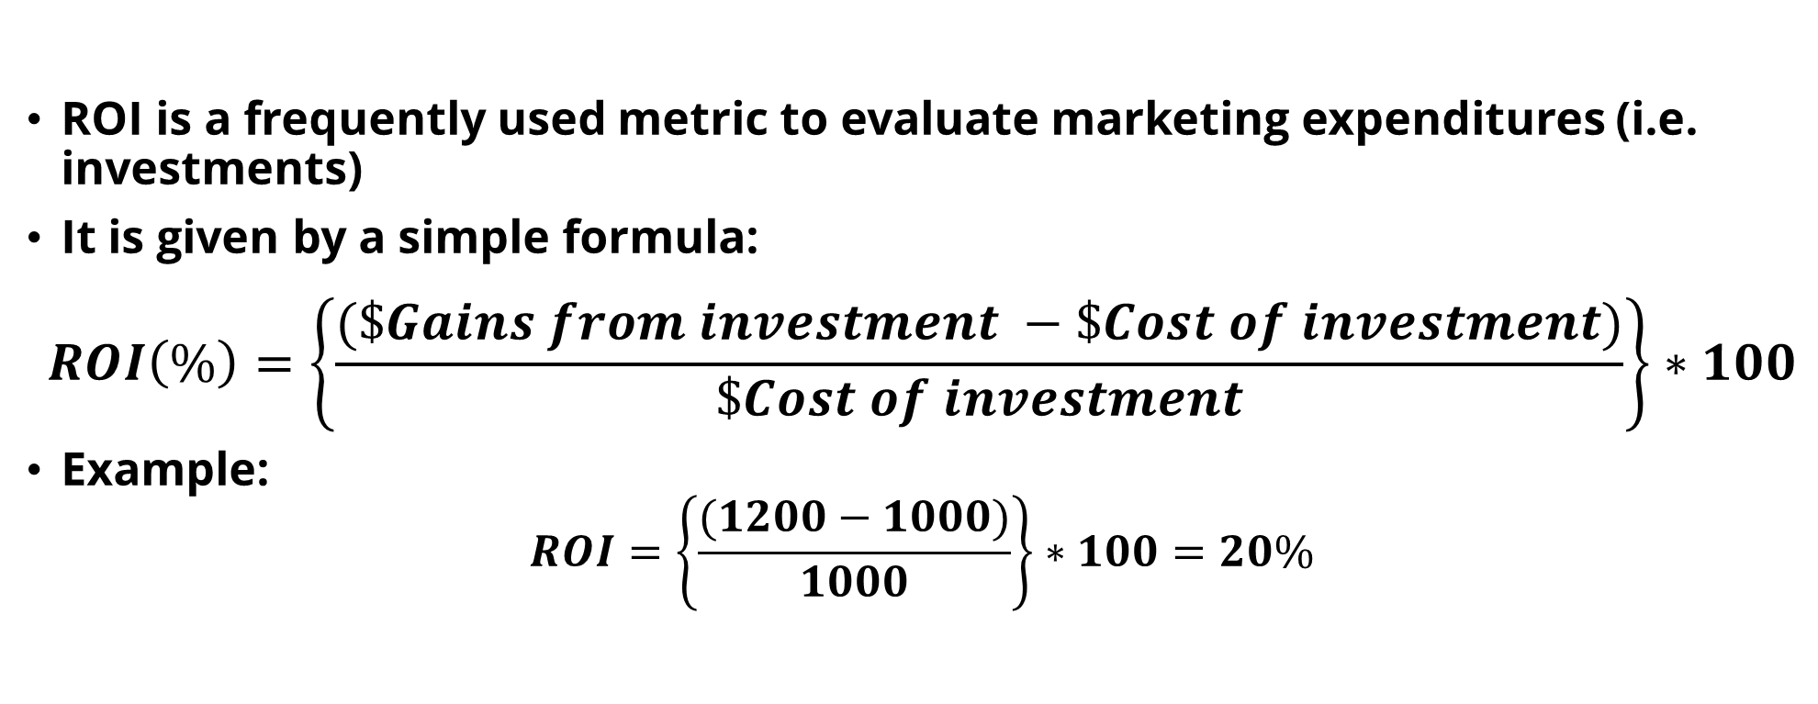
Return on Investment (ROI) 投资报酬率
ROI is a frequently used metric to evaluate marketing expenditures (i.e. investments)
It is given by a simple formula:
$$ROI\left(\%\right)=\left\{\frac{(\$Gains from investment −\$Cost of investment)}{\$Cost of investment}\right\}∗100$$
Example:
$$ROI=\left\{\frac{(1200−1000)}{1000}\right\}∗100=20\%$$
https://project-management.info/return-on-investment-roi/
https://project-management.info/cost-benefit-analysis-business-cases/
Notes:
The ROI formula is pretty straightforward to compute if you know the cost associated with your investment and the gains you realize from that investment. It is a measure of the net gains from the investment as a proportion of the cost of the investment. The challenge in computing ROI comes not from the formula, but from being able to precisely define the total costs associated with an investment (which may involve both direct and indirect costs, such as overhead), and even more difficult, to determine the actual gains realized from the investment. The gains could be tangible in some situations such as an investment in the stock of a company. But, in marketing, at some of the gains are intangible. Nevertheless, it is important to determine the cash equivalents of all costs and gains in order to compute a meaningful ROI number. When all the numbers refer to cash flows, then ROI is simply a metric of net cash flow associated with an investment divided by the investment.
As a simple example, consider a social media campaign that cost the company $1000. If the incremental sales attributed to the campaign is $1200, then one could compute the ROI as equal to 20%. One question in this example is whether the numerator really refers to the net cash flow for the company. That depends on whether the $1,000 cost includes all costs, and in particular, the cost of the product. If costs did not include the cost of the product and only included the cost of the social media campaign, then that has to be subtracted from sales to get to the net revenue – say, the cost of the products sold during the social media campaign is $150, then ROI is equal to 5%.
What if the gains above were to be equal to $800, instead of $1200? In that case, the ROI is negative 20% – i.e. we have a net cash outflow. That is an investment to be avoided.

Slide 64
Interpreting ROI numbers
ROI is a single “dimensionless” metric that can be applied to any investment. It is simply a metric of how much money your money earned.
ROI does not have a time reference. Typical time frames in marketing are “campaigns”(a few weeks) and annual.
The long-term return in the stock market is about 8% per year. If your marketing investment does better, you are using your money well! (http://www.stern.nyu.edu/~adamodar/pc/datasets/histretSP.xls).
Notes:
ROI is a number that can literally range from negative infinity to positive infinity, although the range we probably observe will be from say -1000% to 1000%. The reasons for the wide use of ROI is that it is a simple number to compute, and could applied to any investment that a company makes.
A disadvantage is that ROI does not incorporate a natural time frame for evaluating returns from an investment. It can be used to evaluate both short-term and long-term returns to investment. So 2% ROI over one month is better than 10% ROI in the course of a year. So, to properly compare two different investments using ROI, you need to figure out a common time scale for comparison. Also, if you consider longer time periods, you have to discount your cash flows (both costs and benefits) to take into account the risks associated with payoffs that come in the future.

Slide 65
Applying ROI
Helps you make one-off decisions which require investments (of time, money, and equivalents):
  (1) Does a display ad campaign at Yahoo! provide adequate ROI?
  (2) Does getting a liberal arts degree provide a good ROI?
Allows you to rank alternative decisions: Should I advertise in newspapers or Craigslist?
Companies set ROI hurdles for investment (say 15 – 20%), but ROI metric has been notoriously difficult to compute for marketing spend.
Notes:
There are many situations where ROI is used to evaluate one-off investment decisions, such as whether investing $100k in a social media campaign provide adequate ROI? Would a “daily deal” for snow skis generate sufficient returns? Does getting a liberal arts education provide a good ROI? Would the “No Child Left Behind” program generate a positive ROI? Would an investment in emerging markets this year provide good ROI?
There are other situations where ROI is used for ranking investment alternatives. ROI calculations provide a common metric for comparing different investments to identify top performers. It allows you to compare apples and oranges. For example, would we get better ROI putting up a factory in Mexico for $ 2million, or put that $2 million to advertise our new product in the US? The advent of search engine marketing has made ROI calculations pretty much routine in marketing departments – which keywords provide the maximum ROI?
Many companies set ROI hurdles that investment proposals should meet before such investments will be considered further. With these types of hurdles, there is often is a lot of gaming that goes on to get the correct ROI number to pass the hurdle. This is especially true of marketing investments whose returns are difficult to articulate precisely – analytic models could help in such situations. Nevertheless, because there so many moving parts to computing a single ROI number, it is a fertile opportunity for corporate gamesmanship. For example, one company in the energy sector had set an ROI of 15%, and typically most project proposals came in with projected ROI’s higher than 15%. When the company raised the ROI hurdle to 20% miraculously most projects then crossed that barrier as well.

Slide 66
Breakeven Analysis 损益平衡分析: Definitions
Fixed cost (FC ): Costs that remain the same regardless of the sales level. Often, these costs are incurred before the company makes any sale.
Unit variable cost (c ): the cost incurred to produce and sell one unit of a product/service.
Quantity sold (q ): the number or amount of the product/service sold.
Variable cost (VC(q)): Total variable cost at a given sales level (q). This is equal to qc.
Breakeven quantity (BE ): The sales (units) at which total revenue equals total costs, i.e. profit is zero.
Notes:
We now turn to the second concept I will be covering in this video. I will start by defining the quantities that we will be using to do a breakeven analysis.
Fixed costs are costs that do not depend on the level of sales. For example, if you spend money to do a marketing research study before introducing a product, then that cost is fixed and you will incur that regardless of whether you have any sales for the product or not. If you develop a new software, all costs of development will be fixed costs and you will incur them whether or not you any sales for the software.
Fixed costs are costs that do not depend on the sales that you realize. For example, if you spend money to do a marketing research study before introducing a product, then that cost is fixed and you will incur that regardless of whether you have any sales for the product or not. If you develop a new software, all costs of development will be fixed costs which you will incur whether you any sales for the software.
On the other hand, variable costs, as the name suggests, will vary with the amount of sales you realize. When Amazon sells a book, it has to pay the book publisher a certain amount as a proportion of the sales price, but Amazon will not incur that cost unless a book is sold. We need the unit variable cost and the total quantity sold to determine the variable cost. The notation VC(q) is merely to indicate that variable costs depend on the quantity sold.
With this information, we can determine the breakeven quantity, which refers to the quantity of product at which the company breaks even and does not realize a profit or a loss. It comes out even. Breakeven quantity could be applied at the level of an individual product, service, or even a project. It could also be applied at the level of a unit or division of the company, or for the entire company if the company makes one product or service (e.g., Netflix subscription).

Slide 67
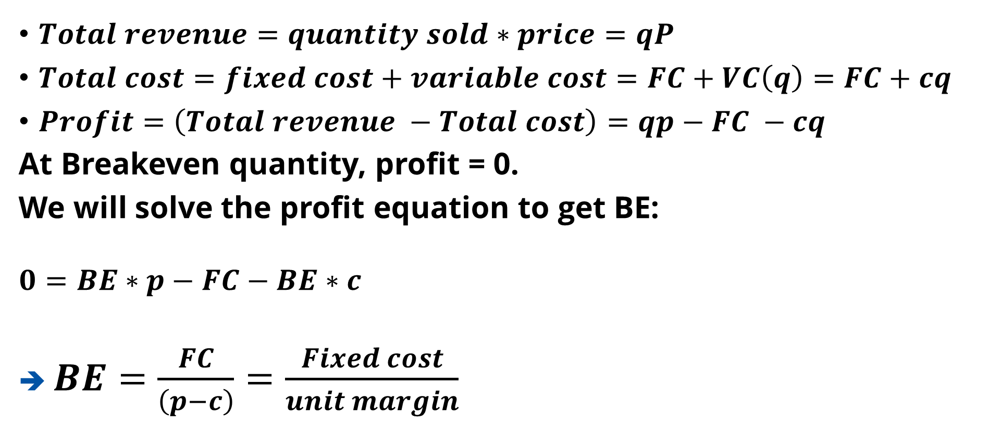
Breakeven Analysis: Computation
$Total revenue=quantity sold∗price=qP$
$Total cost=fixed cost+variable cost=FC+VC\left(q\right)=FC+cq$
$Profit=\left(Total revenue −Total cost\right)=qp−FC −cq$
At Breakeven quantity, profit = 0.
We will solve the profit equation to get BE:
$$0=BE∗p−FC−BE∗c$$
➔ $BE=\frac{FC}{\left(p−c\right)}=\frac{Fixed cost}{unit margin}$
Notes:
The breakeven quantity turns out to be a simple formula, not unlike what we saw in the case of ROI. The devil is in the details. A good way to remember the breakeven formula is that it is equal to fixed cost divided by unit margin.

Slide 68
Breakeven Analysis: Example
Fixed Cost[FC] | 6000
Unit Variable Cost[C] | 10
Price(Unit revenue) [p] | 25
Sales(Unit) | Variable Cost | Fixed Cost | Total Cost | Total Revenue | Profit
10 | 100 | 6000 | 6100 | 250 | -5850
20 | 200 | 6000 | 6200 | 500 | -5700
30 | 300 | 6000 | 6300 | 750 | -5550
40 | 400 | 6000 | 6400 | 1000 | -5400
50 | 500 | 6000 | 6500 | 1250 | -5250
60 | 600 | 6000 | 6600 | 1500 | -5100
70 | 700 | 6000 | 6700 | 1750 | -4950
80 | 800 | 6000 | 6800 | 2000 | -4800
90 | 900 | 6000 | 6900 | 2250 | -4650
100 | 1000 | 6000 | 7000 | 2500 | -4500
110 | 1100 | 6000 | 7100 | 2750 | -4350
Notes:
Let us consider a simple example. I have put this spreadsheet at the course site. This is a breakeven analysis for a new product to be sold in a department store. The product (e.g. a new cosmetic skincare kit) requires an initial investment of $8,000 for the display unit, training of sales associates, store fliers, etc. that costs $6000. This is the fixed cost the department store would incur regardless of whether it sells any kits. Each unit, which is sourced from a supplier, costs $10, and the unit price of the product is $25. This table shows the profits at different levels of sales. For simplicity, I have computed sales in terms of incremental units of 10 kits, instead of a single kit.

Slide 69
Breakeven Analysis: Example
User Goal Seeking to find the Breakeven Point in term of quantity sold.
Notes:
This is a plot of the data in the Table that I just showed you. Here, we see that the breakeven quantity is 300 units. This is the quantity at which the total costs equal revenue. If the store is able to sell more than 300 kits, it will get on the gravy train, and make some money. If the actual sales are 600 kits, then the store will have a substantial margin of safety in recovering the fixed cost (or the investment) that it has incurred. In fact, the value of breakeven analysis is to do various “what if” scenarios to understand how the cost structure will impact business profitability. After all, the purpose of being in business is do better than breakeven. No one gets into business to breakeven!
Let us now consider what happens if the fixed costs go up, other things equal.

Slide 70
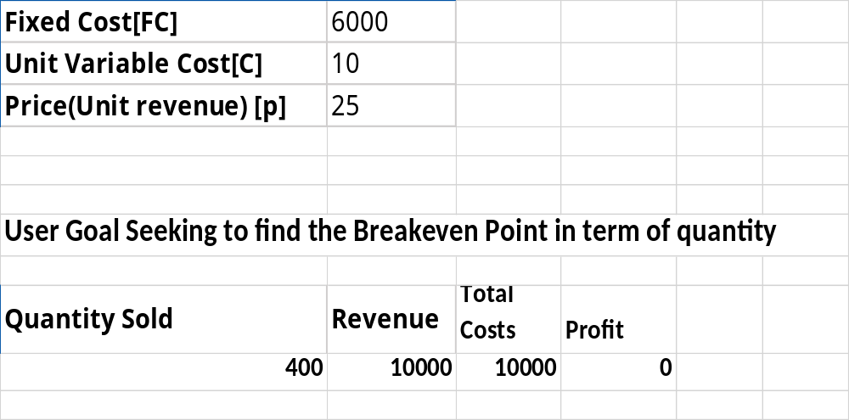
Breakeven Analysis:
Example: Increase in Fixed Cost
Notes:
When Fixed costs increase, breakeven quantity increases, and profits decrease if you don’t sell more. And, as the BE quantity increases, your margin of safety decreases.
You can explore other scenarios, such as what would happen if the margin (p-c) increases.
An interesting issue facing many marketers in the digital space is that either margins are going to zero, or worse, in some cases the price itself is going to 0. For example, the price of online content (e.g. a game for a mobile device) is being pushed toward 0 price, and all that a game marketer is able to realize is revenue from ads, which is typically less than $5 per 1,000 exposures. With fixed costs being high, you would have to get millions of people to download and use the game before you can breakeven. In this type of situation, the company would have to think creatively about marketing strategies such as segmentation and differential pricing to create a sufficient margin of safety.

Slide 71
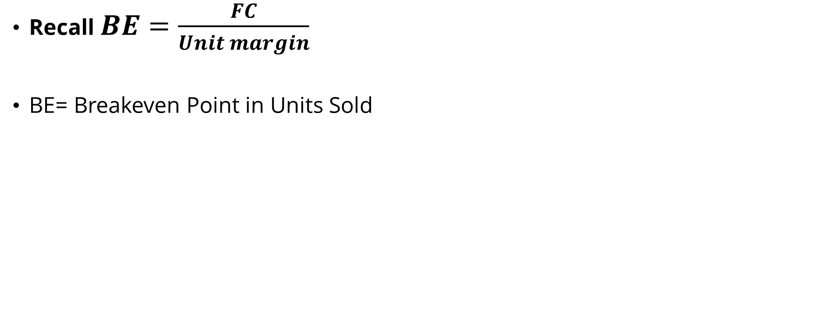
Breakeven Analysis:
Interpretation and Application
Recall $BE=\frac{FC}{Unit margin}$
BE= Breakeven Point in Units Sold
Industries in which “scale of operations” determine succcess (e.g. Amazon, United Airlines)
Industries like Pharmaceuticals and
Aircraft manufacturing
Hi
Fixed cost
Small-scale industries
(e.g. local restaurant, taxi service)
Great industry!
(e.g. Management consulting)
Lo
Lo
Hi
Unit Margin
Notes:
Understanding the fixed and variable cost structure is important for determining the relative importance of volume versus price as a strategic focus of marketing, and for understanding the ease with which potential competitors could enter the market – a high fixed cost could be a deterrent. In high fixed cost industries with low margins, the breakeven volumes will be very high. To create a margin of safety, marketing strategy should focus on increasing sales volume (Amazon CEO Jeff Bezos has been saying for many years that the company’s main strategy is to “Grow big fast.”) Marketing can help increase volume by getting more customers, getting those customers to buy more often (i.e. increase loyalty), and increase the range of purchases they make each time they come to the store (cross selling, up selling, etc.). Analytics is widely employed to help all three aspects. In the top left area of this chart, it is a sort of winner take all situation.
In industries with low fixed cost and high unit margins (the bottom right part of the chart), there will be price pressure as competitors are attracted by this cost structure, and marketing can help in product innovations and enhancements to help keep the price high and increase the barriers to entry. In such industries, typically, revenue per employee will be high (for example, in many management consulting companies, the revenue per employee is more than 500,000 dollars).
Understanding the key drivers of breakeven quantity will help you create marketing programs that reduce the breakeven volume, and increase the margin of safety. The two concepts we have covered so far, namely, ROI and BE analysis, help point you to marketing challenges that you must address to operate your business with a “margin of safety.” Designing marketing programs and plans that will result in high ROI and/or low BE are always good objectives to pursue.

Slide 72
Opportunity Cost of an Action or Decision
Opportunity cost: It is the cost you incur by not pursuing the next best alternative to an action or decision that you do decide to pursue.
Example: What is the opportunity cost of our social media campaign (the action we decide to pursue)?
Profit from social media campaign: $10,000
If the next best alternative is a newspaper campaign with a profit potential of $12,000, then the opportunity cost is $2,000 (the amount you forgo). If potential profit from the newspaper campaign is $8,000, then you did not forgo any gains – you have already made the best decision.
Notes:
Every decision you make or action you take has an opportunity cost associated with it. The opportunity cost is what you forgo by not taking the next best decision or action. It is the cost you incur for the road not taken—in that sense, opportunity cost attempts to answer the question “what if” I had done something else? Not anything else, but the “best” else. For example, the next best alternative to smoking is not necessarily taking up Nicorette gum, but perhaps giving up smoking all together.
The key issue in determining the opportunity cost is to figure out the next best alternative. In many business situations, determining the next best alternative may require you to formulate an analytical model to determine both the next best alternative and the value you would realize from following the decision or action associated with the next best alternative. In the example here, the newspaper advertising is the next best alternative and your opportunity cost is $2000. If newspaper advertising delivers a poorer result then you not incur an opportunity cost by going with the social media campaign.
An opportunity cost is not recorded in the P&L statement or in the Balance sheet, because you do not actually incur the cost. It is a notional cost. Therefore, it is not surprising that most managers do not think carefully about opportunity cost of their action because that would require them to articulate what could happen, often in the future, and many costs. So, most managers are willing to just face just the consequences of actions they have taken, and not actions they could have taken. This probably works out fine in many situations. But, if you are mutual fund manager, and your fund performs poorly compared to another mutual fund manager, the opportunity cost of going with you is something investors can figure out, and your business will suffer. In a later video segment for today’s session, I will show you one way we can determine the opportunity cost before taking an action or decision.
Articulating opportunity costs become particularly important the higher up you are in an organization. On February 1, 2008, Yahoo! had to deal with an interesting opportunity cost problem when Microsoft made an offer to purchase Yahoo! for 44.6 billion dollars. In today’s dollars, that is probably like $50 billion. Yahoo! decided to decline that offer. Its market cap in January 2016 is around 31 billion dollars. The opportunity cost to the shareholders of not selling out to Microsoft in 2008 is at least $13 billion dollars. This turned out to be a costly decision, at least from hindsight.

Slide 73

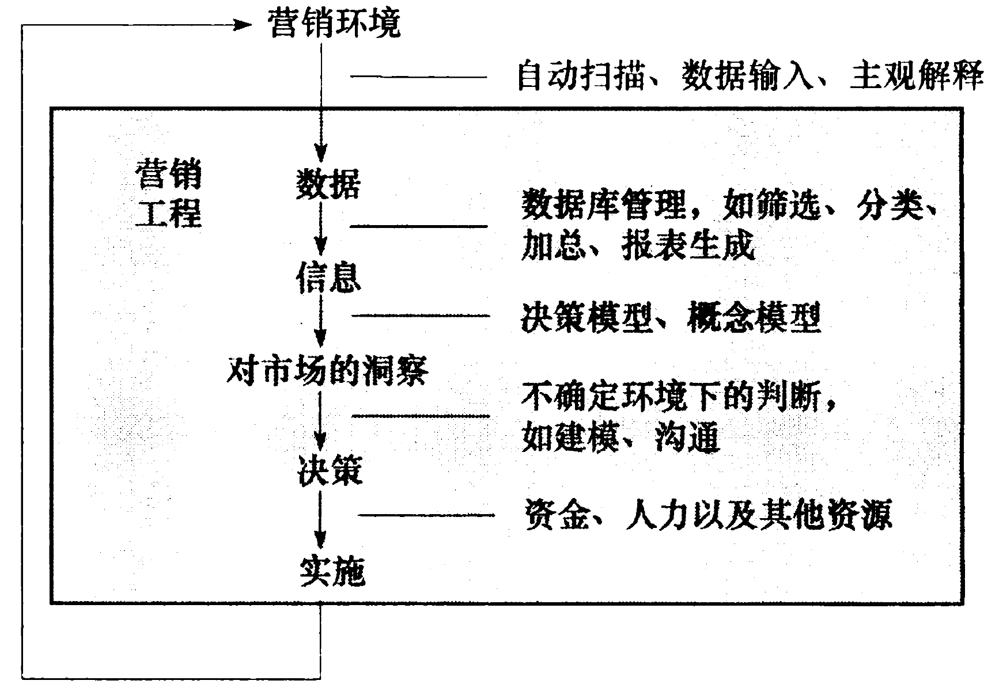


Slide 74
Marketing Engineering
Marketing Environment
Automatic scanning, data entry,
subjective interpretation
Marketing
Engineering
Data
Database management, e.g.., selection, sorting, summarization,
report generation
Information
Decision model; mental model
Insights
Judgment under uncertainty, e.g.., modeling, communication, introspection
Decisions
Financial, human, and other organizational resources
Implementation

Slide 75
Model-Based Analytics are the core of ME:
What is a Model?
A model is a stylized representation of reality that is easier to deal with and explore for a specific purpose than reality itself.
There are many types of models:
  Verbal
  Box and Arrow
  Graphical
  Mathematical
  Spreadsheets
Notes:
Good managerial decision making is about articulating the opportunity costs of various actions (including the no-action option). Opportunity costs can usually be specified only by articulating a model of what would happen under different conditions.
For example, salespeople are taught to “overcome objections” (that is re-frame the opportunity cost for their customers – e.g., the sale ends tomorrow!).

Slide 76
Verbal Model
Sales of a new product often start slowly as “innovators” in the population adopt the product. The innovators influence “imitators,” leading to accelerated sales growth. As more people in the population purchase the product, sales continue to increase but sales growth slows down.

Slide 77
Box and Arrow Model
Bass diffusion model – Wikipedia
Fixed
Population Size
Innovators
Imitators
Innovators
Influence
Imitators
Timing of Purchases by
Innovators
Timing of Purchases by
Imitators
Pattern of Sales Growth
of New Product

Slide 78
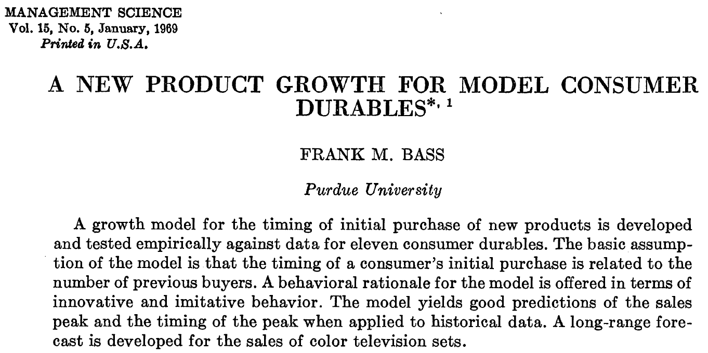
https://pdodds.w3.uvm.edu/files/papers/others/1969/bass1969a.pdf
Bass diffusion model

Slide 79
Graphical Model

Slide 80
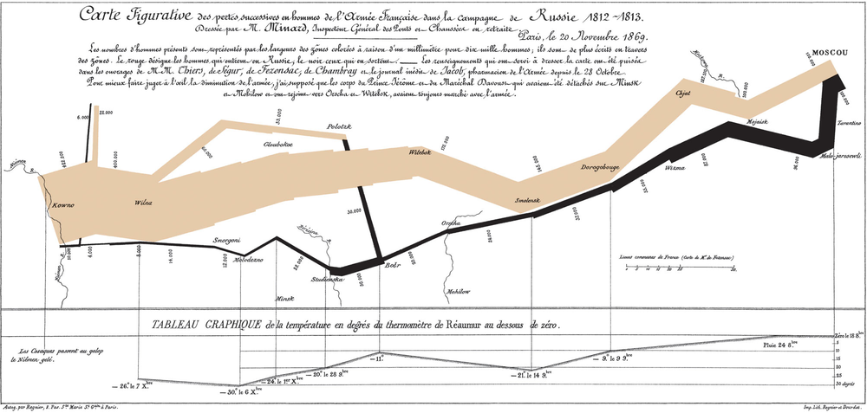
Presenting Information: Infographics & Data Visualization
Notes:
http://overthought-thoughts.blogspot.com/2008/12/charts-i-heart-part-ii.html

Slide 81

A Picture Is Worth a Thousand Words
24 June – 14 December 1812
https://en.wikipedia.org/wiki/File:Napoleons_retreat_from_moscow.jpg

Slide 82
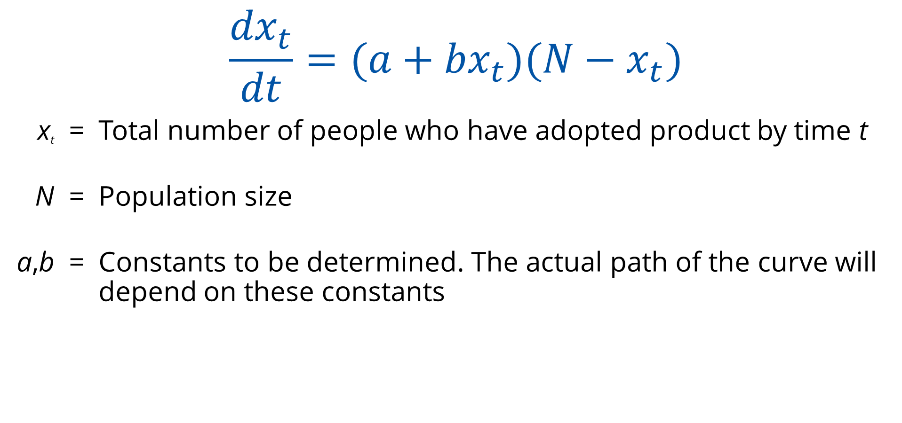
Mathematical Model
$$\frac{{dx}_{t}}{dt}=({a+bx}_{t})({N−x}_{t})$$
x_{t} = Total number of people who have adopted product by time t
N = Population size
a,b = Constants to be determined. The actual path of the curve will depend on these constants

Slide 83
Are Models Valuable?
Models vs Intuition/Judgments
Types of Judgments Experts Had to Make | Mental Model | Subjective Decision Model | Objective Decision Model
Academic performance of graduate students | 0.19 | 0.25 | 0.54
Life expectancy of cancer patients | -0.01 | 0.13 | 0.35
Changes in stock prices | 0.23 | 0.29 | 0.80
Mental illness using personality tests | 0.28 | 0.31 | 0.46
Grades and attitudes in psychology course | 0.48 | 0.56 | 0.62
Business failures using financial ratios | 0.50 | 0.53 | 0.67
Students’ rating of teaching effectiveness | 0.35 | 0.56 | 0.91
Performance of life insurance salesman | 0.13 | 0.14 | 0.43
IQ scores using Rorschach tests | 0.47 | 0.51 | 0.54
Mean (across many studies) | 0.33 | 0.39 | 0.64
Notes:
The literature shows you don’t need objective data to derive value from models—even running subjective data through a formal model often helps. When feasible, use models with objective data. A random model would have had a zero correlation with outcomes, while the mental model has a 0.33 correlation indicating the value of experience and subjective interpretation. However, using either subjective or objective decision models helps improve predictions.

Slide 84
Applicant Profile
(Academic performance of graduate students)
Applicant | Personal Essay | Selectivity of Undergraduate | Undergraduate Major Institution | CollegeGrade Avg. | Work Experience | GMAT Verbal | GMAT Quantitative
1 | poor | highest | science | 2.50 | 10 | 98% | 60%
2 | excellent | above avg | business | 3.82 | 0 | 70% | 80%
3 | average | below avg. | other | 2.96 | 15 | 90% | 80%
• | • | • | • | • | • | • | •
• | • | • | • | • | • | • | •
117 | weak | least | business | 3.10 | 100 | 98% | 99%
118 | strong | above avg | other | 3.44 | 60 | 68% | 67%
119 | excellent | highest | science | 2.16 | 5 | 85% | 25%
120 | strong | not very | business | 3.98 | 12 | 30% | 58%
Notes:
These are the types of data that are used to develop the statistics on line 1 of the previous chart.

Slide 85
Some Takeaways
Seat-of-the-pants decision making is not enough anymore. Marketing Analytics is becoming increasingly important for all types of businesses, especially for supporting core decisions.
Analytics generate results and insights for action.
For important issues, both analytics and judgment (Humans + Computers) are needed for translating results and insights into decisions and actions, especially in marketing.
The process and discipline associated with analytics, by themselves, offer valuable benefits.
Merely quantifying judgment can improve the quality of marketing decisions.
Notes:
CMO of IBM (Anil Menon): At IBM, when we evaluate ad campaigns, we are no longer satisfied with just measuring awareness or recall. We want to know what is the effect of the ad campaign in generating incremental sales, loyalty, and ROI!

Slide 86
On Models and Modeling

Slide 87
What is a model?
A model is a stylized representation of reality that is easier to deal with and explore for a specific purpose than reality itself.
Notes:
Example: a geographic map is a model. A model is designed for a specific purpose.
e.g. a map to navigate does not include all details of the environment (houses etc), but only roads, highway numbers and distances

Slide 88
What is a model?
A model is a stylized representation of reality that is easier to deal with and explore for a specific purpose than reality itself.
“Models are not to be trusted, they are to be used.”
“No model is true, but some models are useful.”
“Models do not make decisions. Managers do.”
Notes:
Example: a geographic map is a model. A model is designed for a specific purpose.
e.g. a map to navigate does not include all details of the environment (houses etc), but only roads, highway numbers and distances

Slide 89
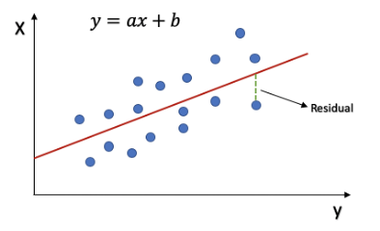
一個簡單線性回歸 Model
y
Y = aX + b
b：截距 (Intercept)，
a：斜率 (Slope) 為 X 變動一個單位 Y 變動的量
x
* Chapter 13: Simple Linear Regression from a Book
簡單線性回歸的顯著性檢定(Significance test) - 邱秉誠資料科學札記 – Medium
[Day 8] 線性迴歸 (Linear Regression) - iT 邦幫忙::一起幫忙解決難題，拯救 IT 人的一天 (ithome.com.tw)
** R-squared, Clearly Explained!!! – YouTube
R-Squared - Definition, Interpretation, and How to Calculate (corporatefinanceinstitute.com)

Slide 90
Terminologies for Regression
y | x
Dependent variable | Independent variable
Explained variable | Explanatory variable
Response variable | Control variable
Predicted variable | Predictor variable
Regressand | Regressor
因变量 (應變量/變因/變項) | 自变量 (獨立變量/變因/變項、操作變因、操縱變因)

Slide 91
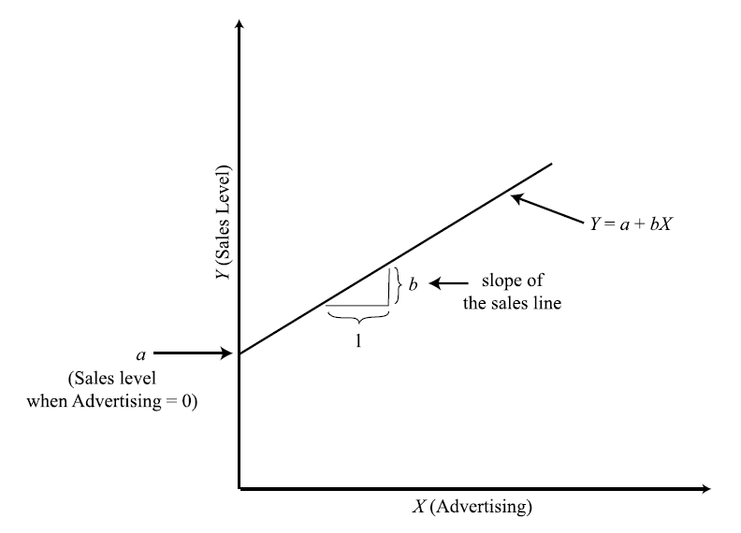
Interpreting the coefficients (model parameters, i.e., a and b) of a linear response model.

Slide 92
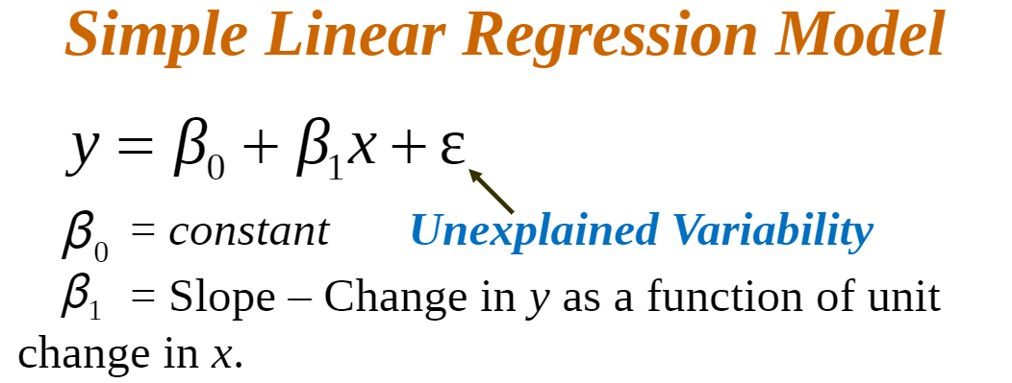
model
β0 and β1 are Called the Parameters of the Model.
ε: Error Term (Normally Distributed Random Variable, Independent with Identical Variances for each value of x.)

Slide 93
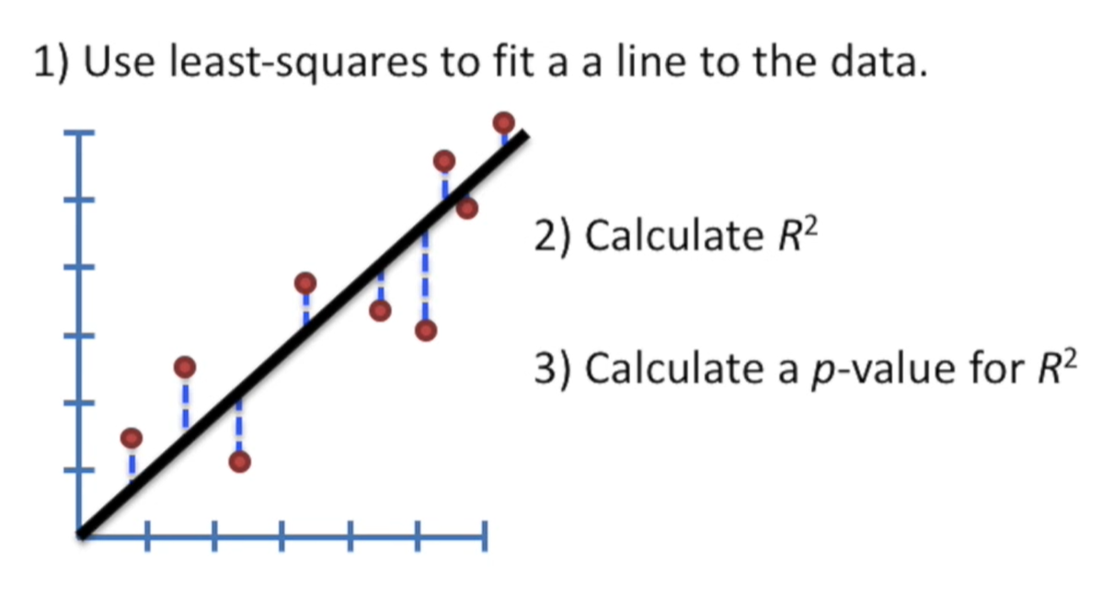
Linear Regression, Clearly Explained!!!
Linear Regression, Clearly Explained!!! - YouTube

Slide 94
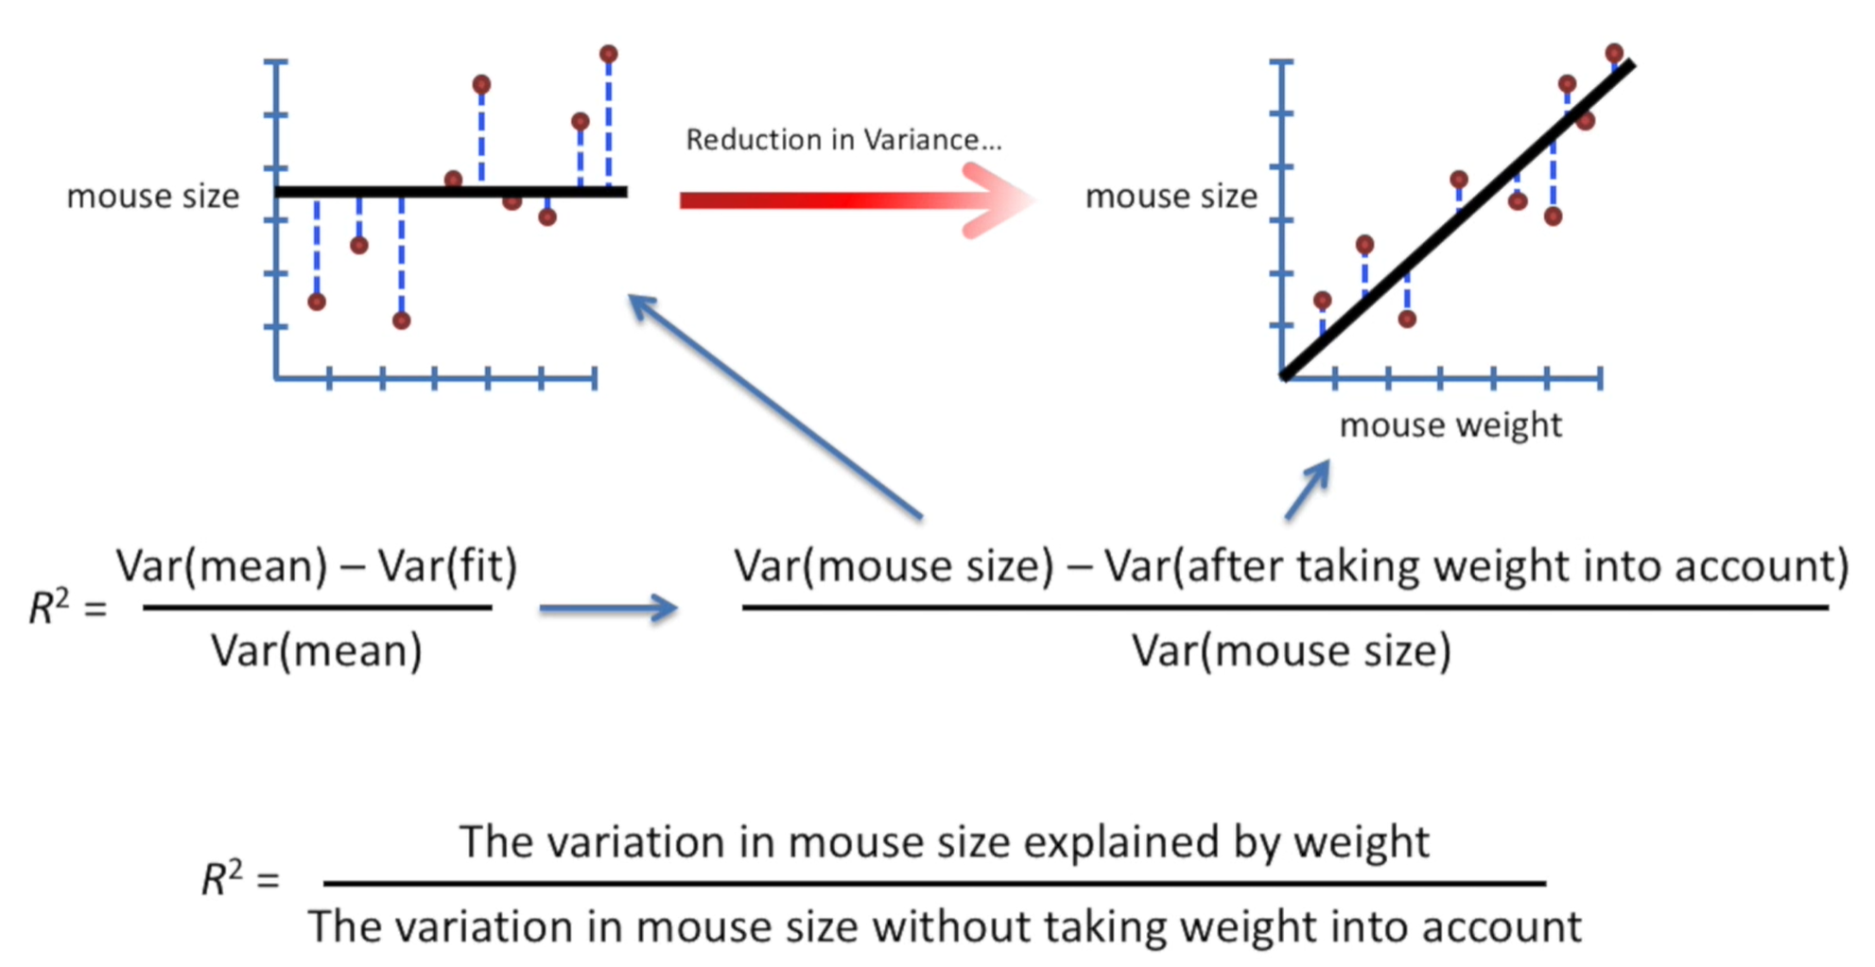
Linear Regression, Clearly Explained!!!
R-Squared (R² or the coefficient of determination) is a statistical measure in a regression model that determines the proportion of variance in the dependent variable that can be explained by the independent variable. In other words, r-squared shows how well the data fit the regression model (the goodness of fit).
Linear Regression, Clearly Explained!!! - YouTube

Slide 95
Simple vs. Multiple Regression
Simple Linear Regression: The Simplest Kind of Regression Involving One Independent and One Dependent Variable with a linear relationship between them.
Multiple Regression: Regression Analysis With 2 or More Independent Variables.
Correlation Analysis: Determining the Extent to Which Variables are Linearly Related.
  Correlation analysis | Analyze correlation between two variables | QuestionPro
https://www.coursehero.com/u/file/8870000/Simple-Linear-Regression/
Notes:
Home Features Correlation analysis
What is correlation analysis?
Correlation analysis in research is a statistical method used to measure the strength of the linear relationship between two variables and compute their association. Simply put - correlation analysis calculates the level of change in one variable due to the change in the other. A high correlation points to a strong relationship between the two variables, while a low correlation means that the variables are weakly related.
When it comes to market research, researchers use correlation analysis to analyze quantitative data collected through research methods like surveys and live polls. They try to identify the relationship, patterns, significant connections, and trends between two variables or datasets. There is a positive correlation between two variabls when an increase in one variable leads to the increase in the other. On the other hand, a negative correlation means that when one variable increases, the other decreases and vice-versa.

Slide 96
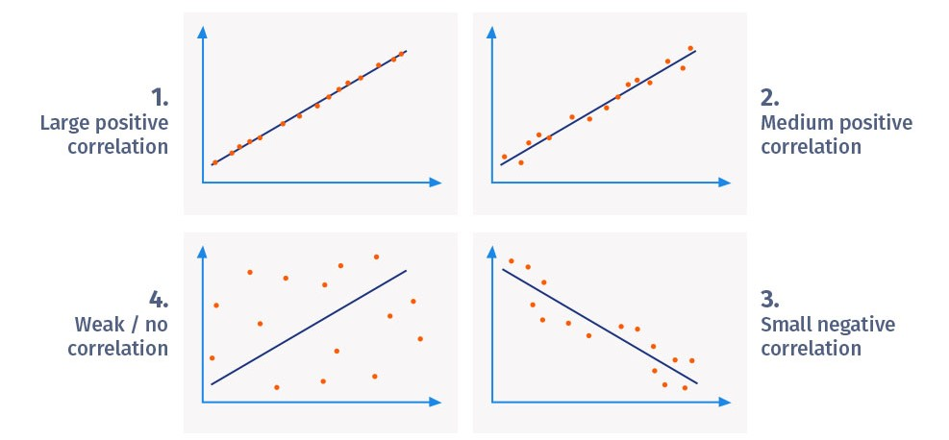
Correlation Analysis
  Correlation analysis | Analyze correlation between two variables | QuestionPro
Notes:
Home Features Correlation analysis
What is correlation analysis?
Correlation analysis in research is a statistical method used to measure the strength of the linear relationship between two variables and compute their association. Simply put - correlation analysis calculates the level of change in one variable due to the change in the other. A high correlation points to a strong relationship between the two variables, while a low correlation means that the variables are weakly related.
When it comes to market research, researchers use correlation analysis to analyze quantitative data collected through research methods like surveys and live polls. They try to identify the relationship, patterns, significant connections, and trends between two variables or datasets. There is a positive correlation between two variabls when an increase in one variable leads to the increase in the other. On the other hand, a negative correlation means that when one variable increases, the other decreases and vice-versa.

Slide 97
What does a model look like?
Verbal
Box and Arrow
(Influence Diagram*)
Graphical
Mathematical
Sales
Sales= F(A, D, Ad)
“Sales is a function of customers’ awareness, distribution, and advertising”
Advertising
S = W × D × A1/2
Sales
Advertising
*Influence Diagrams - Analytica (lumina.com)
Notes:
It is just a simplification that only advertising is included in box 2 and 3.
W = awareness
D = distribution
A = advertising

Slide 98
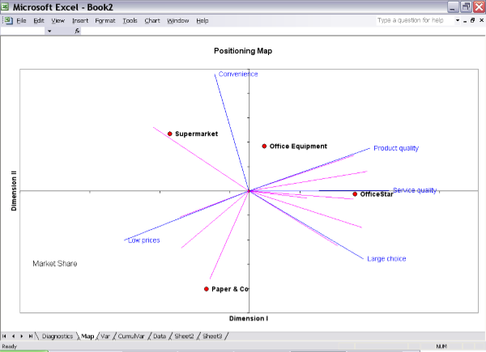
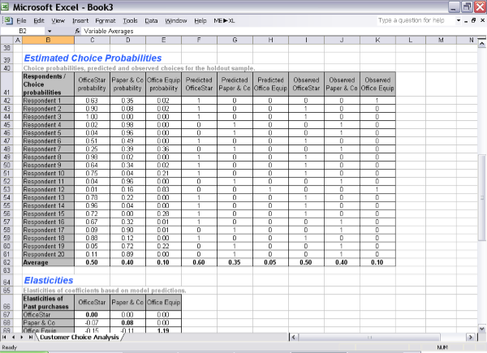
What kinds of models?
Descriptive
Predictive/Normative
E.g., how are my products and my competitors’ products perceived by the market? Gaining insight in the process…
E.g., which customers should I target? (given objectives & constraints)
Notes:
Purpose is different:
Descriptive: simplify reality so I can understand it better
Predictive: model reality so I can make better choices

Slide 99
What benefits?
Gain additional insight
  Even small models can offer insight – they can change your goals, priorities and mental models, even if you stop using them
Explore more options
  De-anchoring, simulations, “what if” scenarios, etc.
Help reach group consensus, support group decisions
  Avoiding the battle of faiths
Make more consistent, better decisions
  Humans are inconsistent, but “creative”. Models are consistent information processors. Managers + Models = (possibility of) better decisions
  Models do not make decisions. Managers do

Slide 100
How to Build a Model
Specify
  Variables (which ones to include)
  Relationships, interactions, dynamics (how they are linked)
Calibrate
  Statistical estimation with real data (econometric approach)
  Judgmental calibration (tribal wisdom approach)
Validate
  Global fit (R², model fit)
  Variable significance (correct signs, t-tests)
  Face validity (does it make sense?)
Apply
  Unique vs. multiple objectives?
  Short term vs. long term?
Calibration (Model Parameters) 模型校准
can be defined as finding a unique set of model parameters that provide a good description of the system behaviour, and can be achieved by confronting model predictions with actual measurements performed on the system.

Slide 101
Response Models
Aggregate response models
Individual response models
Shared-experience models
Qualitative response models

Slide 102
The Concept of a Response Model
洞悉事物的本質是爲了更好的預測，而預測則是爲了完成更好的操作。➔「透過現象看本質」
模型，是我們以後用來「看本質」的預備知識。模型，是我們觀察世界的眼睛。沒有眼睛（模型），我們什麼都看不見。
沒有模型，我們看世界，只是停留在很低的解析度上。
  https://www.jianshu.com/p/fbfebde78812
  透過現象看本質1
Idea:
Marketing Inputs:
Selling effort
Advertising spending
Promotional spending
Black Box
Market
Marketing Outputs:
Sales
Share
Profit
Awareness, etc.

Slide 103
透过现象看本质系列 王武佳
透过现象看本质（1）：从认知的角度谈一谈
透过现象看本质（2）：是否存在唯一的本质
透过现象看本质（3）：做认知黑客，而非科学家
透过现象看本质（4）：如何“看”
透过现象看本质（5）：心智计算机的认知观

Slide 104
Marketing Engineering and Analytics
All market response models include:
Inputs: e.g., price, advertising, selling effort, product design, market size, competitive environment
Response Model: links inputs to outputs such as product perceptions, sales, profits
Objectives: used to evaluate actions such as sales

Slide 105

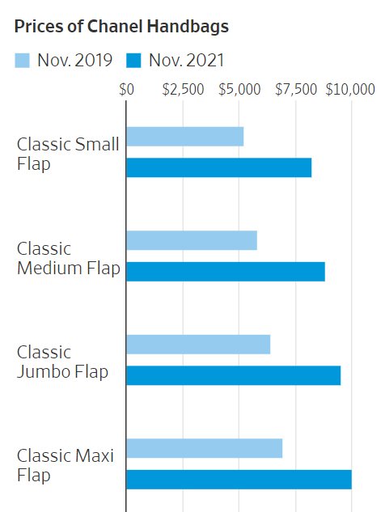

Price ⬆ ➔ Sales?
By
Feb. 5, 2022
By
Suzanne Kapner
Feb. 5, 2022
Notes:
Luxury companies have been taking advantage of surging demand to reposition their brands as even more exclusive and costly, according to industry executives and analysts. The practice predates the pandemic, but has received a renewed push in the past year as shoppers, emerging from pandemic-induced lockdowns, have snapped up high-price handbags, shoes, jewelry and other items….
“All the luxury industry is raising prices,” John Idol, the chief executive officer of Capri Holdings Ltd. CPRI 1.01% , owner of Michael Kors, Jimmy Choo and Versace, told analysts recently. “We’ve seen absolutely no consumer resistance to any of the price increases that we have taken, and there will be more.”
Chanel’s price increases stand out for their size and frequency, said analysts and consumers. It raised prices on its Classic Flap bags three times in 2021. It made another price increase in January on different styles, including Coco Handle and Business Affinity bags, which now cost 8% to 12% more.

Slide 106

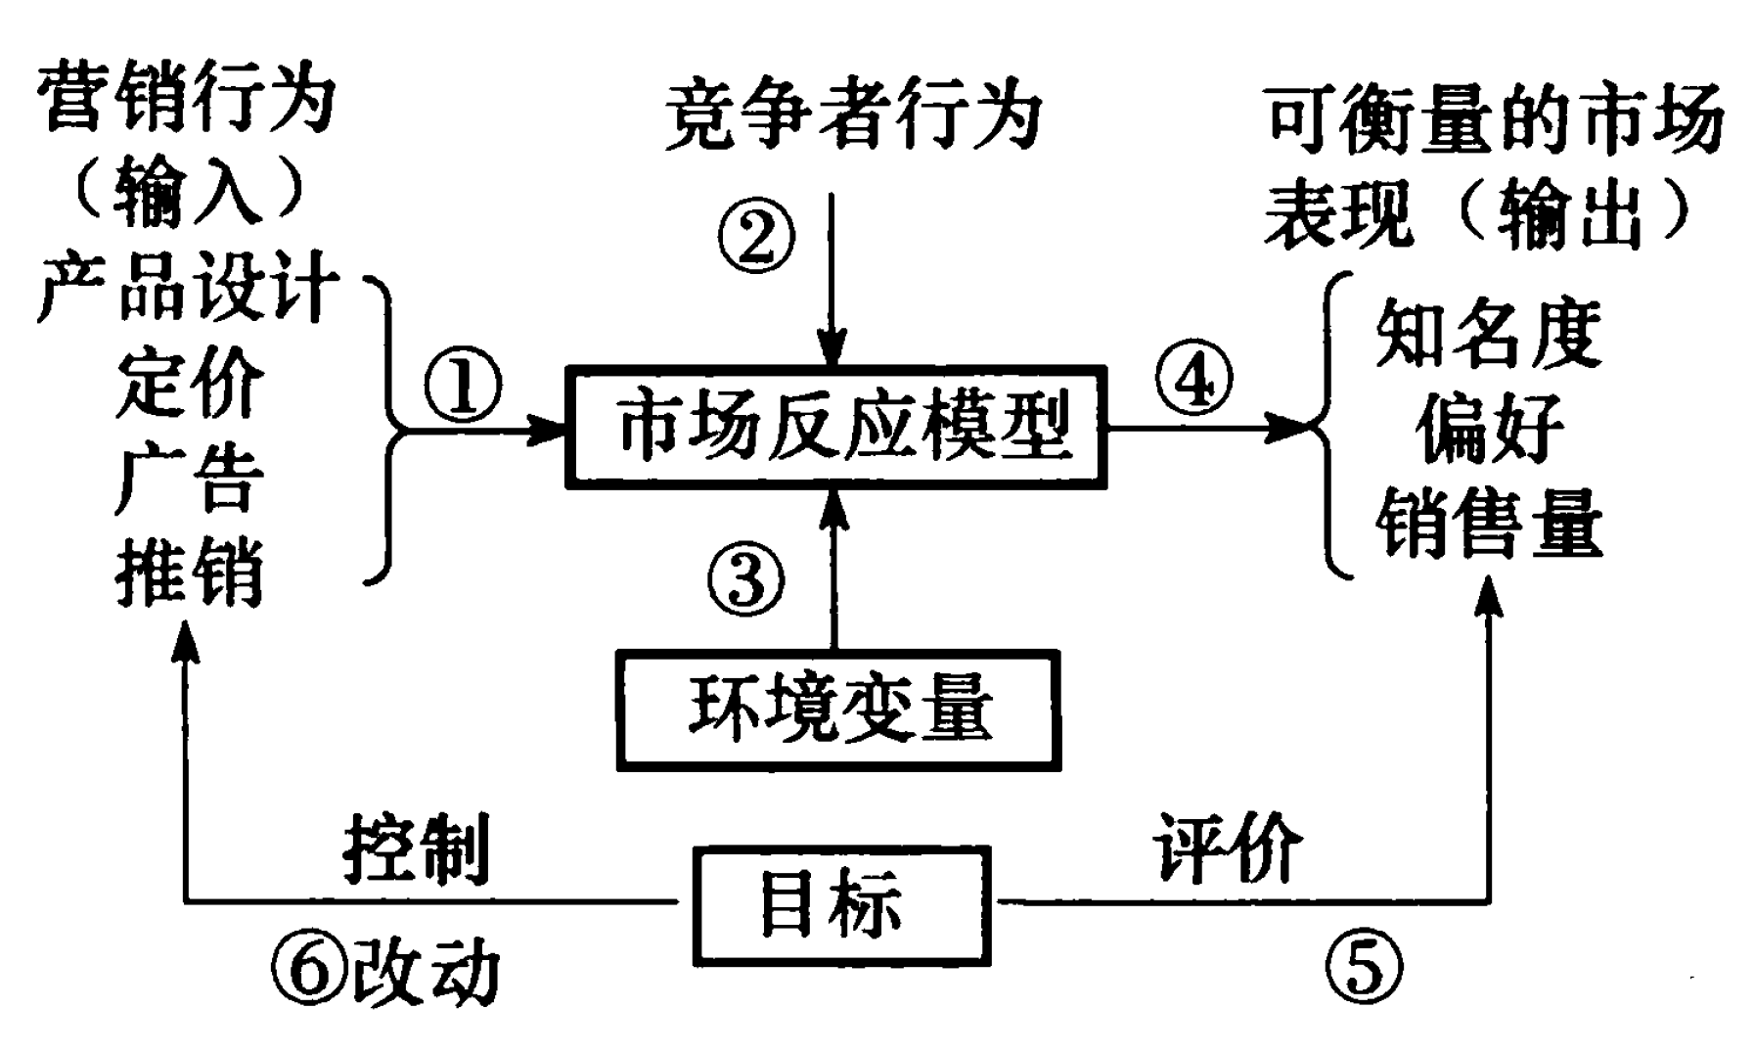

Slide 107
Input-Output Model
Marketing Actions
Inputs
Competitive Actions
Observed Market
Outputs
02
把一個具體的事物變成一個抽象的模型，就是抽取出其中的關鍵特徵(variables)，以及分析特徵之間的相互關係，得出的結果就是一個模型。
透過現象看本質1
Product design
Price
Advertising
Selling effort etc.
Market
Response
Model
Awareness level
Preference level
Sales Level
01
04
03
Environmental
Conditions
Control Adaption
Evaluation
Objectives
06
05

Slide 108
透過現象看本質有三個步驟：
分類——建立類別，並且命名；
歸類——透過現象判定事物所屬的分類；
預測——通過已有分類的模型，進行預測。
模型，是我們以後用來「看本質」的預備知識。模型，是我們觀察世界的眼睛。沒有眼睛（模型），我們什麼都看不見。

Slide 109
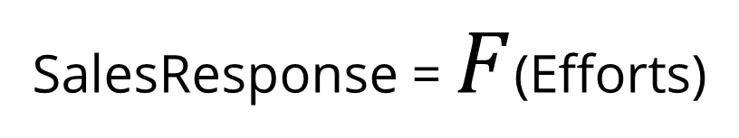
Response Function
SalesResponse = $F$(Efforts)
Range
Notes:
A sigmoid function is a mathematical function having a characteristic "S"-shaped curve or sigmoid curve.
F(x) = 1 / (1 + e^{-x})
In Excel =1/(1+EXP(-A1))

Slide 110

A Simple Model
Y = a + bX ⬅ Y = F(X)

Slide 111


Problems and Perspectives in Management 15(2-2):456-467 DOI:10.21511/ppm.15(2-2).2017.14

Slide 112
Objectives Specified in Models
Profit (= [UnitPrice– UnitVariableCost] X TotalUnitSold - FixedCost )
Sales
Market share
Time horizon
Uncertainty
Multiple goals
Multiple points of view
Others ??

Slide 113
The Concept of a Response Model
Idea:
Marketing Inputs:
Selling effort
Advertising spending
Promotional spending
Market
Marketing Outputs:
Sales
Share
Profit
Awareness, etc.

Slide 114


Response Function
Right mouse click inside the chat➔
Click on the Chart Border Line
To modify Chart elements
Notes:
A sigmoid function is a mathematical function having a characteristic "S"-shaped curve or sigmoid curve.
F(x) = 1 / (1 + e^{-x})
In Excel =1/(1+EXP(-A1))

Slide 115


Pictorial representation of Saunders’ response model phenomena

Slide 116
8 Phenomena
P1. Output is zero when input is zero.
P2. The relationship between input and output is linear.
P3. Returns decrease as the scale of input increases (every additional unit of input gives less output than the previous unit gave).
P4. Output cannot exceed some level (saturation).
P5. Returns increase as scale of input increases (every additional unit of input gives more output than the previous unit).
P6. Returns first increase and then decrease as input increases (S-shaped return).
P7. Input must exceed some level before it produces any output (threshold).
P8. Beyond some level of input, output declines (supersaturation point).
Microsoft Word - TN02 - Response_Models_21Feb07.doc (decisionpro.biz)

Slide 117
透過現象看本質 Phenomena➔P1 to P8
透過現象看本質➔洞悉事物的本質是爲了更好的預測，而預測則是爲了完成更好的操作。(透過現象看本質)
A picture is worth a thousand words.
一張圖片勝過千言萬語。
➔
從現象
看本質
* TN02 - Response_Models_ (decisionpro.biz)

Slide 118
Phenomena
The phenomena we wish to incorporate in our model of the marketplace depend on many things, including what we have observed about the market (data), what we know about the market (judgment or experience), and existing
theory about how markets react.
P5:Increasing Returns (convex凸的)
P6: S-shape
Y
Y
X
X
P7: Threshold
P8: Super-saturation
Y
Y
X
X
*Feature Article—Aggregate Advertising Models: The State of the Art (informs.org)

Slide 119

Convex vs Concave (凸与凹)
A function of a single variable is concave if every line segment joining two points on its graph does not lie above the graph at any point.
concave up, smiley face Concave down, frowny face
A function that has an increasing first derivative bends upwards and is known as a convex function. On the other hand, a function, that has a decreasing first derivative is known as a concave function and bends downwards. (link)

Slide 120
Aggregate Response Models:
Linear Model
Y = a + bX ⬅ Y = F(X)
Linear/through origin (when a=0)
Saturation (Y <= N) and threshold (in ranges) (X >= M)
在统计学中，线性回归（英語：linear regression）是利用称为线性回归方程的最小平方函數对一个或多个自变量和因变量之间关系进行建模的一种回归分析。这种函数是一个或多个称为回归系数的模型参数的线性组合。只有一个自变量的情况称为简单回归，大于一个自变量情况的叫做多元回归（multivariable linear regression）。
線性回歸 - 维基百科，自由的百科全书 (wikipedia.org)

Slide 121

Aggregate Response Models: Fractional Root Model
Y = a + bX^{c}
c can be interpreted as elasticity when a = 0.
Linear, increasing or decreasing returns (depends on c ).
c=1/2: square root model, c=-1: reciprocal model (Y approaches a when x gets large.
When x is price c<0; for other variables c>0.
Linear (P1,P2, c=1), increasing (P5, c>1 ) or decreasing returns(P3, c<1).
幂 - 维基百科，自由的百科全书 (wikipedia.org)

Slide 122
Aggregate Response Models:
Exponential Model (指數增長)
Y = ae^{bx}; x > 0
Increasing or decreasing returns (depends on whether b is positive or negative).
Increasing returns (b>0)
Decreasing returns (b<0)
Widely used in a price-response function (b<0)
https://faculty.biu.ac.il/~fruchtg/829/lec/2.pdf
More slides of an older version of the textbook at https://faculty.biu.ac.il/~fruchtg/829/table.htm

Slide 123


⬅说明了指数增长（绿色）如何超过线性增长（红色）和幂增长（蓝色）。
指數增長 - 维基百科

Slide 124
Aggregate Response Models:
Modified Exponential Model
Y = a (1 – e^{–bx}) + c
Decreasing returns and saturation (P3 and P4)
upper bound at a+c
lower bound at c.
Widely used in marketing: selling effort.

Slide 125

Aggregate Response Models:
Adbudg (Advertising Budget) Function
Y = b + (a–b)
S-shaped and concave; saturation effect.
Widely used.
Amenable to judgmental calibration.

Slide 126


Slide 127

blue_mountain_coffee_adbudg in Excel

Slide 128


AdBudg using Excel

Slide 129
Aggregate Response Models:
Multiple Instruments
Additive model for handling multiple marketing instruments
Y = a f(X₁) + b g(X₂)
Easy to estimate using linear regression.➔ Multiple linear regression (MLR), also known simply as multiple regression, is a statistical technique that uses several explanatory variables to predict the outcome of a response variable.

Slide 130

Aggregate Response Models:
Multiple Instruments cont’d
Multiplicative model for handling multiple marketing instruments
b and c are elasticities.
Widely used in marketing.
Can be estimated by linear regression (by taking logarithms (对数 ) on both sides of the equation). ➔ 加减法代替了乘除法
$$Y=aX_{1}^{b}X_{2}^{c}$$

Slide 131
Dynamic Effects
The marketing response (i.e., sales) is a function of marketing efforts (e.g., sales promotion) and time.
Sales = F (marketing mix, Time)
Spending Level
(Stimulus)
Time
** Feature Article—Aggregate Advertising Models: The State of the Art (informs.org) John Little 1979

Slide 132
Dynamic Effects
2. Conventional “delayed response” and “customer holdout” effects
Spending Level
Sales Response
Time
customer retention rate
Customer-holdover effect, arises when new customers created by the marketing expenditures remain customers for subsequent periods. Their later purchases should be credited to some extent to the earlier marketing expenditures. Some percentage of such new customers will be retained in each subsequent period; this phenomenon gives rise to the notion of the customer retention rate and its converse, the customer decay rate (also called the attrition or erosion rate).

Slide 133

Dynamic Effects
3. “Hysteresis” effect(磁滯現象)。
磁性物質都具有保留其磁性的傾向，磁感應強度B的變化總是滯後於磁場強度H的變化的，這種現象就是磁滯現象。
Sales Response
Time
The asymmetry in sales buildup compared with sales decline. For example, sales may rise quickly when an advertising program begins and then sales remain the same or decline slowly after the program ends.

Slide 134
Dynamic Effects
4. “New trier” “wear out” effect
Sales Response
Time
Sales reach a peak before settling down to steady state, are common for frequently purchased products, for which many customers try a new brand but only a few become regular users.

Slide 135
Dynamic Effects
5. “Stocking” effect (屯積效應)➔搶購衛生紙
Sales Response
外部因素
Time
It is explained by price promotions that not only attract new buyers, but also result in loyal buyers purchasing and stocking extra supplies of the product. This leads to a decrease in sales in the period immediately following a promotion.

Slide 136
Aggregate Response Models: Dynamics
Dynamic response model
Y_{t} = a₀ + a₁ X_{t} + λ Y_{t–1}
Easy to estimate.
Carry-over
effect
Current
effect

Slide 137
Market-Share Models and Competitive Effects
Y = M ⋅V
Brand sales models (Y) – Total Sales of a brand
Product class sales models (V) – Total Sales of a product category in the marketplace.
Market-share models (M) – Market share of the brand
Models of product class sales (V) explaining demand through environmental variables (population sizes, growth, past sales levels, etc.) and by aggregate values of marketing variables (total advertising spending, average price, etc.).
Each firm’s market share must be between 0 and 100 percent (range restriction) and market shares, summed over brands, must equal 100 percent (sum restriction).
Notes:
A class of models that satisfy both the range and the sum restrictions are attraction models,
where the attraction of a brand depends on its marketing mix. Essentially these
models say our share=us/(us+them), where “us” refers to the attractiveness of our
brand and (us+them) refers to the attractiveness of all brands in the market,
including our brand.

Slide 138
Aggregate Response Models: Market Share
Market share (attraction) models
A_{i}
M_{i} = ––––––––––––––––––
A₁ + A₂ + . . . + A_{n}
A_{i} = attractiveness of brand i.
Satisfies sum (market shares sum to 1.0) and range constraints (brand share is between 0.0 and 1.0)
Has “proportional draw” property ➔ a new competing brand will draw market share proportionally from all existing brands.

Slide 139
Model Benefits
Small models can offer insight – they can change your goals and priorities, even if they don’t influence your decisions.
Even simple models can align management beliefs (mental model) with marketing policy.
You don’t need hard data to get value from models--judgments and intuition is often enough.
Digital data capture enables large model ROI.

Slide 140
The end

Slide 142

Today’s trends
Notes:
It’s a general trend… Marketing as a field is changing. Just like finance changed in the 80’s

Slide 143


Today’s trends

Slide 144

Today’s trends

Slide 145
The Opportunity for Marketing Analytics
Zone of Death
Wish Marketing
Zone of Exceptional
Marketing
The Bell Curve for
Marketing Performance
(Below Average)
(Above Average)
(Average marketing program)
(Well Below Average)
(Well Above Average)
Marketing Performance
Critical
Troubling
Average
Pleasing
Amazing
Marketing Share Growth
Precipitous Decline
Significant Decline
Modest Decline
Increase
Dramatic Increase
New Product Success Rate
0%
5%
10%
25%
40%+
Advertising ROI
Negative
0%
1-4%
5-10%
20%
Promotional Programs
Disaster
Un-profitable
Marginally Unprofitable
Profitable
Very Profitable
Customer Satisfaction
0-50%
51-65%
66-75%
76-82%
83-90%
Customer Retention (Annual)
0-40%
41-60%
61-80%
81-90%
91-97%
The objective is very simple.
To improve marketing performance.
Source: Adapted from Copernicus Marketing Consulting
Notes:
New Product success rates are based on study by Nielsen.
Ad ROI based on article in Advertising Age.
Satisfaction scores based on Michigan index. Amazon score at Michigan satisfaction index is 88!’
Retention rates based on study by Reicheld. New York Times and MBNA have customer retention rates of over 90% In the auto industry, retention rates of over 60% are considered very good (Chevy).

Slide 146
Top Performing Companies Use Analytics
High Performers |  | Low Performers
65% | Have significant decision-support/analytical capabilities | 23%
36% | Value analytical insights to a very large extent | 08%
77% | Have above average analytical capability within industry | 33%
77% | Have BI/Data Warehouse modules installed | 62%
73% | Make decisions based on ES data and analysis | 51%
40% | Use analytics across their entire organization | 23%
* Based on an Accenture study with a sample of 400 companies worldwide (2005). Source: Tom Davenport.

Slide 147
21st Century Marketing Decisions
We have too much data of the wrong kind, not enough of the right kind (data and information have no value by themselves, but generate value through their use).
Humans are inconsistent, but “creative” information processors (in both analyzing and synthesizing information).
Computers/mathematical models are consistent information processors.
Managers + Models ➔ (Possibility of) Better Decisions
Notes:
From e-marketer (March 7, 2007)
Less than 10% of information within organizations is ranked by value. Untagged data are not readily useful throughout a company.
Another quarter of information in companies lies outside of data centers, which, again, makes it less useful. Small businesses account for as much as 30% of corporate information, and the number of people who have access to the data is limited.
So we come again to a paradox which has been around for most of the Information Age, and which keeps getting more acute every year: We have more information available than ever, but getting the right information at the right time is getting harder all the time.
----
A good way to respond to these challenges to combine judgment and data. The gut/brain dichotomy is largely false in today’s world. Few decision makers ignore good information when they can get it. And most accept that there will be times they can't get it and so will have to rely on instinct. Fortunately, the intellect informs both intuition and analysis, and research shows that people's instincts are often quite good. In The Fifth Discipline, Peter Senge elegantly sums up the holistic approach: "People with high levels of personal mastery…cannot afford to choose between reason and intuition, or head and heart, any more than they would choose to walk on one leg or see with one eye."
Thus, computer models do not replace judgment. They supplement judgment.

Slide 148
Something to Think About
“In the end, sustained white-collar productivity enhancement is less about breakthrough technologies and more about newfound efficiencies in the cerebral production function of the high value-added knowledge worker”
-- Roach 2002 (Chief Economist, Morgan Stanley)

Slide 149
The Opportunity for Marketing Analytics
The Global 1,000 companies spend about $1 trillion on Marketing (Source: Accenture study 2001).
68% of the participants indicate they have problems even articulating, much less measuring, the ROI of marketing (Source: Accenture study 2001).
“The mathematical modeling of humanity promises to be one of the great undertakings of the 21st century.” (Business Week, January 23, 2006).
Systematic marketing decision making can improve marketing productivity by 5 – 10% with minimal additional costs (i.e., it has very high ROI). (Source: Several studies documented in Principles of Marketing Engineering).

Slide 150
Reducing Dimensionality of Data
Factor Analysis
  Goal — Finding latent variables (潜在变量) in a data set➔ Factors/Constructs
  Factor analysis is a theory driven statistical data reduction technique used to explain covariance among observed random variables in terms of fewer unobserved random variables named factor.
  Factor Analysis tries to find latent variables that make sense to us. We can rotate the solution until we find latent variables that have a clear interpretation and “make sense”.
Principal Component Analysis (Principal component analysis – Wikipedia)
  Goal — Reducing the number of dimensions of a data set
    https://towardsdatascience.com/what-is-the-difference-between-pca-and-factor-analysis-5362ef6fa6f9
    A Step-by-Step Explanation of Principal Component Analysis (PCA) | Built In
Notes:
潜在变量是一种不作为解释变量或响应变量包含在分析中的变量，但该变量会影响变量间关系的解释。潜在变量可能会错误地确定变量间存在很强的关系，或者可以隐藏实际关系。例如，一位研究科学家研究节食和锻炼对人体血压的效应。也会对血压产生影响的潜在变量包括此人是否吸烟以及所受压力的水平。
在统计模型中，误差项可解释影响此过程的潜在变量。要发现潜在变量，您必须花些时间了解您的数据以及可能会影响过程的重要变量。您也可以创建数据图以查找可确定是否存在潜在变量的非线性趋势。
Factor Analysis
Factor analysis is a procedure used to determine the extent to which shared variance (the intercorrelation between measures) exists between variables or items within the item pool for a developing measure.⁵⁰ It is a means of determining to what degree individual items are measuring a something in common, such as a factor.^{50,51} Factors are underlying hypothetical, unobservable construct.^{50,51} Factor analysis is a process in which items are analyzed in such a way as to create a mathematical model that estimates factors, or construct domains, within the pool of items. Factor analysis produces factor loadings, which are the Pearson correlation coefficient of an original variable or item with a given identified factor or domain within the metric. Factor loadings can be used as a means of item reduction (multiple items capturing the same variance or a low amount of variance can be identified and removed) and of grouping items into construct subscales or domains by their factor loadings.^{50,51} Factor analysis remains a critical component of measure development and is a staple of classical test theory. Factor analysis is part of the test-level approach seen in classical theory that assumes each item in the test is of equal difficulty and thus test items are essentially parallel instruments.⁵²

Slide 151
Data vs. Model
The C.D.C.’s New Challenge? Grappling With Imperfect Science
The Omicron coronavirus variant is moving much faster than researchers can, worsening a longstanding problem: The agency must make tough decisions with scant data.
Your Model is only as Good as your Data!
DATA PREPROCESSING TECHNIQUES IN R. | by Data Science. | Medium
https://www.nytimes.com/2022/01/17/health/cdc-omicron-isolation-guidance.html

Slide 152
Business Intelligence, Analytics and Decisions: Bridging the Language Barrier
Optimization
"""What’s the best that can happen?
Predictive Modeling
What will happen next?
Predictive Analytics
(the “so what”)
Forecasting/ extrapolation
What if these trends continue?
Competitive Advantage
Statistical analysis
Why is this happening?
Alerts
What actions are needed?
Query/drill down
What exactly is the problem?
Descriptive Analytics (the “what”)
Ad hoc reports
How many, how often, where?
Standard Reports
What happened?
Sophistication of Intelligence
Copyright © 2011 Accenture All Rights Reserved.
16

Slide 153
Analytical Questions
Past
Present
Future
What happened? (Reporting) | What is happening now? (Alerts) | What will happen? (Prediction, Simulation)
How and why did it happen? (Modeling) | What’s the next best action? (Recommendation) | What’s the best that can happen? (Optimization)
Information
Insight
Copyright © 2011 Accenture All Rights Reserved.

Slide 154
Models: Marketing Engineering and Analytics
In marketing engineering methods and models can be classified in several categories:
Customer value assessment
Segmentation and targeting
Positioning
Forecasting
New product and service design
Marketing mix
https://en.wikipedia.org/wiki/Marketing_engineering

Slide 155
Book Binder Club Case Study
Using our customer choice model, students can apply the theory to the case to answer the following question: "Which of several possible methods (RFM, regression or binary logit) is best for prioritizing customers to target and how large a campaign should the company launch?"
** Case study introduction: Bookbinders Club – YouTube
https://www.enginius.biz/index.php/case_studies/bookbinders-case-study-predictive/

Slide 156


Additional References
Saunders, J. (1987), "The Specification of Aggregate Market Models", European Journal of Marketing, Vol. 21 No. 2, pp. 5-47. https://doi.org/10.1108/EUM0000000004681

Slide 157
Additional References
Aggregate Advertising Models: The State of the Art (informs.org) by John C. Little 2001
Saunders, J. (1987), "The Specification of Aggregate Market Models", European Journal of Marketing, Vol. 21 No. 2, pp. 5-47. https://doi.org/10.1108/EUM0000000004681

Slide 158
Shared Experience Models
Base the response model on behavior observed at other leading firms (i.e., this results in a “benchmark” response function).
Notes:
Example models of this type of model in Marketing are PIMS and Advisor.

Slide 159
Qualitative Response Models
Rules to capture qualitative response:
The retailer will accept the trade deal, but what he does with it is based on coop advertising dollars. If the deal includes coop money, the retailer will accept the deal and pass on all of the discount to the consumer. If the discount is greater than 30 percent, he will put up a big display. Otherwise, the retailer leaves the item at regular price and does not use an ad feature or a display

Slide 160
We Focus on End-User Models
 | End-User Models | High-End Systems
Scale of problem | Small/Medium | Small/Large
Time Availability (for setting up model) | Short | Long
Costs/Benefits | Low/Medium | High
User Training | Moderate/High | Low/Moderate
Technical Skills | Low/Moderate | High
Recurrence of problem | Low | Low or High*
*Low for one-time studies. High for models in continuous use

Slide 161
Are Models Valuable?
Belief: ‘No mechanical prediction method can possibly capture the complicated cues and patterns humans use for prediction.’
Hard Fact: A host of studies in medical diagnosis, loan granting, auditing and production scheduling have shown that even simple models out-perform expert judgement.
Example: Bowman and Kunreuther showed that simple models based on managers’ past behavior, (in terms of production scheduling and inventory decisions) out-perform the managers themselves in the future.

Slide 162
Are ‘Models’ the Whole Answer? No!
The widespread availability of statistical packages has put
mathematical bazookas in the hands of those who would be
dangerous with an abacus.
—Barnett
To evaluate any decision aid, you need a proper baseline.
1. Intuitive judgement does not have an impressive track record.
2. When driving at night with your headlights on you do not necessarily see too well. But turning them off will not improve the situation.
3. ‘Decision aids do not guarantee perfect decisions but when appropriately used they will yield better decisions on average than intuition.’
—Hogarth, p.199

Slide 164

The Times’s Classic Weather Chart: Now Online with 3,000 Cities - The New York Times (nytimes.com)

Slide 165
Marketing Response Model
Competitive
Actions
Marketing Actions
Inputs
Observed Market
Outputs
02
Product design
Price
Advertising
Selling effort etc.
Market
Response
Model
Awareness level
Preference level
Sales Level
01
04
03
Environmental
Conditions
Control Adaption
Evaluation
Objectives
06
05

Slide 166
Response models in the decision loop…
Marketing Actions
Inputs
Competitive Actions
Observations
(outputs)
Product design,
Price,
Advertising
Selling effort
Awareness
Preferences
Sales
Response
Model
Environmental
Conditions
Control Adaption
Evaluation
Objectives

Slide 167
A (simple) example of response model
Notes:
Explain what the minimum is (loyal customers), the maximum (saturation), why it’s nonlinear

Slide 168
Individual-Level Response Models: Requirements
Satisfies sum and range constraints.
Is consistent with the “random utility” model.
Has the “proportional draw” property.
Widely used in marketing.

Slide 169
Individual-Level Response Models: multinomial logit model (MNL)
The multinomial logit model can be used to represent “probability of choice.” The individual’s probability of choosing brand 1 is given by (similar equations can be developed for other brands in the consideration set of consumers):
e^{A1}
P_{i 1} = ––––
∑e ^{Aj}
j
where A_{j} = ∑ b_{k} X_{ijk} and
k
b_{k} are parameters representing importance weights that are to be estimated from data (i represents consumer, j represents brand, and k represents marketing variable).
Multinomial logistic regression - Wikipedia
Notes:
https://bookdown.org/mike/marketing_research/analytical-models.html

Slide 170
An Important Implication of the Logit Model
Study more at
StatQuest: Logistic Regression - YouTube
Notes:
Marketing effort has the highest effect on people who are “sitting on the fence” (i.e., those with a probability of 0.5 of choosing the alternative of interest).

Slide 171
Attribute Ratings per Store
Store | Performance | Quality | Variety | Value
1 | 0.7 | 0.5 | 0.7 | 0.7
2 | 0.3 | 0.4 | 0.2 | 0.
3 | 0.6 | 0.8 | 0.7 | 0.4
4 (new) | 0.6 | 0.4 | 0.8 | 0.5
Importance Weight | 2.0 | 1.7 | 1.3 | 2.2

Slide 172
Shares per Store
(Illustrates Proportional Draw Property)
 | (a) | (b) | (c) | (d) | (e)
Store | A_{j} = b_{k} X_{jk} | e^{Aj} | Share estimate without new store | Share estimate with new store | Draw (c)–(d)
1 | 4.70 | 109.9 | 0.512 | 0.407 | 0.105
2 | 3.30 | 27.1 | 0.126 | 0.100 | 0.026
3 | 4.35 | 77.5 | 0.362 | 0.287 | 0.075
4 | 4.02 | 55.7 |  | 0.206
The new store draws share from each existing store proportional to that store’s market share (subscript i to represent individual is omitted).

Slide 173


Eddie Woo, Introduction to Logarithms (1 of 2: Definition) - YouTube

Slide 174
Objectives of this course
Learn about different decision areas in marketing
Learn concepts and analytical frameworks used in marketing
Learn specific analytical models/tools, the process of using them, and their value for improving marketing decisions
Learn to interpret analytical results, and link them to business performance
Learn how to address organizational issues in implementing analytical results
Become a better consumer of marketing analytics

Slide 175

What Do You See?
Notes:
The human brain fills the gaps.
There is a book out titled, On Intelligence by Jeffrey Hawkins which argues that all functions of the human brain could be explained by its ability to predict events. But, how does the brain predict events that have not happened yet? Hawkins believes that our cortex is essentially a hierarchical memory system that continually predicts the future and compares prediction to reality, modifying memories each time the prediction and memory don’t match. The surprising thing about this statement is that it is independent of sensory input. There is a common cortical algorithm that operates in the same way no matter where you look in the neocortex.
Our brain gets better and better at identifying the inputs that occur frequently (patterns) so that it can conserve energy. But computers don’t have to conserve energy! The patterns form the basis of intelligence, which Hawkins defines as "the capacity to remember and predict patterns in the world, including language, mathematics, physical properties of objects, and social situations.
Today's computers can solve problems in seconds that require hours or days for a person. Yet even a child can recognize a familiar face and understand speech, while the most advanced computers struggle and falter over the tasks.

Slide 176

Why is Marketing important?
https://www.consuunt.com/marketing/

Slide 177

Big Data and Cloud Computing/Cloud Storage: AWS
https://aws.amazon.com/s3/

Slide 178


Data Science Venn Diagram
Programming
http://drewconway.com/zia/2013/3/26/the-data-science-venn-diagram
Drew Conway’s Venn diagram of data science
https://towardsdatascience.com/why-the-data-science-venn-diagram-is-misleading-16751f852063

Slide 179

Today’s trends

Slide 180

https://www.kdnuggets.com/2018/06/difference-between-data-integration-data-engineering.html

Slide 181

Machine Learning and Artificial Intelligence (AI)
https://medium.com/@anjaliksahar/data-based-job-roles-data-analyst-data-engineer-data-scientist-and-machine-learning-engineer-bac3e44ae539

Slide 182

The 4Cs of Marketing.
traditional 4P Marketing Mix uses the Business perspective, while the 4Cs are more focused on the Customer Experience.
The Needs, Perceptions and Customer Satisfaction.
*** https://www.consuunt.com/4c-marketing-model/

Slide 183
OBJECTIVES
Learn About Different Decision
Areas in Marketing
Learn Concepts and
Analytical Frameworks
Used in Marketing
Learn Specific Analytical
Tools and their Value
for Improving Marketing
Decisions
Learn to Interpret Analytical Results, and Link them to Business Performance
Learn How to Address Organizational Issues in Implementing Analytical Results
Become a Better Consumer of
Marketing Analytics
EXPERIENCES
(Session 2)
Marketing Mix and
Resource Allocation
Market Response
Models and Elasticity of
Response
Opportunity Costs of Decisions
Return on Investment
(ROI)
Break Even
and Safety Margin
Fixed Costs and Variable Costs and their Impact on Business Performance
Using Excel and
Using Solver Tool
Within Excel
Break-Even Analysis
Sales and Market Share Response
to Different Prices and Levels of
Advertising and Sales Effort
Sales and Market Share Response
to Different Prices and Levels
of Advertising and Sales Effort
Understand the Contributions
of Judgment (Intuition or
Experience) and Analytics
Developing/Using Organizational Chart to Anticipate Issues in Implementing Analytical Results
Understand the Contributions of Judgment (Intuition or Experience) and Analytics
SUPPORTING
EVIDENCE
Installing and Using
Marketing Engineering
Software (Exercise)
Running Different Decision Scenarios for Allegro (Exercise)
Computing Elasticity
And Cross-Price
Elasticity (Exercise)
Reflecting on the
Results from Allegro
Smart Spreadsheet
How Analytics Helps Decision Making in High Fixed Cost and High Variable Cost Industries
Developing an Organizational
Chart for Their own
Role/Position (Exercise)
Thinking About How to Present
Resource Planning Results to Peers
and to Higher Ups (Exercise)

Slide 184

Notes:
https://www.google.com/url?sa=i&url=https%3A%2F%2Fmobile.twitter.com%2Fmohansawhney&psig=AOvVaw2DDGDDnSpCnVlvYZ78Pydn&ust=1643228685562000&source=images&cd=vfe&ved=0CAsQjRxqFwoTCKjZwIDezfUCFQAAAAAdAAAAABA3

Slide 185

Notes:
https://www.hakuhodo-global.com/news/interview-with-prof-mohan-sawhney-on-the-future-cmo.html

Slide 186
Marketing Engineering:
Marketing Analytics for the Manager
Marketing Engineering: a systematic approach to harness data and knowledge to drive effective marketing decision making and implementation through a technology-enabled and model-supported interactive decision process.
Marketing Engineering involves developing and using interactive, customizable, computer-decision models for analyzing, planning, and implementing marketing tactics and strategies……or
Concepts, frameworks and tools to the rescue!
Even people who don’t particularly care for computers, software, or math can learn some systematic ways to think about marketing problems, and ask the right questions.
Notes:
Gartner has created its own definition for Analytics: "Analytics leverage data in a particular functional process (or application) to enable context-specific insight that is actionable." Analytics is not the same as business intelligence.

Slide 187
4Ps of Marketing
Product: An item that satisfies a customer need or want
Price: The amount a customer pays for a product or service
Promotion: Communications used to tell customers about your product or service. Includes advertising, public relations and personal sales and promotion.
Place: Broadly defined as distribution. Place is where transactions take place and how customers access your product or service.
https://www.xero.com/blog/2012/03/small-business-marketing-introducing-the-four-ps/

Slide 188
6 Ps in Marketing
Element | Description
1: Product | The customer benefits derived from using your products.
2: Price | The buying cost and discounting practices for customers.
3: Promotion | Communication plans highlighting why they should buy from you.
4: Place | The location of all your sales channels.
5: People | The staff involved in the selling and procurement process.
6: Process | The operational procedures needed to procure a sale.

Slide 189
#5: People
In today’s customer-centric approach to marketing, you might assume “People” refers to your target audiences, buyer personas and customers. However, the People in the 7Ps model actually refers to the people within your organisation that interact with your customers – both directly and indirectly:
Marketers: The 7Ps model highlights the importance of hiring the best talent for every position on your marketing team.
Sales team members: These are the people who typically handle the first person-to-person interactions with your customers – and often seal the deal.
Customer service team: The individuals tasked with keeping your customers happy, even when things aren’t quite going to plan.
Recruitment: Hiring the best talent starts with having quality recruitment personnel.
Training & skills: The people responsible for ensuring all of your team members encompass the brand ethos and meet your requirements.
Managers: The people with people skills to manage teams, get the best out of everyone and ensure you hit targets.
https://www.ventureharbour.com/marketing-mix/

Slide 190

4Ps of Marketing
https://www.xero.com/blog/2012/03/small-business-marketing-introducing-the-four-ps/

Slide 191
What are the 7Ps of marketing?
Products/Services: How can you develop your products or services
Prices/Fees: How can we change our pricing model
Place/Access: What new distribution options are there for customers to experience our product, e.g. online, in-store, mobile etc
Promotion: How can we add to or substitute the combination within paid, owned and earned media channels
Processes: Are there internal process barriers in the way to delivering the best customer value
People: Who are our people and are there skills gaps
Physical Evidence: How we reassure our customers, e.g. impressive buildings, well-trained staff, great website
Partners: Are we seeking new partners and managing existing partners well?.
https://www.smartinsights.com/marketing-planning/marketing-models/how-to-use-the-7ps-marketing-mix/

Slide 192
OBJECTIVES
Learn About Different Decision
Areas in Marketing
Learn Concepts and
Analytical Frameworks
Used in Marketing
Learn Specific Analytical
Tools and their Value
for Improving Marketing
Decisions
Learn to Interpret Analytical Results, and Link them to Business Performance
Learn How to Address Organizational Issues in Implementing Analytical Results
Become a Better Consumer of
Marketing Analytics
EXPERIENCES
(Session 2)
Marketing Mix and
Resource Allocation
Market Response
Models and Elasticity of
Response
Opportunity Costs of Decisions
Return on Investment
(ROI)
Break Even
and Safety Margin
Fixed Costs and Variable Costs and their Impact on Business Performance
Using Excel and
Using Solver Tool
Within Excel
Break-Even Analysis
Sales and Market Share Response
to Different Prices and Levels of
Advertising and Sales Effort
Sales and Market Share Response
to Different Prices and Levels
of Advertising and Sales Effort
Understand the Contributions
of Judgment (Intuition or
Experience) and Analytics
Developing/Using Organizational Chart to Anticipate Issues in Implementing Analytical Results
Understand the Contributions of Judgment (Intuition or Experience) and Analytics
SUPPORTING
EVIDENCE
Installing and Using
Marketing Engineering
Software (Exercise)
Running Different Decision Scenarios for Allegro (Exercise)
Computing Elasticity
And Cross-Price
Elasticity (Exercise)
Reflecting on the
Results from Allegro
Smart Spreadsheet
How Analytics Helps Decision Making in High Fixed Cost and High Variable Cost Industries
Developing an Organizational
Chart for Their own
Role/Position (Exercise)
Thinking About How to Present
Resource Planning Results to Peers
and to Higher Ups (Exercise)

Slide 193


What is an Influence Diagram? | Analytica Software

Slide 194
Inference
Four kind of inference: deduction, induction, abduction, dialectics
Western is good at deduction, induction inference, but Eastern, is good at abduction and dialectics.
如果用中文表達，您會如何選擇符合當代人了解用語？
演繹、歸納、溯因、辯證
研讀易經的卦爻辭，這四個推理方式都用上了。
馬克斯唯物辯證法是大陸教育的重點，台灣年輕人這方面挺吃虧啊！
是的，東方最擅長的溯因法與辯證法，台灣年輕人應該都不會吧！
* Abductive reasoning ➔ 溯因推理

Slide 195

(PDF) Inferential Dialectics: On Dialectical Reasoning in Critical Social Science and the Socio-Cultural World (researchgate.net)
Notes:
Fig. 1. Three geoscientific ways to interrogate reality. Firstly, description of reality by concepts
and data (top right), which may be biased by the describer’s frame of reference. The baldness
in the cartoon lion refers to the first author, the tattoo to the second and the beard to the third.
Secondly, “to twist the lion’s tail” and observe what would happen – Lord Bacon’s view on doing
experimental science – is not commonly possible with large watersheds or the weather system
because it is dangerous. Instead, we twist tails of down-scaled representatives of lions: cats
(bottom right), which may lead to scale problems. Thirdly, modelling based on established
laws (bottom left) is limited in general representativeness of nature by the choices of laws,
parameters, numerics and initial and boundary conditions.

Slide 196

演繹、歸納、溯因、辯證
HESSD 6, 6581–6610, 2009 Experimentation and explanatory modelling in hydrology M. G. Kleinhans et al
https://hess.copernicus.org/preprints/6/6581/2009/hessd-6-6581-2009.pdf

Slide 197

Dialectics of Inference
Inferential Dialectics: On Dialectical Reasoning in Critical Social Science and the Socio-Cultural World
January 2018
DOI:10.1007/978-981-10-6641-2_5

Slide 198

2. Two types of analytics

Slide 199

A Typical EDA process
https://devopedia.org/exploratory-data-analysis

Slide 200


