Slide 1


Design of New Products Through
Conjoint Analysis
Role of design in new product development
Conjoint Analysis for product design/offering
Notes:
We focus on conjoint analysis here for two reasons—it is a widely used tool and it supports customer value assessment (Ch 2), segmentation (Ch 3), new product forecasting (Chapter 5) as well as product design decisions (here)
We introduce conjoint analysis as a decompositional approach, indicating that by providing a series of holistic product-concept ratings, an individual provides information that allows us to decompose those ratings into a series of part-worth ratings or utilities. We illustrate this idea first with restaurant choice and pizza design examples that show how the process allows us to assign economic value to feature alternatives.
We have found it useful to introduce the software during the class and go through the following features of the software while evaluating some product of interest to the class like local night spots, restaurants, or the like:
Designing the study (determining the features and the levels and the bundles to be evaluated).
Obtaining data (get a class member to do this).
Evaluating options .
You should show how to translate these part-worths into market-share estimates against existing products. This will raise questions such as “Which share rule is right?” (Depends on the product category) and Will I see this share?” (Probably not—as with ASSESSOR, this assumes complete awareness and consideration and is a long-run projection). The students will also note that the part-worths differ widely amongst respondents. Compare this to what they got with ABB if you did that case with the logit choice model. Conjoint give utilities at the individual level, while logit can only give utilities at the segment or whole market level.
The ability to look at individual utilities raises the question about whether we should be building a product for the average customer or only for a segment. You should ask, “What tools do we have to see if there are segments, you should ask?” Use the sementation and classification software to determine value-based market segments, sort the customers appropriately and then the class can see if the best product for the market as a whole is best for the selected segments.

Slide 2
Case Studies: Conjoint & Segmentation
Dürr Environmental (9)
Forte Hotel (10)

Slide 3
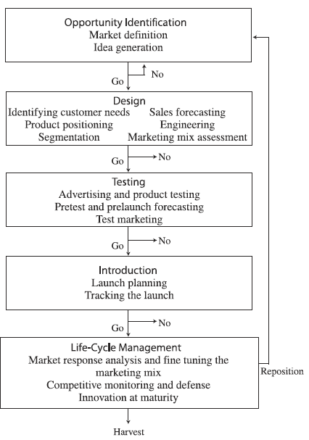
The various stages and decisions involved in the new product development process
New Product Development (NPD) stages
➔
Stage-Gate Model
High failure rates
High costs (e.g., 1.2 billion for a new drug)
Increasingly shorter product life cycle
https://www.stage-gate.com/discovery-to-launch-process/

Slide 4
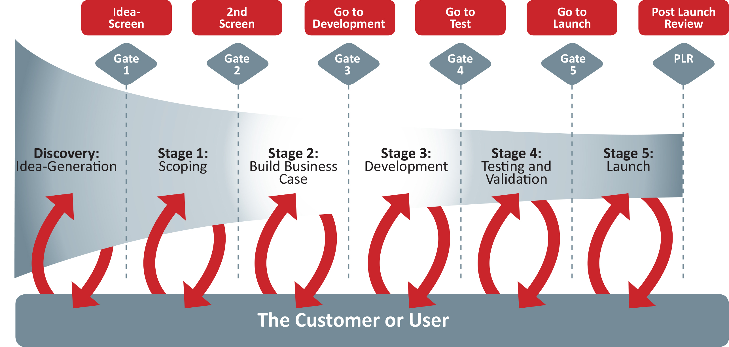
Stage-Gate Model for NPD
Idea screening
https://gembainnovation.dk/stage-gate/

Slide 5
GE/McKinsey portfolio designed to Evaluate New Product Ideas
Competitive Strength Dimensions (of Business Unit or product)
Fit with strategic focus of company.
Technical feasibility.
Resource requirements (finance, manufacturing, marketing).
Ability to protect intellectual property (IP).
Organizational and channel support.
Industry Attractiveness Dimensions
Size of potential market.
Growth rate of potential market.
Attractiveness of market (competitive superiority, profitability).
Regulatory compliance.

Slide 6
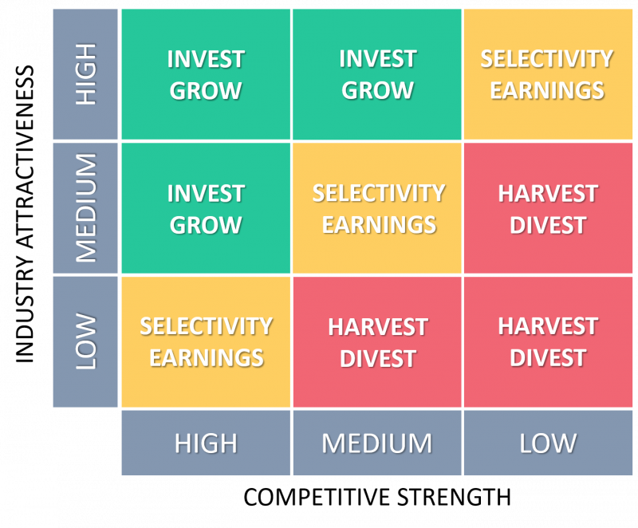
GE McKinsey Matrix➔ Portfolio Analysis Tool
Strategic implications
Invest/Grow strategy
Selectivity/Earnings strategy
Harvest/Divest strategy
https://www.mckinsey.com/business-functions/strategy-and-corporate-finance/our-insights/enduring-ideas-the-ge-and-mckinsey-nine-box-matrix
https://thinkinsights.net/strategy/ge-mckinsey-matrix/

Slide 7
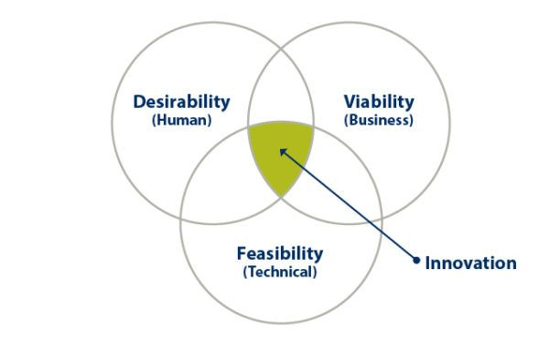
Value of Good Design
80% of a product’s manufacturing costs are incurred during the first 20% of its design (varies with product category).
Source: Mckinsey & Company Report
Conjoint Analysis is a systematic approach for matching product design with the needs and wants of customers, especially in the early stages of the New Product Development process.
Design Thinking is another useful approach!!!➔ Human Centered
Notes:
The McKinsey report is based on the following influential paper that appeared in 1983. The reported figure is an average and varies by product category.
Reinertsen, Donald (1983), Whodunit? The search for new product killers, Electronic Business, Vol. 9, p. 62-65.
*Reinertsen, Donald (1983), Whodunit? The search for new product killers, Electronic Business, Vol. 9, p. 62-65.

Slide 8
Impact of Product Superiority on Product Success
Mkt Share
53.5%
Mkt Share
32.4%
Mkt Share
11.6%
Product Superiority
Based on a study of 203 products in B2B -- Robert G. Cooper, Winning at New Products (1993) . Success measured using four factors:
whether it met or exceeded management’s criteria for success,
the profitability level (1-10 scale),
market share at the end of three years, and
whether it met company sales and profit objectives (1-10 scale).

Slide 9
Impact of Early Product Definition on Product Success
Mkt Share
37.3%
Mkt Share
36.5
Mkt Share
22.9
Product Definition
Source: Robert G. Cooper, Winning at New Products (1993)

Slide 10
Impact of Market Attractiveness on Product Success
Mkt Share
36.5%
Mkt Share
33.7
Mkt Share
31.7
Market Attractiveness
Source: Robert G. Cooper, Winning at New Products (1993)

Slide 11
Resources Allocated at Each Stage of NPD
Source: Robert G. Cooper (1993)
Notes:
Although design has great impact on a product’s costs and success, it does not get as high a level of resources it deserves.

Slide 12
想像力➔創造力
想像力是連結兩個或兩個以上的概念，並將這些概念結合在一起成為新概念。概念結合的想像力是創造力的重要泉源。
Ex. 筆記本 + 電腦 = 筆記型電腦
Ex. 毒品 + 狗 = 緝毒犬
創造力(創意)是要超越現有的框架和界限，找出並且重新定義事物和事物之間的相關性。或是將一事物中的元素拆解後，予以增刪替換，再重新組合，以提供不同的功能，滿足不同的需求。

Slide 13
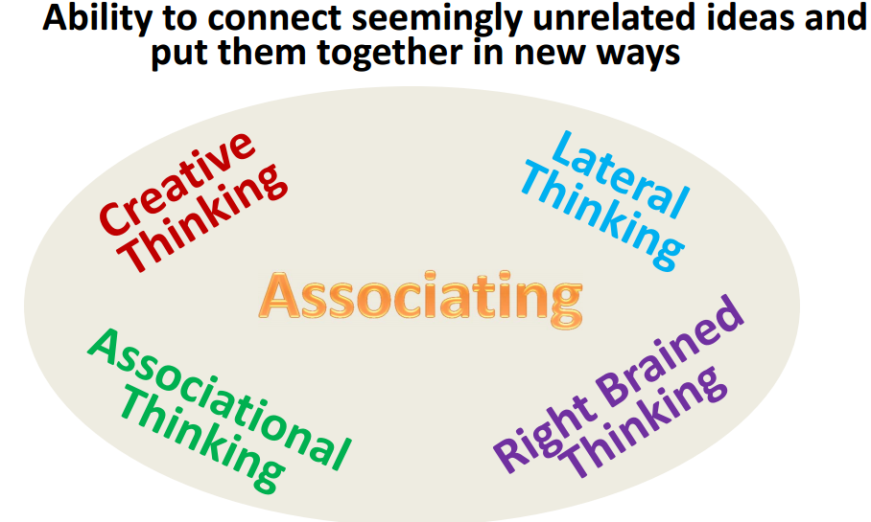
Where Do Innovative Ideas Come From?
http://krm.vo.llnwd.net/o43/u/hbs0011408/21666/216661a.pdf

Slide 14

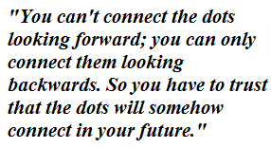
觸類旁通
Calligraphy and Mac ➔ It was the first computer with beautiful typography proportionally spaced fonts.
-- Steve Jobs

Slide 15
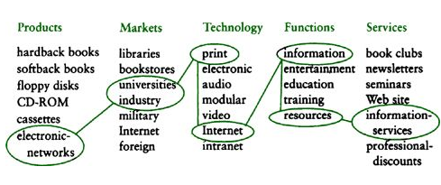
物相雜，故曰文 Making Novel Combinations
六爻相雜，唯其時物也。
The six lines are mixed together, according to the time and their substance.
道有變動，故曰爻；爻有等，故曰物；物相雜，故曰文；文不當，故吉凶生焉。
This Way is marked by changes and movements, and hence we have the imitative lines. Those lines are of different grades representing people, things, objects. They are mixed together, and elegant forms arise. When such forms are not in their appropriate places, the ideas of good fortune and bad are thus produced. - The Book of Changes http://ctext.org/book-of-changes/xi-ci-xia

Slide 16
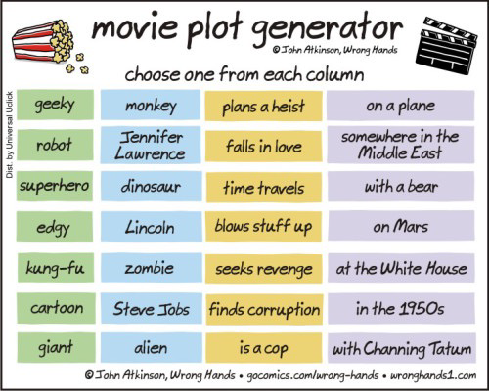
The Writer's Plot Idea Generator
random story ideas
http://writers-den.pantomimepony.co.uk/writers-plot-ideas.php
https://wronghands1.com/2016/02/05/movie-plot-generator/

Slide 17
Conjoint Analysis
联合分析
(組合分析)
(“Considered jointly”)
https://www.qualtrics.com/experience-management/research/types-of-conjoint/
https://www.easyatm.com.tw/wiki/組合分析
https://www.youtube.com/watch?v=5-CI3ZVcOZk with Enginius

Slide 18
联合分析与新产品开发
通常,产品或服务具有多种能、属性款式、包装、价格水平等,而每一个消费者对于他们的偏好各不相同,企业不可能设计出完全满足所有消费者共同需求的产品。
另一方面,消费者心中对于各种产品的功能属性之间也存在着一种微妙的权衡和取舍,如果企业不能够深入了解这其中的关系,而是一味地追求产品各方面属性的"卓越",投入巨资开发出各方面都是最先进、质量最好的产品,或者开发全方位的产品线来满足所有消费者的差异化需求,都会面临很大的市场风险。消费者可能并不愿意付出与开发成本相对等的高价格来购买该产品,或者说巨额的成本投入不一定能够换取最好的回报。
因此,企业在进行新产品开发时,需要解决以下几个问题:
了解产品各个功能属性中,每个功能属性的地位及其在消费者心目中的重要程度如何;
当各个属性出现矛盾时,消费者如何权衡和取舍;
根据消费者偏好的属性,开发设计出最受消费者欢迎的产品组合。

Slide 19
What is Conjoint Analysis?
Conjoint Analysis is a systematic approach for new product /offering design based on the "derived importance" of the attributes of offerings that will provide the most value to both customers and the company.
The analysis can be completed before a product is prototyped.
The new product can be designed to win in the marketplace against existing competing products.
It embeds the tradeoffs that customers make when choosing products, i.e., customers cannot get everything they want in an offering, especially all for the same price.
It allows for designing products with different features for different customer segments.
It leads to development of products that meet management targets (for market share, profitability, etc.)

Slide 20
联合分析与新产品开发
在联合分析中,产品(服务)被描述为轮廓(profile),每一个轮廓由能够描述产品(服务)重要特征的属性(attribute)以及赋予每一个属性的不同水平/ 選項(level / option)的组合构成。
例如Surface Pro: Quad-core 10th Gen Intel® Core™ i7 CPU、16G内存、512G硬盘, 定义了一个具体的笔记本电脑。
联合分析的一个重要基本假定是:消费者根据构成产品(服务)的多个属性来进行偏好(preference)判断; 消费者对产品(服务)的偏好每次并不是基于一个因素而是基于几个因素的组合綜合来判断的,消费者对某一“轮廓”的偏好可以透過演算法分解成构成该轮廓的多个属性水平的偏好得分。
联合分析能够较好地模拟消费者购买的实际过程,从而相对客观、真实地测量消费者对某一产品轮廓的偏好及产品不同属性及其水平在购买过程中的不同重要性。

Slide 21
联合分析
联合分析的基本思想是通过设定某些产品具有某些属性,对产品的不同属性进行模拟组合,然后让消费者根据自己的喜好对这些虚拟产品属性组合进行判断(打分或排序)
然后运用数理统计方法将这些特征与特征水平分离,从而对每一特征及特征水平做出效用评价,以达到分析消费者选择行为的目的,并最终找出符合消费者消费心理的最优产品组合。
企业使用联合分析方法的主要目的有以下三个方面:
确定消费者对某个变量(水平)貢献和效用的感知以及各个属性的相对重要性;
找消费者可接受的某种产品的最佳属性组合,这种组合初可能并没有被消费者所认知;
模拟市场,估计市场佔有率和市场佔有率变化趋势。

Slide 22
在联合分析的过程中,还需要注意几个方面
设计产品时,必须在提供给顾客的各种产品属性和利益之间进行权衡与取舍。
必须将产品或者服务分解成为若干可控的对顾客有意义的基本属性。
可以将现有产品视为各种属性水平的组合,新产品由这些基本的属性之不同的水平重新组合而成。
可用文字或者图片真实地描述产品属性组合,也可以就实际产品进行评分。
联合分析方法的局限主要表现在产品对消费者的总效用等于该产品各个属性的效用之和。因此,一种产品在某一属性的效用值很高,可能会弥补其他属性的不足,但是在许多情况下,消费者的选择是不能互相补偿的,比如不管其他属性有多好,顾客都不可能购买。性能存在问题的笔记本电脑,此时,联合分析可能会导致错误的结论。
在联合分析中如果涉及的属性过多,将会增加调研对象评价各种产品属性组合的工作量,可能会导致不准确的答复。

Slide 23
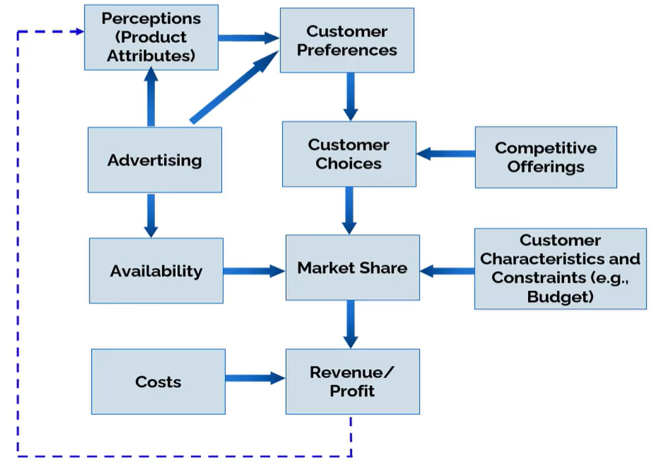
The Value of Conjoint Analysis: New Product Design for Market Success
With Conjoint Analysis, we can "reverse" this process by determining the product attributes that can achieve a desired market share or revenue.

Slide 24
What Does Conjoint Analysis Do? (Measure Importance by Assessing Preferences)
The basic outputs of conjoint analysis are:
  A numerical assessment of the relative importance that customers attach to attributes of a product category
  The value (utility) provided to customers by each potential feature (attribute option) of an offering
  Identification of product designs that maximize market share or other indices.
Information from conjoint analysis is used in the following EXCEPT ______.
A brand extension
B pricing
C sampling
D new product design
Notes:
C is incorrect!

Slide 25

Managerial issues
Managerial issues we will address:
How to understand and quantify what consumers value, like, dislike and prefer?
How to link consumers’ preferences to consumers’ choices?
How to evaluate potential market shares of new product offerings, and product cannibalization(產品自相殘殺)?
How to identify market opportunities for new product offerings?

Slide 26
Example of Attributes & Levels (Options)
Color
  Red
  Blue
  Green
  Black
Warranty
  No warranty
  1-year warranty
  3-year warranty
Brand
  Samsung
  Acer
  HP
Number of stops
  Non-stop flight
  1 stop
  2 stops or more
Meat cooking
  Rare
  Medium-rare
  Medium
  Well done
Customer ratings
  5 stars
  4 stars
  …

Slide 27
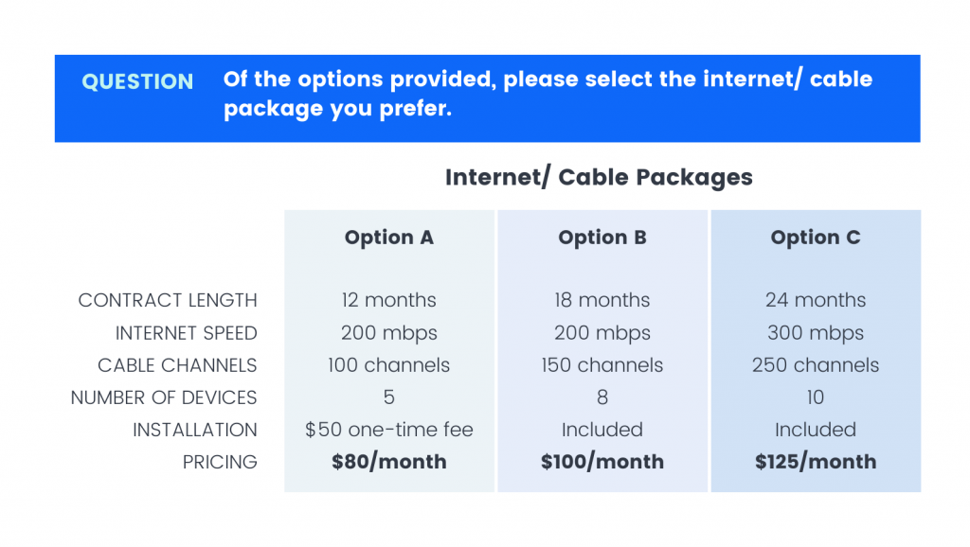
Conjoint Analysis
Bundling product with service ➔
Price can be an attribute
⬅⬅
Getting familiar with conjoint analysis - Pollfish Resources
Conjoint Analysis (pollfish.com)

Slide 28
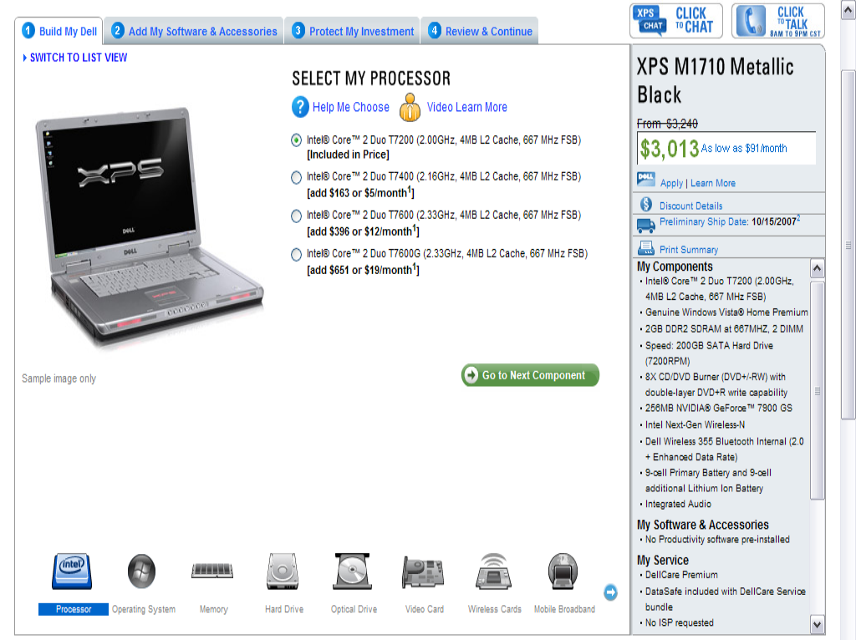
Example of of Selecting Attributes & Levels➔ Mass Customization
ATTRIBUTE LEVELS FOR THE
“PROCESSOR” ATTRIBUTE

Slide 29
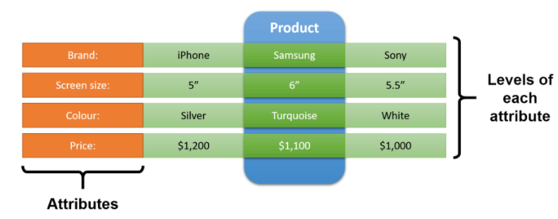

Conjoint Analysis
Conjoint analysis works by breaking a product or service down into its components (referred to as attributes and levels) and then testing different combinations of these components to identify consumer preferences.
Profile
What is Conjoint Analysis? - Conjoint.ly (conjointly.com)
Come with Exel tool

Slide 30
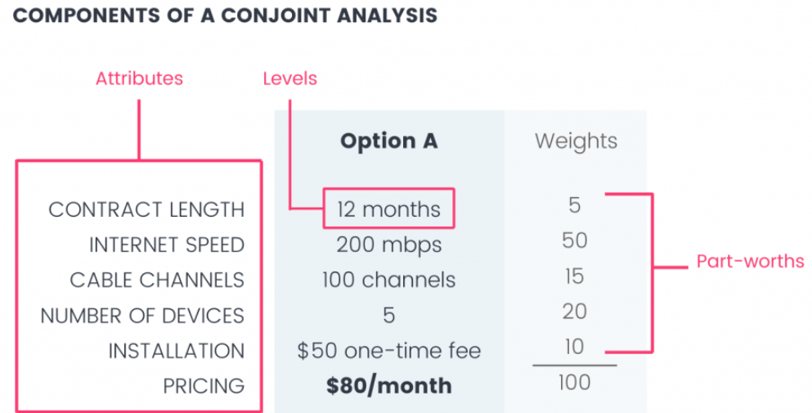
Conjoint Analysis
Part-Worths
(部分價值)
Profile
Getting familiar with conjoint analysis - Pollfish Resources Conjoint Analysis (pollfish.com)

Slide 31
Products, Product Attributes, and Attribute Levels
Product
Attribute
Attribute
Attribute
Level
Level
Level
Level
Level
Level
Level

Slide 32





Products, product attributes, and attribute levels
Your next vacations
Transportation
Destination
Budget
Plane
Bus
Beach
Mountain
450 €
600 €
800 €

Slide 33
Products are bundles of attribute levels
A product profile is simply a bundle (combination) of attributes at different levels
Product 1 Beach, by Plane, for 450 €
Product 2 Mountain, by Plane, for 600 €
Product 3 Beach, by Bus, for 800 €
Etc.
2 × 2 × 3 = 12 different products (and nothing more!)
Transportation
Destination
Budget
Plane
Bus
Beach
Mountain
450 €
600 €
800 €
Notes:
Here, it is important to insist on the fact that any factor that is not “coded” into an attribute is irrelevant.
For instance, whether the vacation is sold by JetAir or Air France doesn’t matter, because “Brand” is not an attribute. People are indifferent between the two.
It’s hence very important to well define the correct attributes and attribute levels when you design a conjoint study, if you want to correctly capture preferences.

Slide 34
Preference partworths
A value is associated with each level to indicate preference
Transportation
Destination
Budget
Plane
Bus
Beach
Mountain
450 €
600 €
800 €
25
0
20
0
55
20
0
Notes:
Here, insist on the fact that to get reliable estimates of these numbers is the real trick… And we will get there later.
A few questions to ask here:
Do this customer prefer the Beach or the Mountain?
Do this customer prefer Plane or Bus?
What’s most important for this customer? Transportation or Destination? (transportation)
If the trip in bus costs 600 €, is this customer willing to pay 200 € more to go by plane? (yes, gains 5 preference points in the process)
If vacations to Mountain costs 600 €, is this customer willing to pay 200 € more to go to the Beach? (he’s indifferent)

Slide 35
From Preference Partworths to Product Preferences
The preference score for a product becomes
the sum of the part-worth preference scores for
attributes at various levels of that product.
Product 1 : Beach (20), by Plane (25), for 450 € (55) = 100
Product 2 : Mountain (0), by Plane (25), for 600 € (20) = 45
Product 3 : Mountain (0), by Bus (0), for 800 € (0) = 0
Since Product 1 is preferred to Product 2, it is “more likely” to be purchased.
(Later, preferences can be translated into choices)
Notes:
Clearly insist that most preferred items are not always bought, for various reasons (randomness, variety seeking) – we’ll talk about that in details later.

Slide 36
Comments
For simplicity, preference for products are scaled between 0 and 100
  Worst levels = 0
  Sum of most preferred levels = 100
  (done automatically by the software)
Of course, people prefer to pay less!
  What’s important is how strong these preferences for low prices are, compared to preference for other attributes
Preferences vary across customers
  Later, we will see customers can be segmented based on their preference partworths, to build segments of customers who share similar preferences

Slide 37
Preference Partworth Estimation
The question then becomes “how to estimate these preference partworths?”
You can’t ask  not reliable
You have to estimate it indirectly through
conjoint analysis
(“considered jointly”)
Notes:
If you ask the following question to a consumer:
“You have two shirts. They are absolutely identical on all dimensions, quality, color, everything. One has a Lacoste logo, the other does not. How much more are you willing to pay for the one with the Lacoste logo?”
Most people will underestimate the real value they would be willing to pay – consciously or not. You can’t measure how much the attribute “brand” is worth directly, you need indirect methods. That’s what we explain next.

Slide 38
Preference Partworth Estimation Steps 1 & 2 - Profile Generation and Rating
First, create a list of products
  Also referred to as “bundles” or “profiles”
Ask respondents to rate them on a scale (e.g., 0-100, 1-10)
  Also referred to as “preference scores” on the overall products.
Profile #1
Profile #2
Profile #3
Bus
Beach
450 €
Plane
Beach
600 €
Bus
Mountain
800 €
75
65
?
  (NB: other conjoint estimation techniques exist: choice-based conjoint, ranking, etc.)
Notes:
Respondents rate products as a whole. It will indirectly give more precise estimates.

Slide 39
Preference Partworth Estimation
Steps 3 – regression analysis
Third, run a regression analysis to estimate each attribute level’s contribution to the overall preference score.

Slide 40
Preference partworth estimation Steps 3 – regression analysis
Transportation |  | Destination |  | Budget |  |  | Score
Plane | Bus | Beach | Mountain | 450 € | 600 € | 800 €
 | ✓ | ✓ |  | ✓ |  |  | 75
✓ |  | ✓ |  |  | ✓ |  | 65
 | ✓ |  | ✓ |  |  | ✓ | 0
✓ |  |  | ✓ | ✓ |  |  | 80

Slide 41
Preference Partworth Estimation Steps 3 – regression analysis
Transportation |  | Destination |  | Budget |  |  | Y
X₁ | X₂ | X₃ | X₄ | X₅ | X₆ | X₇
0 | 1 | 1 | 0 | 1 | 0 | 0 | 75
1 | 0 | 1 | 0 | 0 | 1 | 0 | 65
0 | 1 | 0 | 1 | 0 | 0 | 1 | 0
1 | 0 | 0 | 1 | 1 | 0 | 0 | 80
X_{y}: is this attribute level present in that profile? 1=yes, 0=no
Notes:
The next slides show step by step how customers’ ratings are input into a regression analysis.
First, put a 1 if the level is present, 0 if not.

Slide 42
Preference partworth estimation Steps 3 – regression analysis
Transportation |  | Destination |  | Budget |  |  | Score
Plane | Bus | Beach | Mountain | 450 € | 600 € | 800 €
 | ß₂ | ß₃ |  | ß₅ |  |  | =75
ß₁ |  | ß₃ |  |  | ß₆ |  | =65
 | ß₂ |  | ß₄ |  |  | ß₇ | =0
ß₁ |  |  | ß₄ | ß₅ |  |  | =80
+
+
+
+
+
+
+
+
ß_{y}: contribution of that attribute level to the overall score
Notes:
Next, add a variable (to be estimated) that represents the preference score of each individual attribute level.
If the level is present, it’s multiplied by 1 and left unchanged.
If the level is absent, it’s multiplied by 0 and disappears from the equation.
It leads to a set of equations with ß1…ßn parameters to be estimated (regression analysis) to best predict the actual scores given by respondents.

Slide 43
Comments
Once you have computed preference partworths (ß’s), you can estimate how much a profile will be liked by the respondent
  Even products he did not rate
  Even products that do not exist yet
Let the software determine the list of profiles that will be rated (Experimental Design)
  Will ensure that statistical prerequisites of regression analysis are met (enough profiles to estimate everything, multicollinearity, etc.)
https://www.qresearchsoftware.com/experimental-design-for-conjoint-analysis

Slide 44
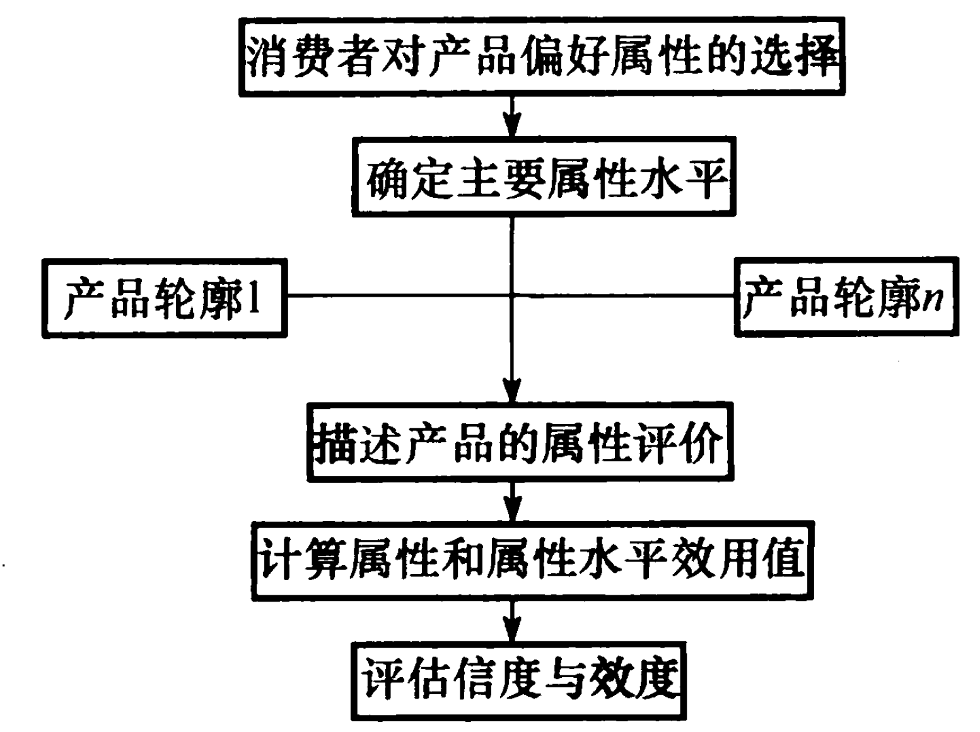

消费者对(現有及虚拟)产品輪廓1~n做评比

Slide 46
From preferences to choices
How to go from preferences to choices?
Profile | Preference score
Product A | 70
Product B | 20
Product C | 10
?
Probability of choice?
Notes:
Now that we know customers’ preferences (estimated through regression analysis), how can we transform these preferences into choices?
Let the students guess a little. Take various examples to contradict their first ideas.

Slide 47
From preferences to choices
How to go from preferences to choices?
Choice rule depends on the context
  High-stake decision? (house, a car) → First choice
  High variety seeking? (meals)? → Share of preference
  In-between? (clothes)? → Logit
  (if current market shares are known, the alpha-rule provides yet another rule, more precise and versatile)
Profile | Preference score
Product A | 70
Product B | 20
Product C | 10
First Choice | Logit | Share of preference | Random
100% | 83% | 70% | 33%
0% | 13% | 20% | 33%
0% | 4% | 10% | 33%
?
Notes:
PS: the “Random” option is just for pedagogical reasons. It is of course never used in practice.

Slide 48
Running simulations
Once you have…
  Defined attributes and levels
  Collected data (ratings) from a sample of your target customers
  Estimated preferences
  Linked preferences to choices
You can run simulations and estimate market shares if
  You increase price? Change characteristics of a product?
  You introduce a new product?
  Competition introduces a new product?
  Are there opportunities to introduce new products? Which ones?
  Cannibalization?
  Etc.

Slide 49
Simulation: example #1
What if we changed an existing product?
Profile #3
People prefer planes to buses
Let’s do it by plane, and slightly increase price to cover additional costs
Profile | Preference score | Market Share
Beach, 800 € by Plane | 45 | 31%
Beach, 600 € by Bus | 40 | 26%
Mountain, 450 € by Bus | 55 | 42%

Slide 50
Simulation: example #1
What if we changed an existing product?
Profile #3
People prefer planes to buses
Let’s do it by plane, and slightly increase price to cover additional costs
Profile | Preference score | Market Share | Delta
Beach, 800 € by Plane | 45 | 35% | +4%
Beach, 600 € by Bus | 40 | 30% | +3%
Mountain, 600 €, Plane | 45 | 35% | -7%
Profile | Preference score | Market Share
Beach, 800 € by Plane | 45 | 31%
Beach, 600 € by Bus | 40 | 26%
Mountain, 450 € by Bus | 55 | 42%
Notes:
If they apply this change, preferences will decrease because of increase in price, AND increase because of the preferred transportation option.
BUT in total the net effect is negative, so market shares are predicted to decrease.
NOW is a good time to talk about the fact that customers have heterogeneous preferences. This new option might be preferred by some, not by others, and that’s why we need a large sample of customers in conjoint analysis to understand who is affected, and to what extend. For example:
Some people might hate taking the plane
Others might hate taking the bus
Some might choose the cheapest option
Others might not be very price sensitive

Slide 51
Simulation: example #2
What if there were a new entrant?
Low-cost company
Profile | Preference score | Market Share
Beach, 800 € by Plane | 45 | 31%
Beach, 600 € by Bus | 40 | 26%
Mountain, 450 € by Bus | 55 | 42%

Slide 52
Simulation: example #2
What if there were a new entrant?
Low-cost company
Note: of the third product (Mountain, 450 €, by Bus) is offered by the same company, there is significant cannibalization(自相残杀)
Profile | Preference score | Market Share | Delta
Beach, 800 € by Plane | 45 | 15% | -16%
Beach, 600 € by Bus | 40 | 13% | -13%
Mountain, 450 €, By Bus | 55 | 21% | -22%
Beach, 450 € by Plane | 100 | 51% | +51%
Profile | Preference score | Market Share
Beach, 800 € by Plane | 45 | 31%
Beach, 600 € by Bus | 40 | 26%
Mountain, 450 € by Bus | 55 | 42%

Slide 53
Running a conjoint study
Stage 1: Design the conjoint study
    Select Attributes relevant to product/service category
    Select relevant Levels (options) for each Attribute
    Develop the "product bundles" (profiles) to be evaluated
Stage 2: Collect data from a sample respondents and estimate preference partworths
    Design a data collection procedure and collect data
    Estimate/compute preference partworths (using regression)
Stage 3: Exploit the results to evaluate product design options
    From preferences to choices: select appropriate choice rule
    Run simulations (market shares, new products)
    Segment customers based on their part-worth preferences
Notes:
Now that we know what we can do a with a conjoint analysis, we’ll discuss how to design and run one.
It’s important to note that students might decide to use conjoint for the term project – the next slides are important.

Slide 54
Stage 1: Design the conjoint study
Select relevant Attributes
  Ask consumers, managers, experts
  Analyze secondary sources (public media, brochures)
  Select between 4 and 6 attributes maximum
Select relevant Levels for each Attribute
  Ask managers, experts (product managers, manufacturers)
  Analyze secondary sources (public media, brochures)
  Be realistic, try to span all options present in the market
  Select between 2 and 4 levels maximum per attribute
  (Try to) include the same number of levels for each attribute
Develop the product bundles to be evaluated
  Let the software decide
  If some profiles do not make sense, review your design
Notes:
Being realistic:
If in a conjoint study analyzing preferences for cars, the price attribute includes 15000 EUR, 20000 EUR and 30000 EUR, and the brand attribute includes PEUGEOT, FIAT and FERRARI, it means some products might be “FERRARI at 15000 EUR”, which doesn’t make sense.
The problem comes from the fact that FERRARI and the other brands do not evolve in the same market, hence the design does not make sense. Be consistent and realistic.

Slide 55
Stage 2: Collect data and estimate preferences
Collect data
  Develop a survey (design, scale, prototypes)
  Select a sample of respondents
  Collect data from respondents
Estimate preference partworths (regression)
  Run a regression analysis on collected data
Profile #1
Bus
Beach
450 €

Slide 56
Stage 3: Exploit the results
From preferences to choices: choice rule
  What choice rule? (first-choice, share of preferences, etc.)
  Do you have market shares to estimate alpha-rule? (advanced)
Run simulations (market shares, new products)
  Replicate the existing market
  Select scenarios (new product, new entrant, changes)
  Run simulations
Segment customers based on preferences
  Preferences are heterogeneous in the population
  Regrouping similar customers might lead to great insights
  A new offering might have low global market shares (why?), but dominate a specific niche or segment (e.g., those who hate flying)

Slide 57
Other Issues That Can Be Addressed
Revenue/profit/market share potential of a new product
Find an optimal product by segment
Assess (but don't be afraid) cannibalization potential of new product to your own products!

Slide 58

Kirin Case Issues Explored Enginius
Market segments
Targeting
Product design
Simulation of market outcomes
  Choice rule
  Profit/market share
  Cannibalization
  Adjustments for awareness/distribution
Notes:
These slides are linked to the Kirin case and should be skipped if that case is not being used.

Slide 59

Example of Adjustments for Awareness and Availability
Brand name | Computed Market share (a) | Awareness X availability from case Exhibit (b) | (a)*(b) (c) | Normalized market share (c)/42.9
Kirin_new | 11.94 | 0.1 | 1.194 | 0.028
Heinekin | 13.85 | 1 | 13.85 | 0.323
Beck's | 13.14 | 0.4 | 5.256 | 0.123
Bass/Guiness | 12.11 | 0.21 | 2.5431 | 0.059
Amstel Light | 12.61 | 0.25 | 3.1525 | 0.073
Molson | 9.86 | 0.55 | 5.423 | 0.126
Corona | 15.18 | 0.6 | 9.108 | 0.212
Sapparo | 11.32 | 0.21 | 2.3772 | 0.055
 |  |  | 42.9038
Notes:
Conjoint analysis is done in a simulated settings, where consumers are assumed to be aware of all the products, all products are equally available, etc. To translate market shares from the simulations to real-world market shares, the computed shares from Conjoint Analysis should be adjusted for actual levels of awareness, availability, product usage index, etc. The above is an example of how this can be done in the Kirin case.

Slide 60
Draw/Cannibalization
Do before/after analysis
Exclude new product(s) before doing analysis
Do analysis with new product(s) included

Slide 61
Situations Where Conjoint Analysis Might Be Valuable
The new offering involves important tradeoffs affecting design, production, marketing, or other operational variables.
The offering is realistically decomposable into a set of basic attributes.
Consumer choices with respect to the offering and its market tends to be high involvement.
Factorial combinations of basic attribute levels are believable.
Desirable new offerings alternatives can be synthesized from basic alternatives.
The alternatives can be realistically described, either verbally or pictorially. (Otherwise, actual product formulations should be considered).
Perceptions of hypothetical combinations are reasonably homogeneous across members of the target group.
Notes:
Strengths of traditional conjoint:
Good for addressing both product design and pricing issues
Can be administered on paper, computer/internet
Shows products in full-profile, which many argue mimics real-world
Can be used even with very small sample sizes
Weaknesses:
Limited ability to study many attributes (more than about six)
Limited ability to measure interactions and other higher-order effects (cross-effects)
Artificial setting (to some extent this can be overcome with “choice-based conjoint” in which respondents choose their most preferred product within sets of product options, rather than rating each product option).

Slide 62
Summary: Utility of Conjoint Analysis
Design new offerings that enhance customer value.
Forecast sales/market share/profit of alternative offerings.
Identify market segments for which a given concept/offering has high value.
Identify the “best” concept/offering for a target segment.
Explore impact of alternative pricing and service strategies.
Plan production in flexible manufacturing systems.

Slide 63
Other Slides

Slide 64
Choice-Based Conjoint Question
Which PC would you purchase?
Compaq
500MHz
64 Meg Ram
21-inch monitor
$1,500
IBM
800MHz
128 Meg Ram
15-inch monitor
$1,250
Dell
1MHz
256 Meg Ram
17-inch monitor
$1,000
NONE: I wouldn’t purchase any of these

Slide 65
Conjoint Enhancements
Adaptive Conjoint
Choice-based Conjoint
Internet data collection tools
Improved input/output
Notes:
For more advanced classes, this slide can be used as a springboard to explore the different issues above. Otherwise the slide (and the following slide) should be skipped.

Slide 66
Other Aspects to Consider
Incorporate revenue potential of a product
  Market share × Incremental margin over base product
Design optimal product by segment
  Segment 1 (Value segment – 52.5% of the market): A thick-crust pizza with 6 Oz mixed cheese and pineapple (or sausage) topping priced at $7.99. This will get about 32% share and revenue index of around 100 (the same as the base product).
  Segment 3 (Premium segment -- 27.5% of the market): A pan pizza with 2 Oz of Romano cheese and pepperoni or sausage topping priced at $9.99. This will get 31% share of this segment and have revenue index of about 100.

Slide 67
Measuring Importance of Attributes
When choosing a restaurant, how important is…
Circle one
Not Very
Important Important
Decor 1 2 3 4 5 6 7 8 9
Location 1 2 3 4 5 6 7 8 9
Quality of food 1 2 3 4 5 6 7 8 9
Price 1 2 3 4 5 6 7 8 9
Notes:
This example illustrates the most common (and least reliable) type of measurement of customer-attribute importance.

Slide 68
Measuring Importance of Attributes
Notes:
If respondents are not forced to consider trade-offs, they will indicate that everything is important—and everyone wants a lot of features at a low price. Conjoint forces customers to make tradeoffs before they respond to questions.

Slide 69
Measuring Importance By Measuring Utility
For single-attribute products, an underlying preference or utility scale can be constructed as follows:
  If a customer tells you she prefers Blue to Red, Red to Yellow, and Blue to Yellow (transitivity), then you can create an underlying numeric scale with the following “utiles” to represent customer preferences for the three colors: assign 3 to Blue, 2 to Red, and 1 to Yellow; or you could assign 10 to Blue, 9.95 to Red, and 1 to Yellow. From this can we say whether this customer would prefer Orange to Red?
Note: Preferences represent a higher-order construct than Utility, i.e., utility comes from preferences.
How do we come up with an underlying scale to represent customer preferences for multi-attributed products?
Notes:
We seek a measurement system that will apply whether we are measuring preferences for restaurants, or entertainment, characteristics of your date, or for presidential candidates. If not, at the empirical level, there will be hopeless diversity of models and processes to characterize preferences. A key assumption of “rational choice theory” is that preferences are transitive. However, most observed preferences are not transitive. In that case, we may say that we are only concerned with behavior that is transitive (and that it applies in many situations), or we may contend that it is “close enough approximation to reality,” or we may limit ourselves to “idealized representations for theoretical purposes.” Here Orange is a color that falls between red and yellow, and if customer preferences are transitive, then this customer will prefer orange to yellow and red to orange.
If we have a measurement scale, then we do not have to constantly keep asking people what they like – we can make inferences about their preferences from the measured scale. (The lack of transitivity and other violations can be consistent with both theories of “preference construction” as well as “random utility” theory.)

Slide 70
Preference for Matt Damon Musical?
 | Type | Lead actor(s) | MPAA Rating | Released
Titanic | Drama | Leonardo Di Caprio Kate Winslet | PG-13 | 1997
A Beautiful Mind | Drama | Russell Crowe; Jennifer Connely | PG-13 | 2001
Scarface | Drama | Al Pacino | R | 1983
Syriana | Drama | George Clooney; Matt Damon | R | 2005
Top Gun | Action | Tom Cruise; Kelly McGillis | PG | 1986
The Bourne Supremacy | Action | Matt Damon; Franka Potente | PG-13 | 2004
Grease | Musical | Olivia Newton-John John Travolta | PG | 1978
Moulin Rouge | Musical | Nicole Kidman | PG-13 | 2001
New Movie -- Name? | Musical | Matt Damon | PG | 2006
Notes:
We start by assuming that people can give preference orderings for compound or conjoint objects/attributes.
If you prefer a CD by Bon Jovi for $20 over a CD by Beatles for $10, it implies that Bon Jovi is worth at least $10 more to you than Beatles. A number of such pairwise preferences can produce asymptotically interval utility scales for CD’s and money.
In the above example, Conjoint Analysis could be used to determine a person’s preferences for each attribute and attribute option, which can then be used to project that person’s liking for the Matt Damon musical (actually, Patrick Swayze or Travolta would be more credible than Matt Damon in a musical).

Slide 71
Simple Example of Conjoint Analysis
Product Option | Cuisine | Distance | Price Range | Preference Rank Value
1 | Italian | 1km | $10
2 | Italian | 1km | $15
3 | Italian | 11 km | $10
4 | Italian | 11 km | $15
5 | Thai | 1km | $10
6 | Thai | 1km | $15
7 | Thai | 11km | $10
8 | Thai | 11 km | $15
Notes:
Consider this simple example with 3 attributes at two levels each, resulting in world with eight potential types of restaurants. Pick a student and ask him/her to provide a rank ordering of these restaurant options (reverse ranks so that higher numbers indicate greater preference). After you get the rank orders for first 2 or 3 product profiles, ask students that those ranks suggest about preferences for attributes – for example, is cuisine more important for that student than distance?
Each level is assumed to be mutually exclusive of the others (a product has one and only one level of an attribute)

Slide 72
Simple Example of Conjoint Analysis
Product Option | Cuisine | Distance | Price Range | Preference Rank Value
1 | Italian | 1 km | $10 | 8
2 | Italian | 1 km | $15 | 6
3 | Italian | 11 km | $10 | 4
4 | Italian | 11 km | $15 | 2
5 | Thai | 1 km | $10 | 7
6 | Thai | 1 km | $15 | 5
7 | Thai | 11 km | $10 | 3
8 | Thai | 11 km | $15 | 1
Notes:
Ask students if given a certain rank ordering (as in the example above), which is the most important attribute for that student, and within that attribute (e.g., Italian versus Thai), which is the preferred option.
Summarize by pointing out how the ranks can be converted to a part-worth preference function to represent the preferences of that student (see next slide).

Slide 73
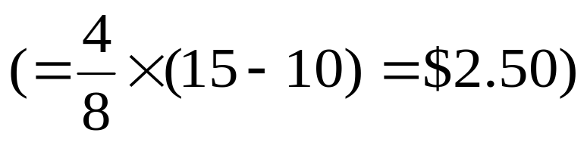
How to Use in Design/Tradeoff Evaluation
Example: Italian vs Thai = 20 – 16 = 4 util units
$10 vs $15 = 22 – 14 = 8 util units
So “Thai” is worth $2.50 more than “Italian” for this customer:
⇒ Can use to obtain value to customer of
service (non-price) attributes.
Notes:
The tradeoff approach allows us to compare “apples and oranges (distance and cuisine) on the same underlying metric. And, if we have include a price attribute, we can also convert every attribute option to an equivalent price for that option, as in the example above.
Given the part-worth function for a representative sample from the target population, then we would be able to predict which products (new or existing) would be preferred by those customers. This allows us to design simulations to assess how a new product would perform in the market when it competes with incumbent products.
Note that for distance, 11km vs 1km = 10 vs 26 util units, so 10 km closer is worth 16 util units. Since 8 util units = $5, this customer should be willing to pay $10 more to eat at a close restaurant of comparable quality, cuisine, etc. The key point is that the customer is never asked this question directly

Slide 74
Conjoint Study Process
Stage 1 —Designing the conjoint study:
Step 1.1: Select attributes relevant to the product or service category,
Step 1.2: Select levels for each attribute, and
Step 1.3: Develop the “product” bundles to be evaluated.
Stage 2—Obtaining data from a sample of respondents:
Step 2.1: Design a data-collection procedure, and
Step 2.2: Select a computation method for obtaining part-worth functions.
Stage 3—Evaluating product design options:
Step 3.1: Segment customers based on their part-worth functions,
Step 3.2: Design market simulations, and
Step 3.3: Select choice rule.
Notes:
It is worthwhile illustrating how these several stages are implemented in the Enginius software.

Slide 75
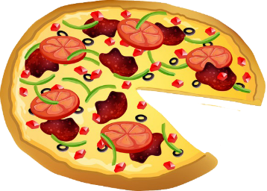
Designing a Frozen Pizza
Attributes Type of crust (3 types) Type of cheese (3 types) Price (3 levels) Topping (4 varieties) Amount of cheese (2 levels)
Crust Pan Thin Thick | Topping Pineapple Veggie Sausage Pepperoni |  | Type of cheese Romano Mixed cheese Mozzarella
Amount of cheese 2 Oz. 6 Oz. |  | Price $9.99 $8.99 $7.99
Note: The example in the book also has a 4 oz option for amount of cheese. A total of 216 (3x4x3x2x3) different pizzas can be developed from these options!
Notes:
This is another good example to use in the ME software.

Slide 76
Designing a Frozen Pizza Example: Paired Comparison Data
 | Aloha Special | Meat-Lover’s treat
Crust | Pan | Thick
Topping | Pineapple | Pepperoni
Type of cheese | Mozzarella | Mixed cheese
Amount of cheese | 2 Oz | 6 Oz
Price | $8.99 | $9.99
Which do you prefer? Which one would you buy?

Slide 77
Designing a Frozen Pizza: Example Ratings Data
Attributes/ Bundles | Type of crust | Topping | Type of cheese | Amount of cheese | Price | Customer 1 Rattings
Bundle 1 | Pan | Pineapple | Romano | 2 Oz. | 9.99 | 10
Bundle 2 | Thin | Pineapple | Mixed | 6 Oz. | 7.99 | 40
Bundle 3 | Thick | Pineapple | Mozarella | 2 Oz. | 8.99 | 5
Bundle 4 | Thin | Pineapple | Mixed | 6 Oz. | 8.99 | 80
Bundle 5 | Pan | Veggie | Mixed | 2 Oz. | 8.99 | 30
Bundle 6 | Thin | Veggie | Romano | 6 Oz. | 8.99 | 5
Bundle 7 | Thick | Veggie | Mixed | 2 Oz. | 7.99 | 90
Bundle 8 | Thin | Veggie | Mozarella | 6 Oz. | 9.99 | 45
Bundle 9 | Pan | Sausage | Mozarella | 6 Oz. | 7.99 | 60
Bundle 10 | Thin | Sausage | Mixed | 2 Oz. | 9.99 | 15
Bundle 11 | Thick | Sausage | Romano | 6 Oz. | 8.99 | 25
Bundle 12 | Thin | Sausage | Mixed | 2 Oz. | 8.99 | 45
Bundle 13 | Pan | Pineapple | Mixed | 6 Oz. | 8.99 | 85
Bundle 14 | Thin | Pineapple | Mozarella | 2 Oz. | 8.99 | 90
Bundle 15 | Thick | Pineapple | Mixed | 6 Oz. | 9.99 | 100
Bundle 16 | Thin | Pineapple | Romano | 2 Oz. | 7.99 | 35

Slide 78
Conjoint Utility Computations
k _{j}
m
P: A particular product/concept of interest
U(P): The utility associated with product P
a_{ij}: Utility associated with the jth level (j = 1, 2, 3...k_{j}) on the ith attribute
k_{j}: Number of levels of attribute i
m: Number of attributes
x_{ij}: 1 if the jth level of the ith attribute is present in product P, 0 otherwise
U(P) = Σ Σ a_{ij}x_{ij}
j=1
i=1
Notes:
While this slide looks complicated, explain to the students that the formula just adds up the individual utility part-worth to come up with a total utility for an offering.

Slide 79
Part-Worth Computation: (Designing a Frozen Pizza)
Repondents/Attributes ans Levels | Customer 1 | Customer 2 | Customer 3
Pan | 1 | 14 | 11
Thin | 0 | 5 | 0
Thick | 8 | 0 | 11
Pinapple | 0 | 69 | 0
Veggie | 7 | 64 | 8
Sausage | 2 | 0 | 64
Pepperoni | 35 | 5 | 59
Romano | 0 | 6 | 1
Mixed | 33 | 0 | 2
Mozarella | 25 | 5 | 0
2 Oz. | 0 | 1 | 0
6 Oz. | 12 | 0 | 3
9.99 | 0 | 10 | 20
8.99 | 3 | 0 | 0
7.99 | 11 | 1 | 7
*Base product for customer 1: Thin pizza with pineapple, 2 oz of Romano cheese, and priced at $9.99.
Notes:
Here is the output in the software for three customers

Slide 80
Market Share and Revenue Share Forecasts
Define the competitive set – this is the set of products from which customers in the target segment make their choices. Some of them may be existing products and, others concepts being evaluated. We denote this set of products as P₁, P₂,...P_{N}.
Select Choice rule
  Maximum utility rule
  Share of preference rule
  Logit choice rule
  Alpha rule
Software also has a “Revenue index option” wherein you can compute the revenue index of any product compared to the revenue index of 100 for a base product you select.
Notes:
To compute preference share or market share, we need to convert preferences to choices using a “choice rule.” The software includes different approaches for doing that.

Slide 81
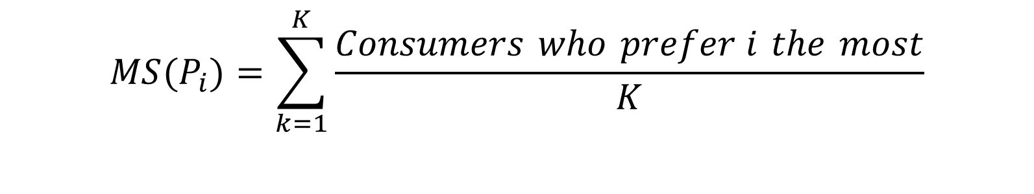
Maximum Utility Rule (Example)
Under this choice rule, each customer selects the product that offers him/her the highest utility among the competing alternatives. Market share for product P_{i} is then given by:
K is the number of consumers who participated in the study.
$$MS(P_{i})=\sum_{k=1}^{K}{\frac{Consumers who prefer i the most}{K}}$$

Slide 82
Other Choice Rules
Share of utility rule: Under this choice rule, the consumer selects each product with a probability that is proportional to the utility of that compared to the total utility derived from all the products in the choice set.
Logit choice rule: This is similar to the share of utility rule, except that it gives larger weights to more preferred alternatives and smaller weights to less preferred alternatives.
Alpha rule: Modified version of share of utility rule. Before applying the share of utility, the utility functions are modified by an “alpha” factor so that the computed market shares of existing products are as close as possible to their actual market shares.

Slide 83
Market Share Computation (Designing a Frozen Pizza)
Consider a market with three customers and three products:
 | Aloha Special | Meat-Lover’s Treat | Veggie Delite
Crust | Pan | Thick | Thin
Topping | Pineapple | Pepperoni | Veggie
Type of Cheese | Mozzarella | Mixed Cheese | Romano
Amount of Cheese | 6 oz | 6 oz | 2 oz
Price | $8.99 | $9.99 | $7.99
Notes:
In order to run a market simulation, you must include all available alternatives that a customer will consider.

Slide 84
Market Share Computation (Designing a Frozen Pizza)
Utility (Value) of each product for each customer.
Maximum Utility Rule: If we assume customers will only buy the product with the highest utility, the market share for Meat Lover’s treat is 2/3 and for Aloha Special is 1/3.
Share of preference rule: If we assume that each customer will buy each product in proportion to its utility relative to the other products, then market shares for the three products are: Aloha Special (29.3%), Meat Lover’s Treat (48.1%) and Veggie Delite (22.6%).
 | Aloha Special | Meat-Lover’s Treat | Veggie Delite
Customer 1 | 41 | 88 | 18
Customer 2 | 88 | 15 | 77
Customer 3 | 14 | 95 | 16
Notes:
This slide shows how two different choice rules lead to different market share projections.

Slide 85
Identifying Segments Based on Conjoint Part Worths
Variable | Overall | CL1 | CL2 | CL3
Pan | 18.1 | 12.6 | 8.12 | 36.1
Thin | 10.3 | 4.67 | 28.1 | 8.00
Thick | 14.9 | 20.1 | 2.50 | 13.8
Romano | 8.45 | 7.29 | 8.00 | 11.0
Mixes Chee | 11.4 | 15.0 | 9.38 | 5.82
Mozzarella | 11.0 | 13.9 | 8.00 | 7.64
9.99 | 2.00 | 3.48 | 0.00 | 0.636
8.99 | 10.8 | 6.14 | 22.9 | 10.8
7.99 | 16.7 | 12.9 | 27.1 | 16.4
Pineapple | 7.90 | 11.1 | 5.62 | 3.45
Veggie | 6.22 | 6.86 | 6.00 | 5.18
Sausage | 8.88 | 10.0 | 6.38 | 8.55
Pepperoni | 7.93 | 7.33 | 5.88 | 10.5
2-0z | 6.90 | 3.10 | 9.75 | 12.1
6-0z | 690 | 10.8 | 1.50 | 3.36
Cluster
Proportion |  | .525 | .200 | .275
Note: You should not use standardize option in segmentation software when determining segments.
Notes:
The part worths can also be used within the Segmentation and Classification software in Enginius to determine the number of distinct value-based segments in a market.
Note, part-worth data should not be standardized before using them within cluster analysis; doing so makes every attribute equally important, undermining the conjoint analysis process.

Slide 86
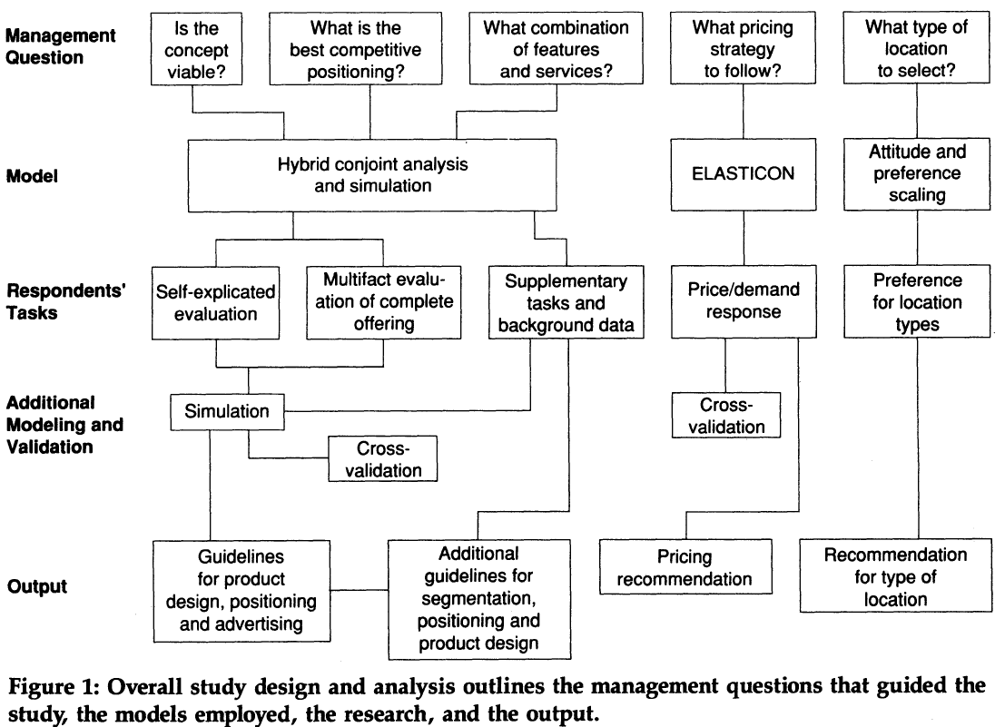
Wind, Green, Shifflet, and Scarborough, “Courtyard by Marriott: Designing a Hotel Facility with Consumer-Based Marketing Models” Interfaces, INFORMS, vol. 19(1), 1989, pages 25-47, February. (link)

Slide 87
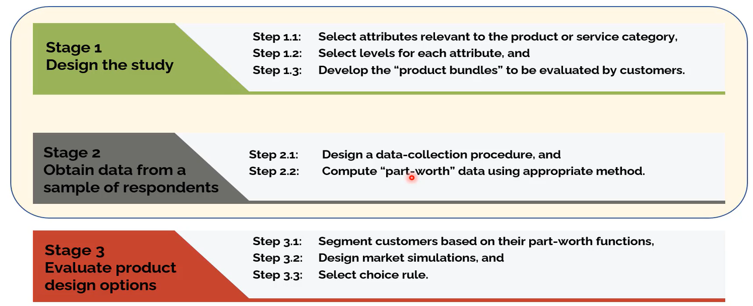
Conjoint Analysis Process

Slide 88
Market Strategy/Business Analysis for New Product/Services
Category | Meaning | Purpose
Product | Finalizing the product based on the concept testing report | Product Design Branding Strategy Level of services offered
Price | Strategizing around product licensing cost, estimating profit margins, and creating an unbeatable marketing strategy | Pricing Strategy Discounting Policies Payment Modes
Promotion | Distinguishing the new solution from others by highlighting the hero point or unique feature | Balancing advertising, marketing, and public relations strategy The mediums to reach out to the target audience Maintaining a fair to-and-fro customer communication frequency limit
Placement | Communicating how it solves the key problems of the customer | Finalizing product distribution strategies Defining the product’s scope, i.e., local vs Global
https://www.netsolutions.com/insights/everything-about-new-product-development/
Notes:
Taking a deeper look at each of these aspects in detail will provide greater clarity.
Unworkable: Figure out whether the brainstormed product concepts will address some real problems. Will the product be able to fill the existing customer experience gaps and will the product achieve product-market fit?
Unavoidable: Is the problem the product will address unavoidable to the extent that it becomes mandatory to comply? It is necessary to find out whether solving that problem is a choice or a compulsion.
Urgent: Is the problem urgent and is a solution highly demanded by the target market? If the answer is affirmative, this could be a chance to cover the white space in the market with the original product.
Underserved: Are there no available products that address the existing user problems? Look for the whitespace in the market and hold on to the idea that looks promising.

Slide 89
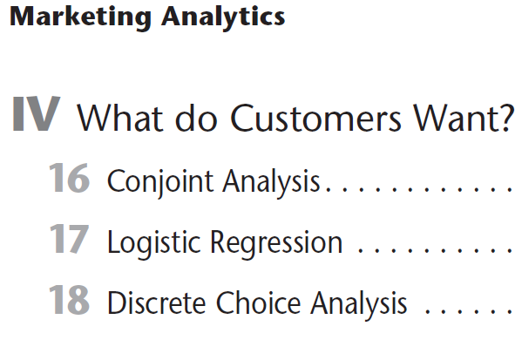
Marketing Analytics: Data-Driven Techniques with Microsoft® Excel, Chapter 16-18

Slide 90
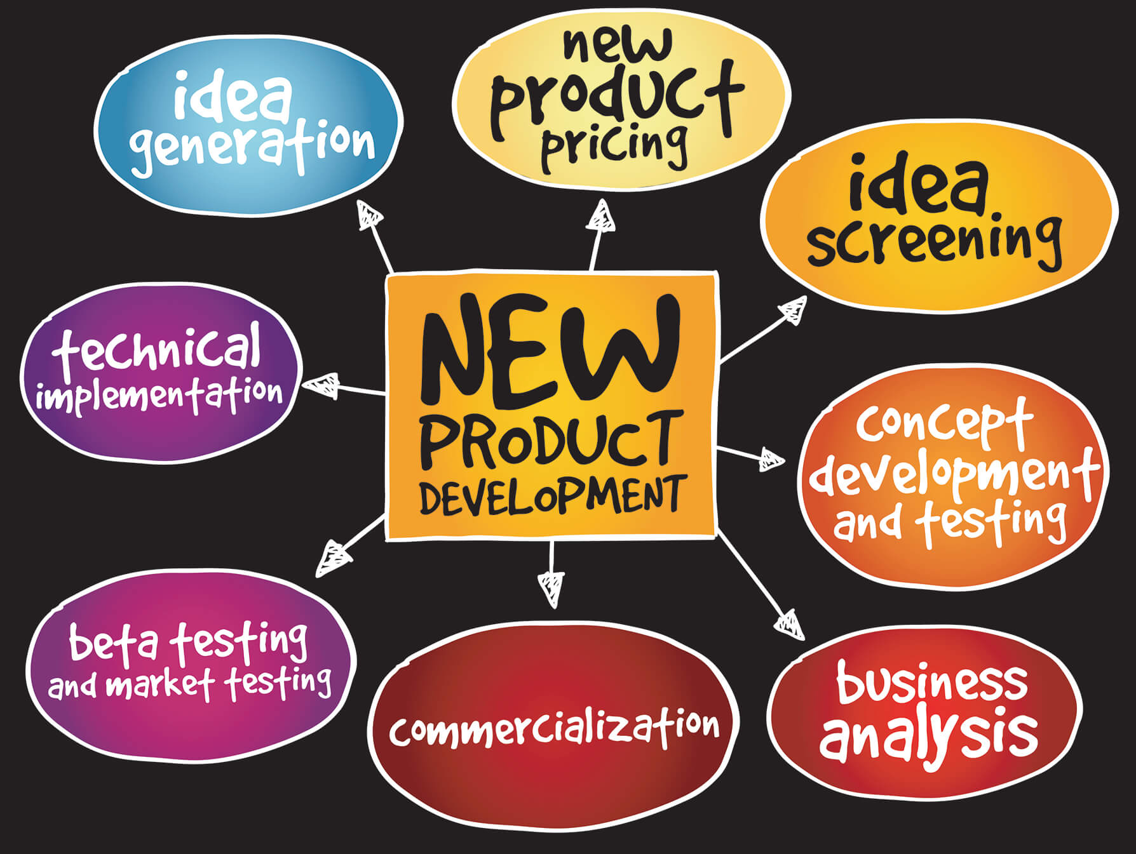
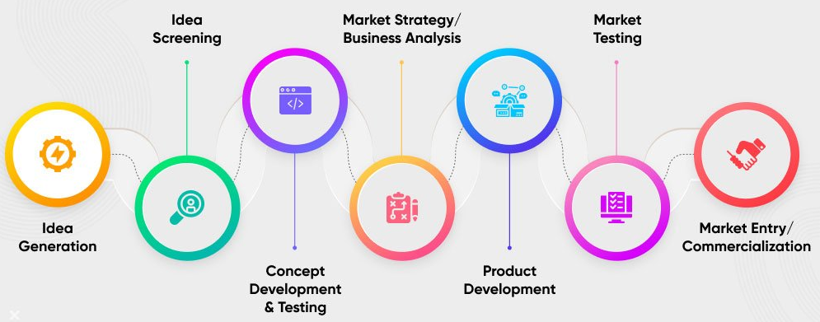
New Product/Services Process
LINK ➔
Market Testing
https://www.netsolutions.com/insights/everything-about-new-product-development/
Notes:
Taking a deeper look at each of these aspects in detail will provide greater clarity.
Unworkable: Figure out whether the brainstormed product concepts will address some real problems. Will the product be able to fill the existing customer experience gaps and will the product achieve product-market fit?
Unavoidable: Is the problem the product will address unavoidable to the extent that it becomes mandatory to comply? It is necessary to find out whether solving that problem is a choice or a compulsion.
Urgent: Is the problem urgent and is a solution highly demanded by the target market? If the answer is affirmative, this could be a chance to cover the white space in the market with the original product.
Underserved: Are there no available products that address the existing user problems? Look for the whitespace in the market and hold on to the idea that looks promising.

Slide 91
Resources
Conjoint Analysis in 2 minutes – YouTube
https://en.wikipedia.org/wiki/New_product_development
What Can Conjoint Analysis Do for You? – YouTube
Conjoint Analysis 101: with example for New Product Development (September 2021) – YouTube
http://www.Conjoint.lt

Slide 92
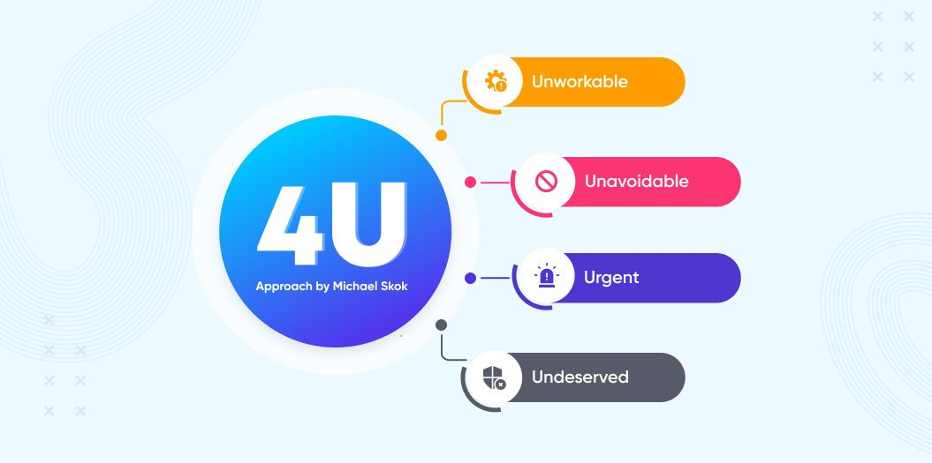
4U to Qualify Problems that New Product/Services Try to Solve
https://www.netsolutions.com/insights/everything-about-new-product-development/
Notes:
Taking a deeper look at each of these aspects in detail will provide greater clarity.
Unworkable: Figure out whether the brainstormed product concepts will address some real problems. Will the product be able to fill the existing customer experience gaps and will the product achieve product-market fit?
Unavoidable: Is the problem the product will address unavoidable to the extent that it becomes mandatory to comply? It is necessary to find out whether solving that problem is a choice or a compulsion.
Urgent: Is the problem urgent and is a solution highly demanded by the target market? If the answer is affirmative, this could be a chance to cover the white space in the market with the original product.
Underserved: Are there no available products that address the existing user problems? Look for the whitespace in the market and hold on to the idea that looks promising.

