Slide 1

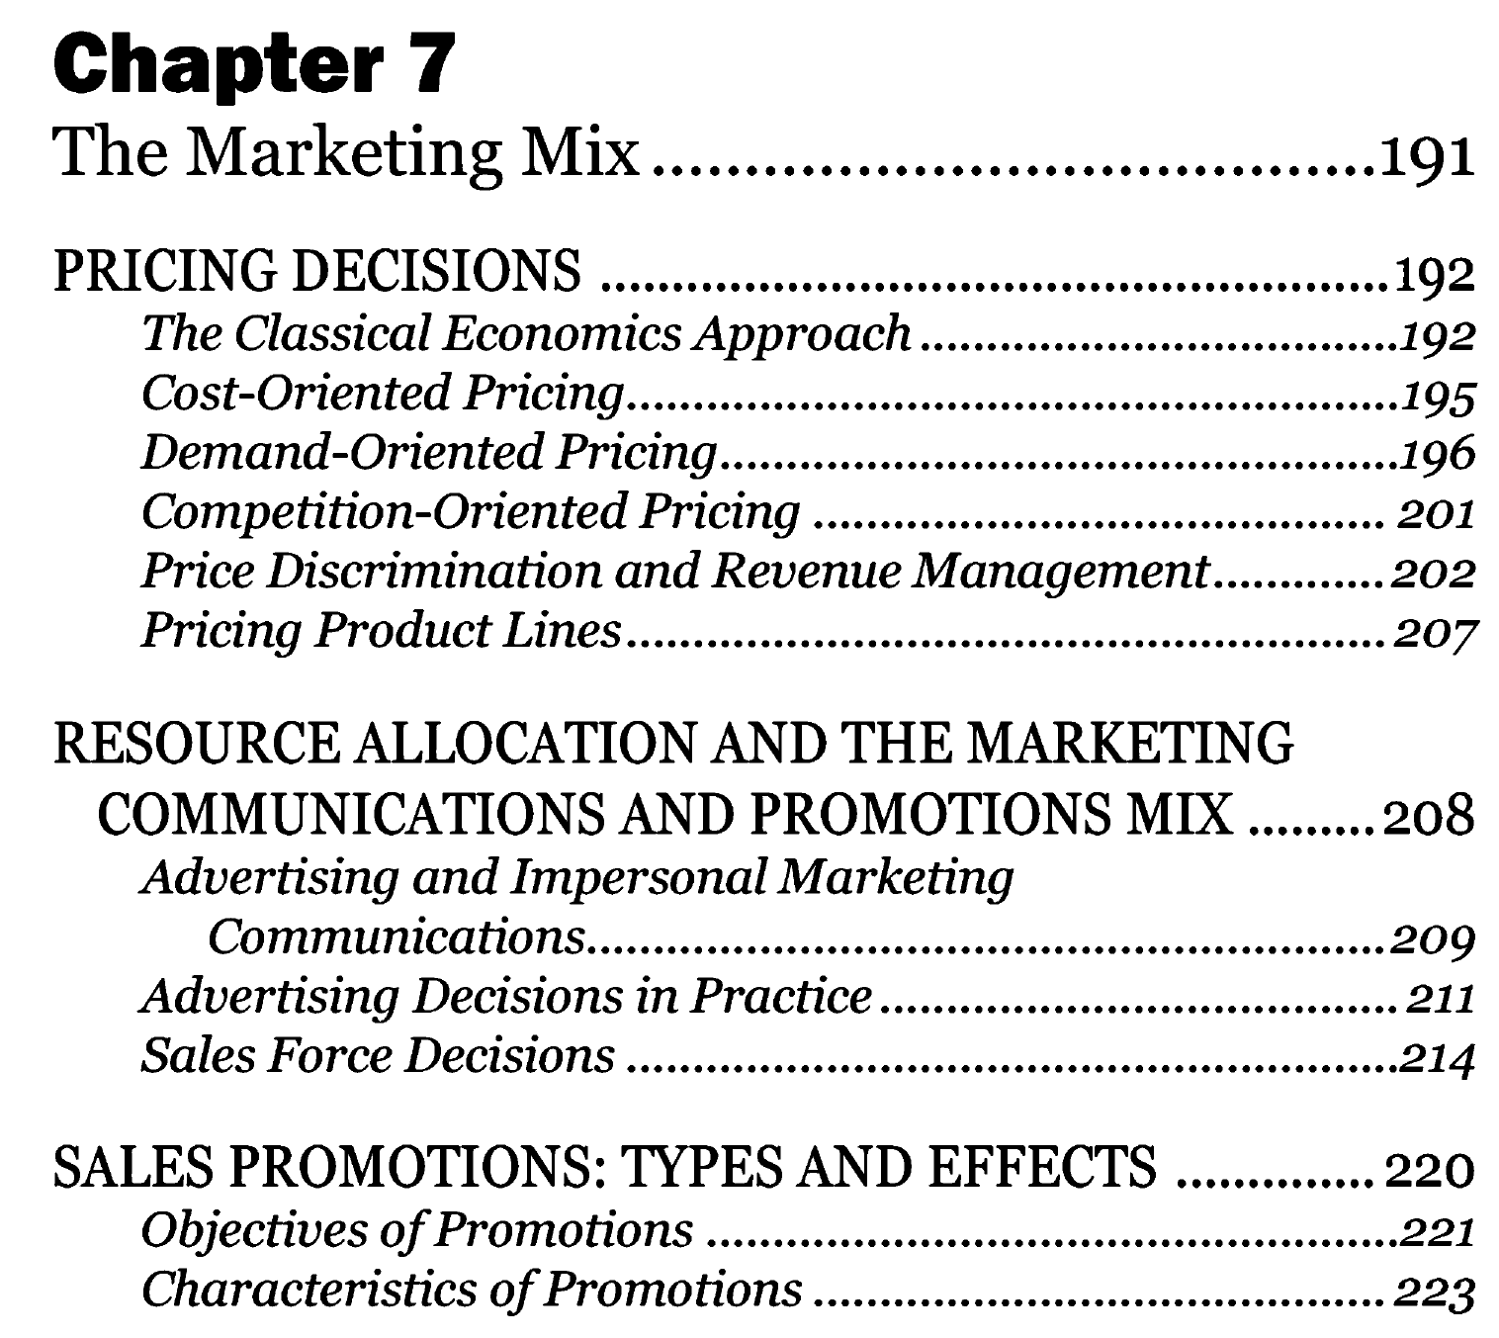
Notes:
This set of overheads covers a great deal of material, much more than in the text. Prof’s who are using Marketing Engineering Revised Edition 2 will find material that corresponds to chapters 8, 9 and 10 from that book. Use only what is appropriate for your treatments of these topics.

Slide 2

Sales & Marketing
張忠謀說，「我到台灣後就發現，許多科技公司都輕視 Sales & Marketing，以為技術最重要，但沒有業務員、你根本沒生意，不會獲利，根本活不了。」
「我很幸運，頭一個產品市場經理很能幹，我跟他共事幾週後，他就非常高興，因為前任總經理總是抱持一個觀念：只要產品好、客人就會自己來，根本不需要 Sales & Marketing，這是很錯誤的觀念」
https://www.cheers.com.tw/article/article.action?id=5100101

Slide 3
營銷短視Marketing Myopia
營銷近視症(Marketing Myopia)是著名的市場營銷專家、美國哈佛大學管理學院西奧多·萊維特(Theodore Levitt)教授在1960年提出的一個理論。營銷近視症就是不適當地把主要精力放在產品上或技術上，而不是放在市場需要(消費需要)上，其結果導致企業喪失市場，失去競爭力。這是因為產品只不過是滿足市場消費需要的一種媒介，一旦有更能充分滿足消費需要的新產品出現，現有的產品就會被淘汰。同時消費者的需求是多種多樣的並且不斷變化，並不是所有的消費者都偏好於某一種產品或價高質優的產品。李維特斷言：市場的飽和並不會導致企業的萎縮；造成企業萎縮的真正原因是營銷者目光短淺，不能根據消費者的需求變化而改變營銷策略。
以客戶為導向，而不是以產品為導向。
Selling product-oriented and short-term view.
Marketing customer-oriented and long-term view.
https://wiki.mbalib.com/zh-tw/营销近视症
*https://www.affde.com/zh-TW/ultimate-guide-to-marketing-myopia.html
Notes:
什麼是營銷近視症？
營銷近視症(Marketing Myopia)是著名的市場營銷專家、美國哈佛大學管理學院西奧多·萊維特(Theodore Levitt)教授在1960年提出的一個理論。營銷近視症就是不適當地把主要精力放在產品上或技術上，而不是放在市場需要(消費需要)上，其結果導致企業喪失市場，失去競爭力。這是因為產品只不過是滿足市場消費需要的一種媒介，一旦有更能充分滿足消費需要的新產品出現，現有的產品就會被淘汰。同時消費者的需求是多種多樣的並且不斷變化，並不是所有的消費者都偏好於某一種產品或價高質優的產品。李維特斷言：市場的飽和並不會導致企業的萎縮；造成企業萎縮的真正原因是營銷者目光短淺，不能根據消費者的需求變化而改變營銷策略。
[編輯]
營銷近視症的具體表現
營銷近視症的具體表現是：
自認為只要生產出最好的產品，不怕顧客不上門；
只註重技術的開發，而忽略消費需求的變化；
只註重內部經營管理水平，不註重外部市場環境和競爭等。
[編輯]
營銷近視症的病因
營銷近視症的產生從根本上是由於企業高層管理者對於產業環境和產業發展規律的錯誤判斷。Theodore Levitt列舉了四個廣泛存在的信念，這些信念或者被企業管理者公開宣講，或者成為其行動的暗含假設，而這四個信念則幾乎一定會導致營銷近視症：
第一，認為人口的自然增長，會為產業增長自動形成一個不斷擴大的市場；
第二，認為產業的主要產品不存在競爭性替代品，對於那些具有自然壟斷性質的產業如石油、電力等產業的經營者尤其如此；
第三，認為大規模生產會形成規模經濟，即單位產品成本會隨著產量的增長而下降，而企業會因此而打敗競爭者；
第四，產品是最重要的，只要造出了比競爭者更好的產品，就可以獲得優勢，企業經營者因此集中精力於完善科學實驗、改進產品和降低製造成本。
[編輯]
營銷近視症信念形成的原因
企業經營者之所以會形成上述四個信念，其原因又可以歸結為：
(1)企業經營者在企業中成長經歷。如果企業經營者是搞技術、抓生產或者管財務起家的，往往會使其眼光向內，較少的考慮顧客需求和市場變化，而過於註重生產效率和成本控制。
(2)“產業健忘症”。一個產業能夠興起，從根本上說是由於它迎合了顧客的需求或者潛在需求，這一過程是一個非常艱難的過程，因為它要求顧客改變消費習慣甚至生活方式去試用一種新產品。當產業渡過了初創期而步入成長期、產業前景一片光明、產業面臨的主要問題不是發現與開拓市場而是“填補”現有市場之時，產業中的企業經營者不能正確認識或是忘記了產業興起的真正原因，或是忙於搶占市場而無暇顧及產業的發展大計，以至忽視了悄然襲來的顧客需求變化和產業衰退的陰影。人們經常把亨利·福特作為產品導向的失敗典型，把他主要作為一個發明家，但實際上，福特其實是最成功的營銷家(Marketer)之一，當然也是最失敗的營銷家之一。當大多數企業生產商在進行成本加成定價時，福特就提出並推行了由價格決定成本而不是相反的做法。他推出500美元的Model T型車並大獲成功，其實是一場營銷戰的經典案例。福特的錯誤在於，他成了自己成功經驗的俘虜，在產業環境和顧客需求已經發生巨大變化之時，仍沉迷於過去成功的光榮之中，忘掉了成功的真正原因。
(3)企業經營者個人的知識。企業經營者個人所受的教育和因此而形成的知識結構，會對其判斷形成巨大的影響，因為它會影響經營者認為正確和應該做的事。企業經營者普遍都學習過經濟學，而在新古典經濟學的理論框架中，薩伊定理可以說一塊基石，即供給會自動創造自己的需求，最終達到供需均衡；而由於產量增長而形成規模經濟，造成單位成本的下降，更是經典教科書中的金科玉律，這些定律不可能不影響經營者的判斷。在嚴格的假定條件下推導出的抽象的經濟學定理，其實忽略了對於企業經營管理者來說至關重要的事實。不加辨別和分析地應用經濟學的原理，將幾乎一定會造成經營策略的失敗。

Slide 4
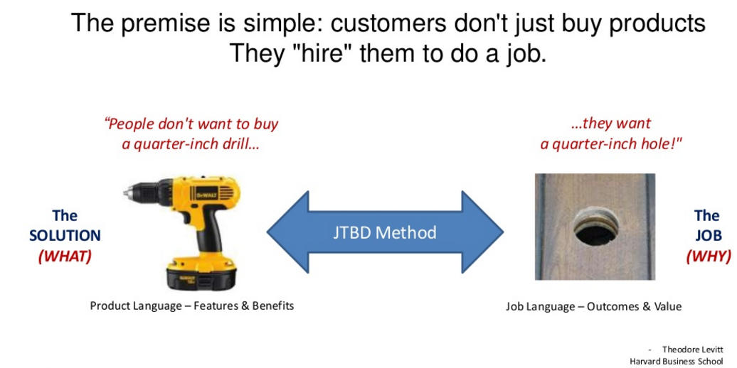
What Is a Job to Be Done?
http://www.slideshare.net/marklittlewood/jobs-to-be-doneswitch-workshop
http://www.slideshare.net/marklittlewood/turn-jobs-to-be-done-theory-into-practice

Slide 5
Cases Assigned
Resource Allocation & Pricing:
(12) Zach (Price)
(11) C-Tek (Resource Allocation)

Slide 6
Marketing Mix
The marketing mix refers to the levers that marketing managers pull to create a marketing plan.
These levers are often called the 4Ps:
Product (chapter 6 – Conjoint Analysis)
*Price
Place
*Promotion
* Cover in this chapter

Slide 7
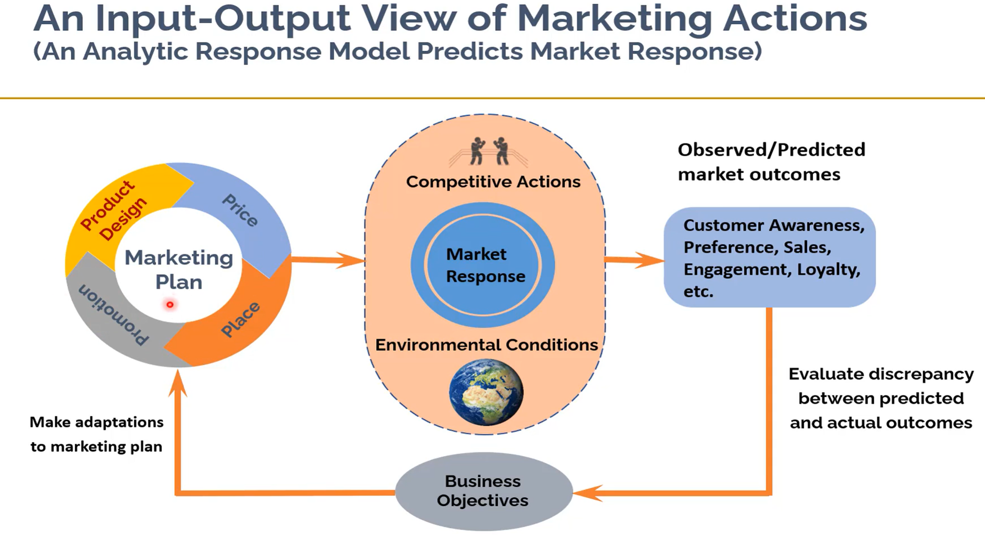
Maximize:
Revenue, Market Share, Profit

Slide 8
Drivers of Customer Demand
The methods marketers use to influence customer demand involve complex processes that encompass:
Interactions among the marketing levers (advertising, price, and promotions),
Delayed effects (spending now may affect demand in the future),
Competitive effects (current actions may cause or be driven by competitive actions), and
Product Line, Geographic, and Channel Considerations (many firms manage thousands, if not hundreds of thousands, of products in multiple channels across diverse geographies).
Pricing
Dealing with each marketing mix (MX) element (category) individually is easier to understand and to fine-tune MX elements, plus no need for coordination cross various units.
Notes:
We and ignore some complexities, particularly the interactions among elements, for several reasons. First, market reactions to single marketing mix elements are far easier to understand than are their interactions. Second, an improved understanding and the resultant ability to fine-tune individual marketing mix elements often represent “low-hanging fruit”—the profitable first step toward optimizing marketing spending across a wider range of marketing mix elements. Third, the optimization of the entire marketing mix may cross organizational boundaries and require sophisticated processes for managing them.

Slide 9
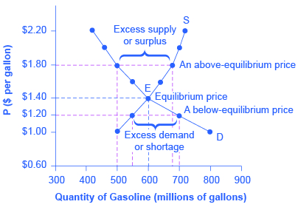
Profit function
Profit = (Price - Cost) x Quantity sold
Volume = Quantity sold
-
Economies
of scale
-
Supply
(均衡價格)
+
Price
Demand
-
+
https://opentextbc.ca/principlesofeconomics/chapter/3-1-demand-supply-and-equilibrium-in-markets-for-goods-and-services/
Notes:
An example of a demand curve shifting. D1 and D2 are alternative positions of the demand curve, S is the supply curve, and P and Q are price and quantity respectively. The shift from D1 to D2 means an increase in demand with consequences for the other variables

Slide 10
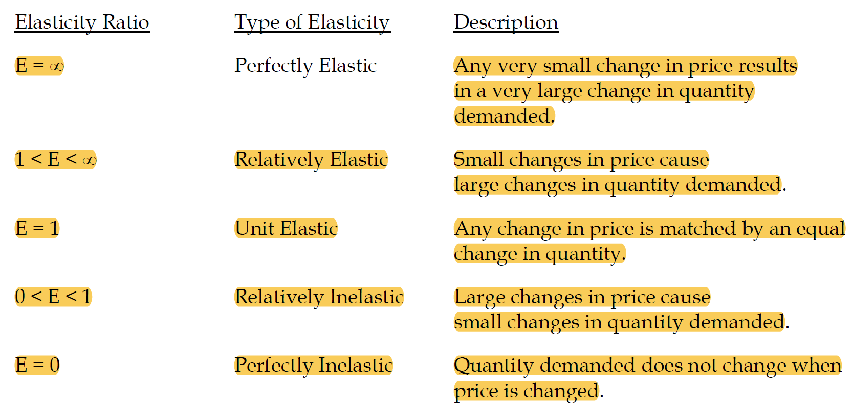
Price Elasticity of Demand (需求价格弹性)= E

Slide 11
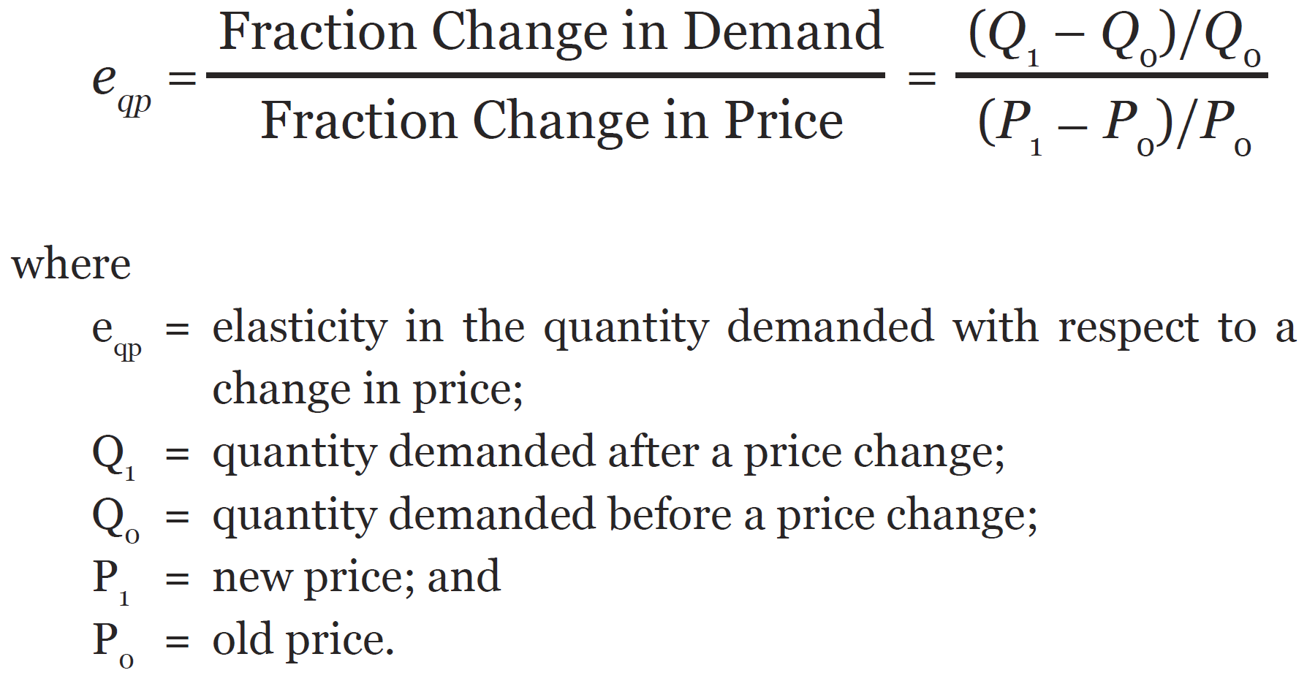
Price Elasticity of Demand 需求价格弹性
(use the absolute value)
price elasticity—how responsive demand will be to a change in price.
A price elasticity of |-1.0| = 1 means that demand rises (falls) by the same percentage that the price falls (rises). In such a case, total revenue remains unaffected.
https://www.investopedia.com/terms/p/priceelasticity.asp
https://hbr.org/2015/08/a-refresher-on-price-elasticity

Slide 12
Practical Pricing Decisions
The classical model is not very useful for decision making.
In practice, firms tend to base their pricing decisions on one of three key factors — cost, demand, or competition — and then rely on models that ignore the other two factors.
Competition-Based Pricing
Cost-Plus Pricing
Dynamic Pricing
Freemium Pricing
High-Low Pricing
Hourly Pricing
Skimming Pricing
Penetration Pricing
Premium Pricing (Freemium)
Project-Based Pricing
Value-Based Pricing
Bundle Pricing
Psychological Pricing
Geographic Pricing
Dynamic Pricing➔ Revenue Management Systems (RMS)
https://blog.hubspot.com/sales/pricing-strategy

Slide 13
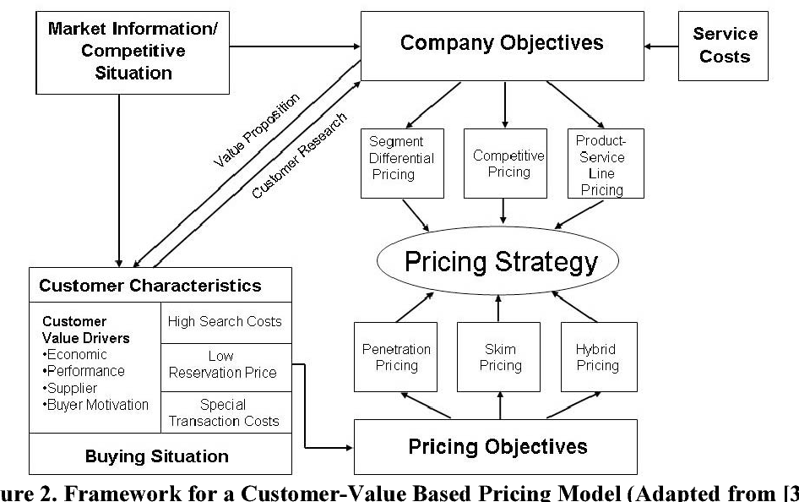




Pricing Strategies
Skim pricing: charges a high initial price and then gradually lowers the price to attract more price-sensitive customers.
Penetration pricing: attract customers to a new product or service by offering a lower price during its initial offering
https://www.profitwell.com/recur/all/value-based-pricing
Notes:
https://www.semanticscholar.org/paper/Pricing-Strategies-for-Information-Technology-A-Harmon-Demirkan/30c584613b73201bd2d9dbf2e1d6d31d290a8a1c

Slide 14
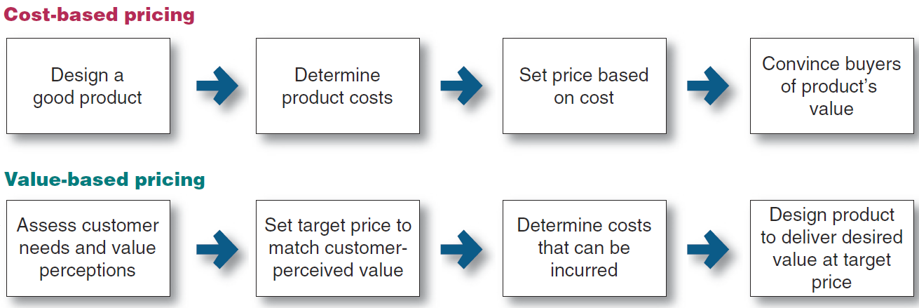
Pricing Strategies
Cost-oriented pricing: Markup and cost-plus pricing (e.g., Costco)
Demand-oriented pricing: Charge a higher price when demand is strong and a lower price when demand is weak, even if production costs remain the same.
Principles of Marketing, Philip Kotler, Gary Armstrong, 2020.

Slide 15
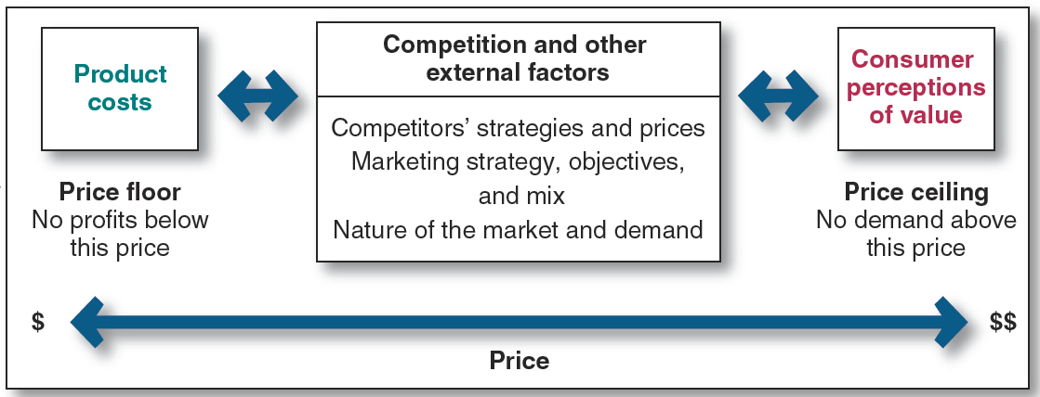
A Customer-Value Oriented Approach to Pricing
Principles of Marketing, Philip Kotler, Gary Armstrong, 2020.

Slide 16
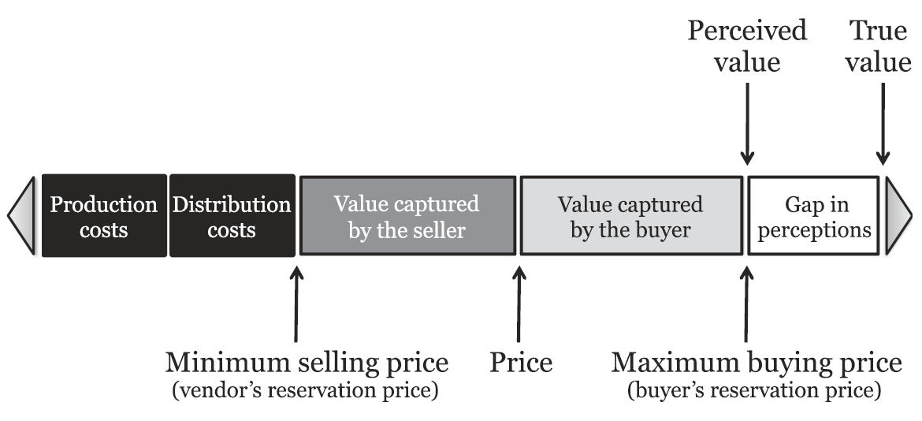
A Customer-Value Oriented Approach to Pricing

Slide 17
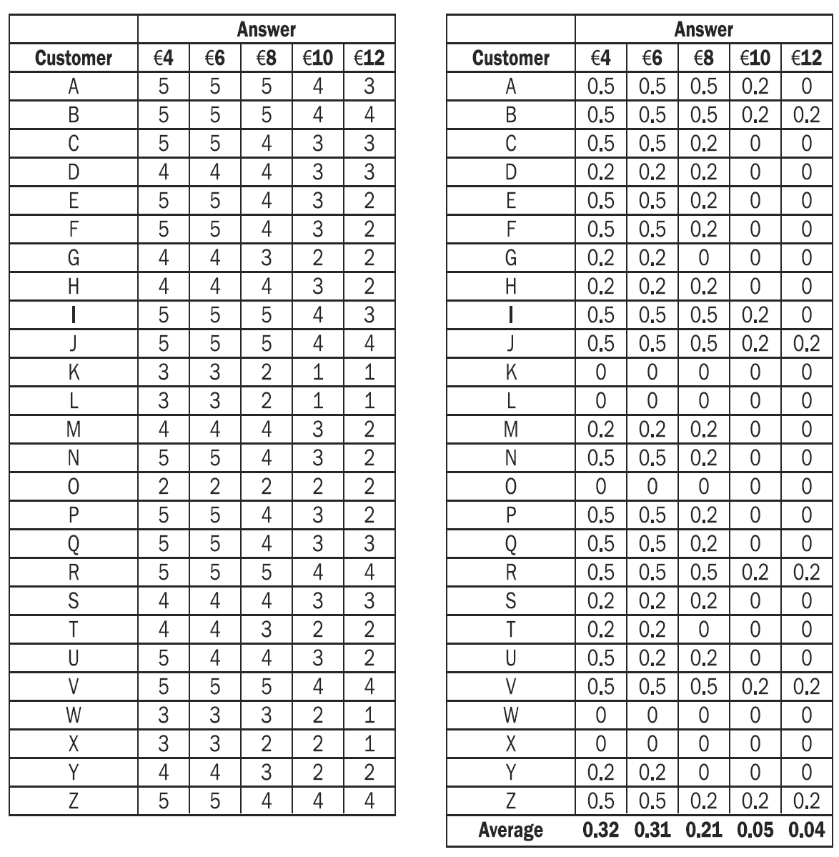
The Gabor-Granger Method
Customers answer on a simple scale ranging from “will never buy” (0%) to "will probably buy" (20%), “will definitely buy” (50%) usually with a 5-point Likert scale.
Responses to likelihood of buying a smartphone case by 26 consumers at 5 different prices with raw scores (table on the left) transformed into actual purchase likelihood and average purchase likelihood.

Slide 18
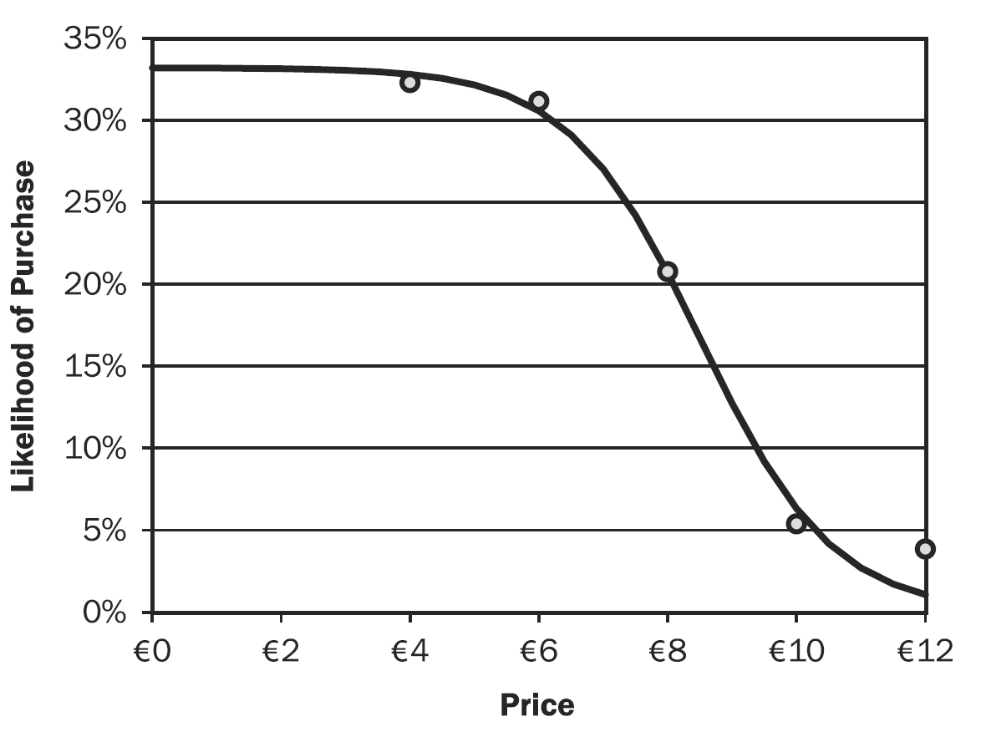
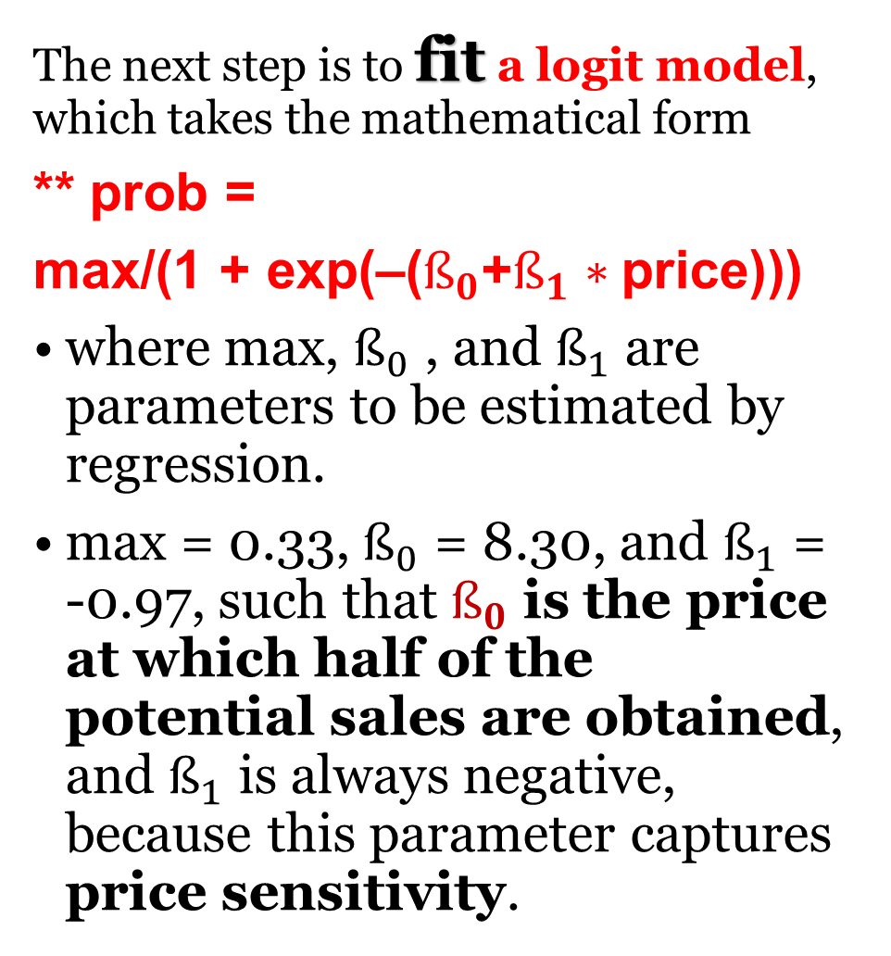
The Likelihood of Purchase Curve from Customer Data
The next step is to fit a logit model, which takes the mathematical form
** prob =
max/(1 + exp(–($ß_{0}$+$ß_{1}∗$price)))
where max, $ß_{0}$ , and $ß_{1}$ are parameters to be estimated by regression.
max = 0.33, $ß_{0}$ = 8.30, and $ß_{1}$ = -0.97, such that $ß_{0}$ is the price at which half of the potential sales are obtained, and $ß_{1}$ is always negative, because this parameter captures price sensitivity.

Slide 19
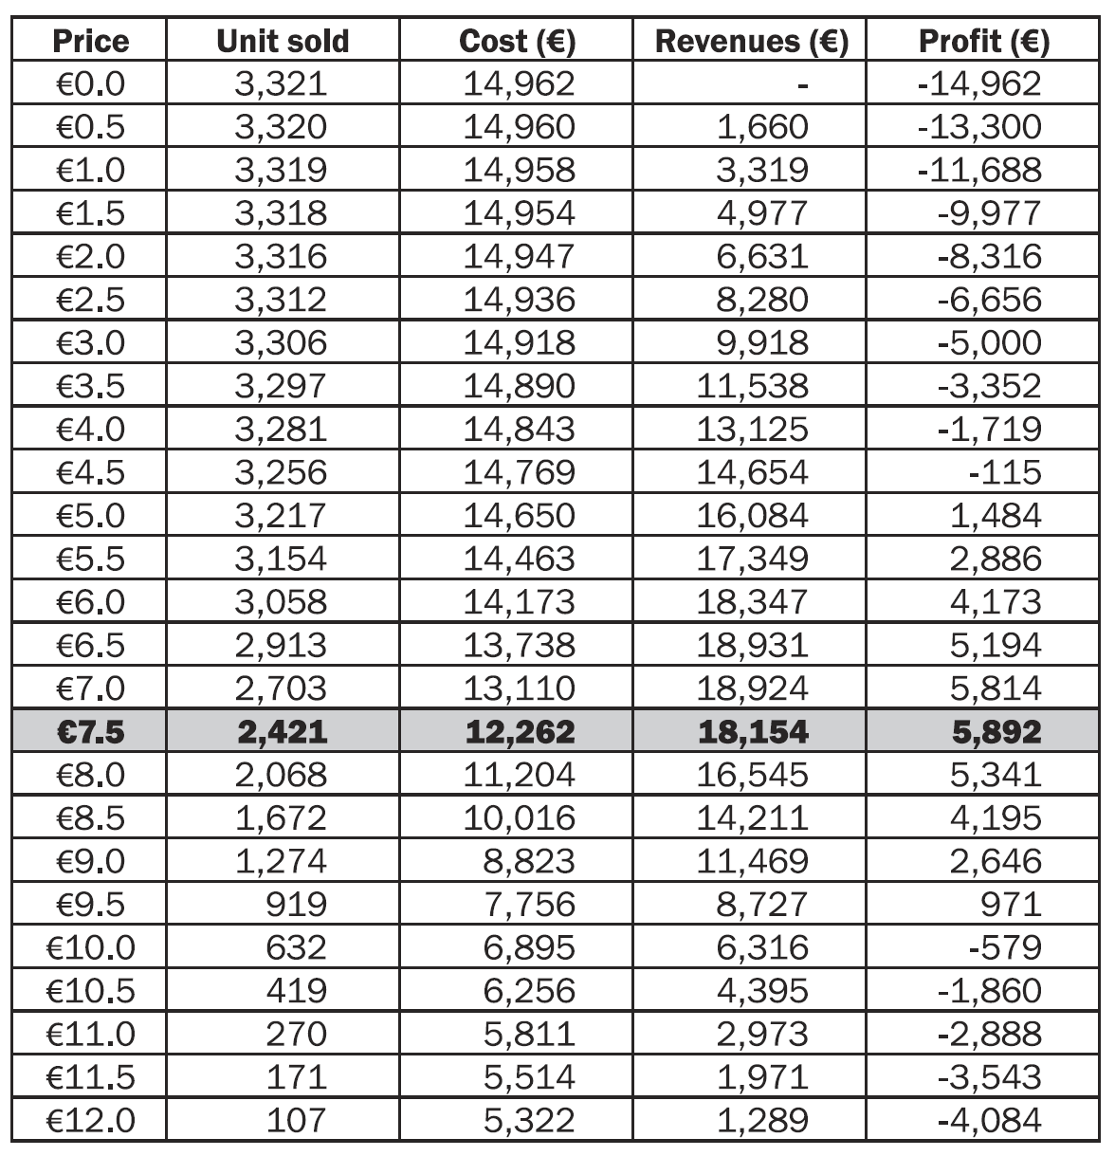
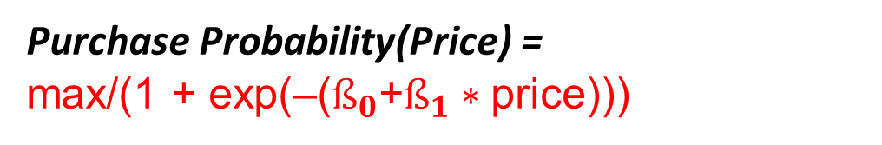
Suppose that the firm has fixed costs of 5000 EUR and marginal unit costs of 3 EUR/unit. Assuming a total market of 10,000 customers, the price that maximizes profit is 7.5 EUR.
Use optimization tool to find the profit maximizing price, using the formula:
Profit =
Total Market (10,000) x Purchase Probability(Price) x
(Price – Marginal cost) – Fixed Costs.
TotalCost = 12262 = 5000 + 2421 * 3
Profit = Price*UnitSold-TotalCost
=7.5*2421-12262
Purchase Probability(Price) =
max/(1 + exp(–($ß_{0}$+$ß_{1}∗$price)))

Slide 20
Resource Allocation and The Marketing Communications and Promotions Mix
Some critical considerations firms must take into account when determining their marketing spending level (i.e., budget) and budget allocations across products, markets, or other entities based on estimated market response functions based on efforts and impacts.
We focus on justifying a total marketing communications and promotions budget.

Slide 21
Marketing Communications And Promotions
Marketing communications (also known as marcom) is the messages and media that marketers use to communicate with target markets.
Examples of marketing communications include traditional advertising, direct marketing, social media marketing, presentations and sponsorships.
Focus on justifying a total marketing communications and promotions budget by addressing the following questions all firms should ask:
How much should we spend in total during a given planning horizon?
How should that spending be allocated to each marketing mix element? How much of our budget should be spent on advertising and other forms of impersonal marketing communications? On sales promotion? On the sales force?
How should those individual budgets be allocated? To customers? To geographies? To sub-elements of the marketing communications mix? Over time?

Slide 22
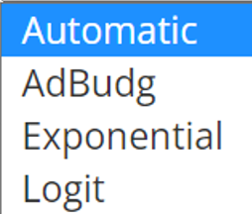
Resource Allocation: Basic Framework
Resources/Efforts
Market Mechanism modeled by Response Functions
Performance/Impacts
Marketing Mix Effort
Impact: Market outcomes
Regression
Tool
Effort
Data
+
Impact
Data
Base Scenario Current effort
Current impact
Cost per effort unit
Margin (Revenue) per output unit
Coefficients of
Response Functions
+
Over multiple categories where resource (budget) will be allocated!
Optimization Tool
(e.g., Excel Solver)
Find
Effort (Advertising Budget) of marketing mix that optimizes net profit!
Use Effort Data & Impact Data to infer
the coefficients of response function (model) parameters ➔
Use the model and Base Scenario data to calculate the model fit at different marketing efforts & to find the Optimized effort.

Slide 23
Resource Allocation and Marketing Communications Mix
Marketing communications mix ➔ Promotion
Advertising: Any paid form of nonpersonal presentation and promotion of ideas, goods, or services by an identified sponsor.
Direct marketing: The use of mail, telephone, the Internet, and other non–face-to-face contact tools to communicate with or solicit a response from specific customers and prospects.
Sales promotion: Short-term incentives to encourage customers to try or purchase a product or service.
Personal selling: Face-to-face interactions with one or more prospective customers for the purpose of making a sale.
Public Relations (PR): PR is managing information flow between an organization and public. Example: Sponsoring events, newspaper articles etc.

Slide 24
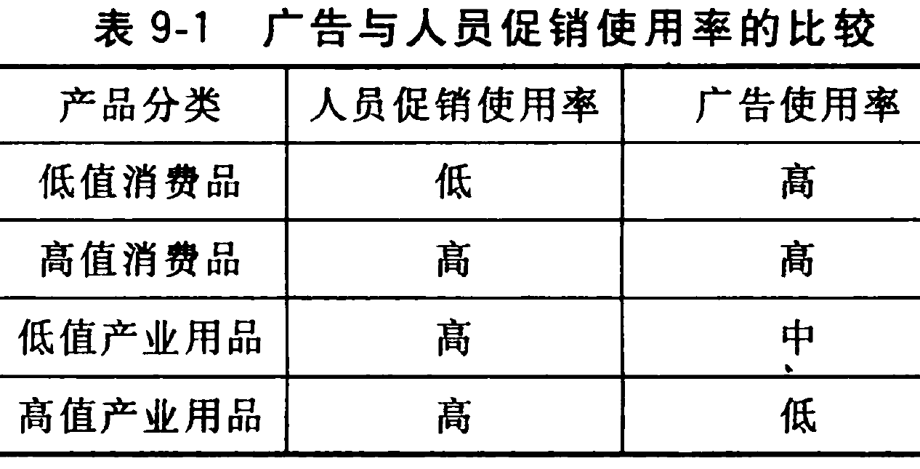
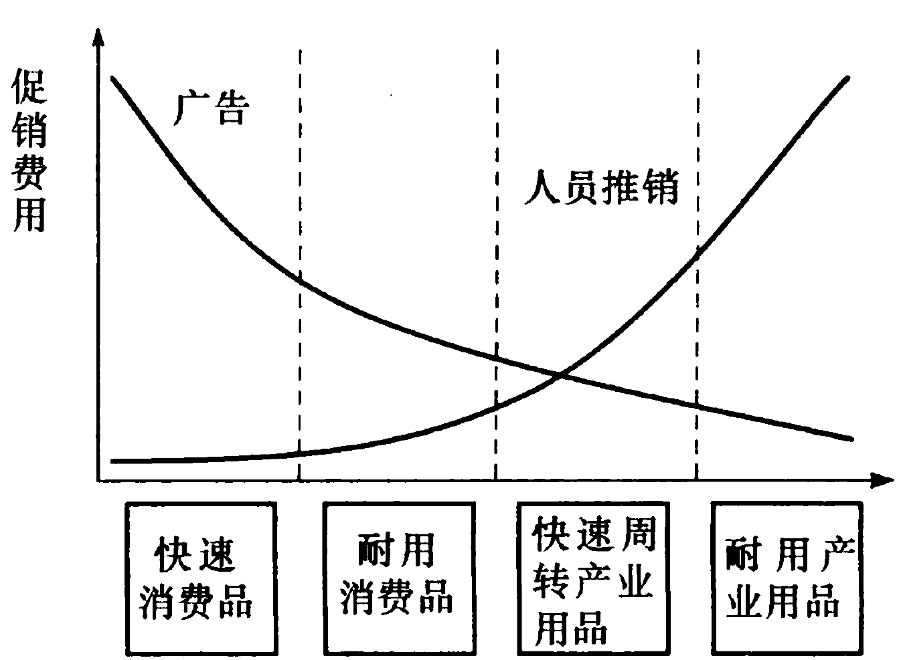
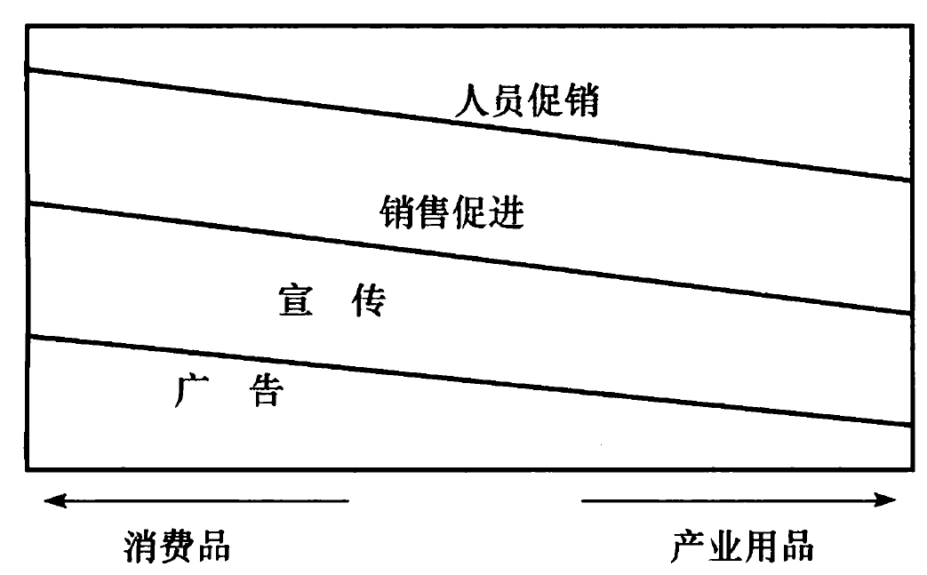







Advertising and Personal Selling
B2C ⬅➔ B2B

Slide 25
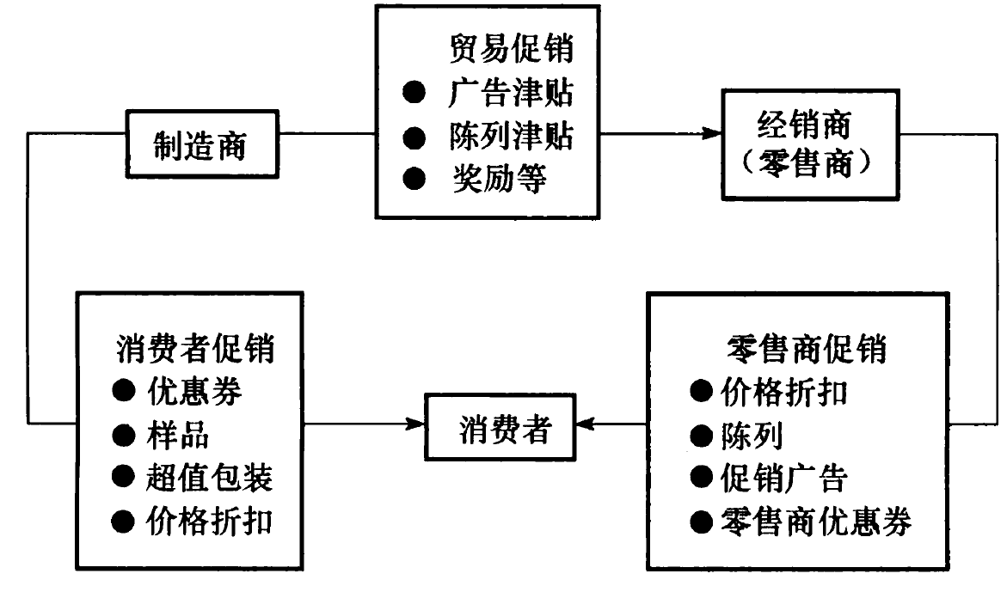
销售促进反应过程示意图
Push➔
Push➔
⬅ Pull
Pull ➔
⬅Push

Slide 26
Promotional Types and Targets
Manufacturer
Trade Promotions
Case allowances
Advertising allowances
Display allowances
Contests
etc.
Trade
(Retailer)
Consumer Promotions
Consumer
Retailer Promotions
Coupons
Samples
Price packs
Value packs
Refunds
Contests
Tie-ins
etc.
Price cuts
Displays
Feature ads
Retailer coupons
Free goods
etc.
Notes:
Note the several ways that promotions work—either by pushing or by pulling.

Slide 27
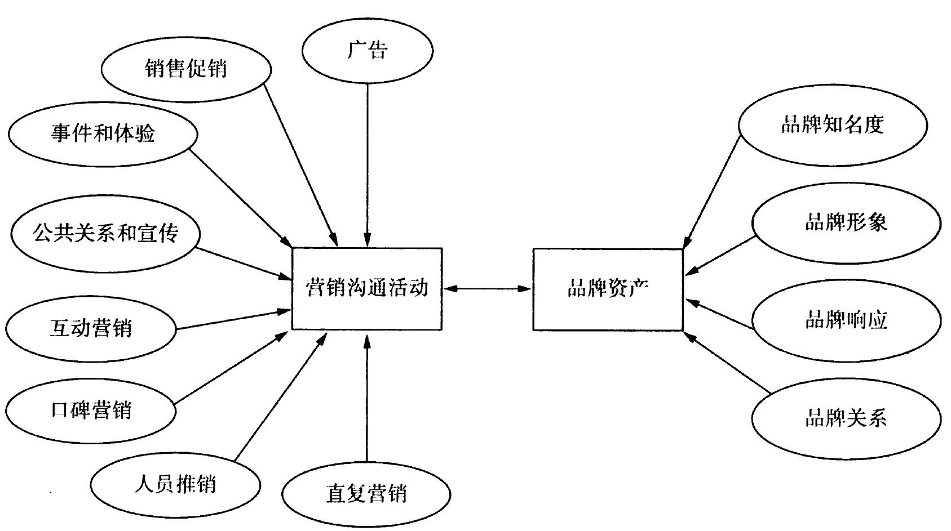

Slide 28
Advertising Budgeting in Practice
Affordable method
Percent of sales
Competitive parity method
Objective/task method
Model-based /Response Model approach
To this day, rules of thumb tend to be the rule because of continuing challenges in advertising justification.
Notes:
To this day, rules of thumb tend to be the rule because of continuing challenges in advertising justification.

Slide 29
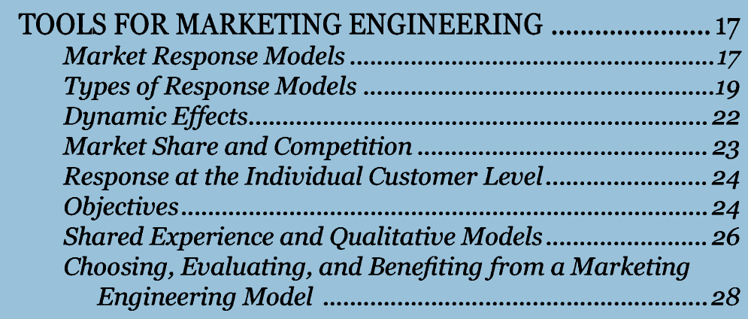
Resource Allocation and the Marketing Communications and Promotions Mix
Chapter 1.3

Slide 30
Marketing Mediums: Offline and Online Marketing
Offline Marketing
Print Media : Newspaper, Magazine
TV, Radio
Out-of-home (OOH) Advertising like Billboards, ads in public places.
Direct Mail like catalogs, letters
Telemarketing
Below The Line Promotions like free product samples or vouchers
Sponsorship
Online Marketing
Search Engine Marketing like Content Marketing, Backlink building etc.
Pay per Click, Pay per Impression
Email Marketing
Social Media Marketing (Facebook, YouTube, Instagram, LinkedIn Ads)
Affiliate Marketing
https://www.listendata.com/2019/09/marketing-mix-modeling.html

Slide 31
Current Trends
Allocate a greater proportion of their marketing budget to online media, which often trigger greater responses than traditional marketing, at least among certain target segments (e.g., young people) and with respect to certain activities undertaken by customers (e.g., researching a product online before buying at a store).
Customer responses to online marketing is easier to track (e.g., response to Google AdWords), and the costs to generate the same customer response generally are less than those required in offline channels.
Adidas is reallocating its marketing budget of about $1.5 billion (13% of its sales) and prioritizing online media as the primary way to reach its target audience of 14–19-year-olds; traditional media (TV and print) will be supplementary in the future. Nike and Puma are pursuing a similar strategy.

Slide 32
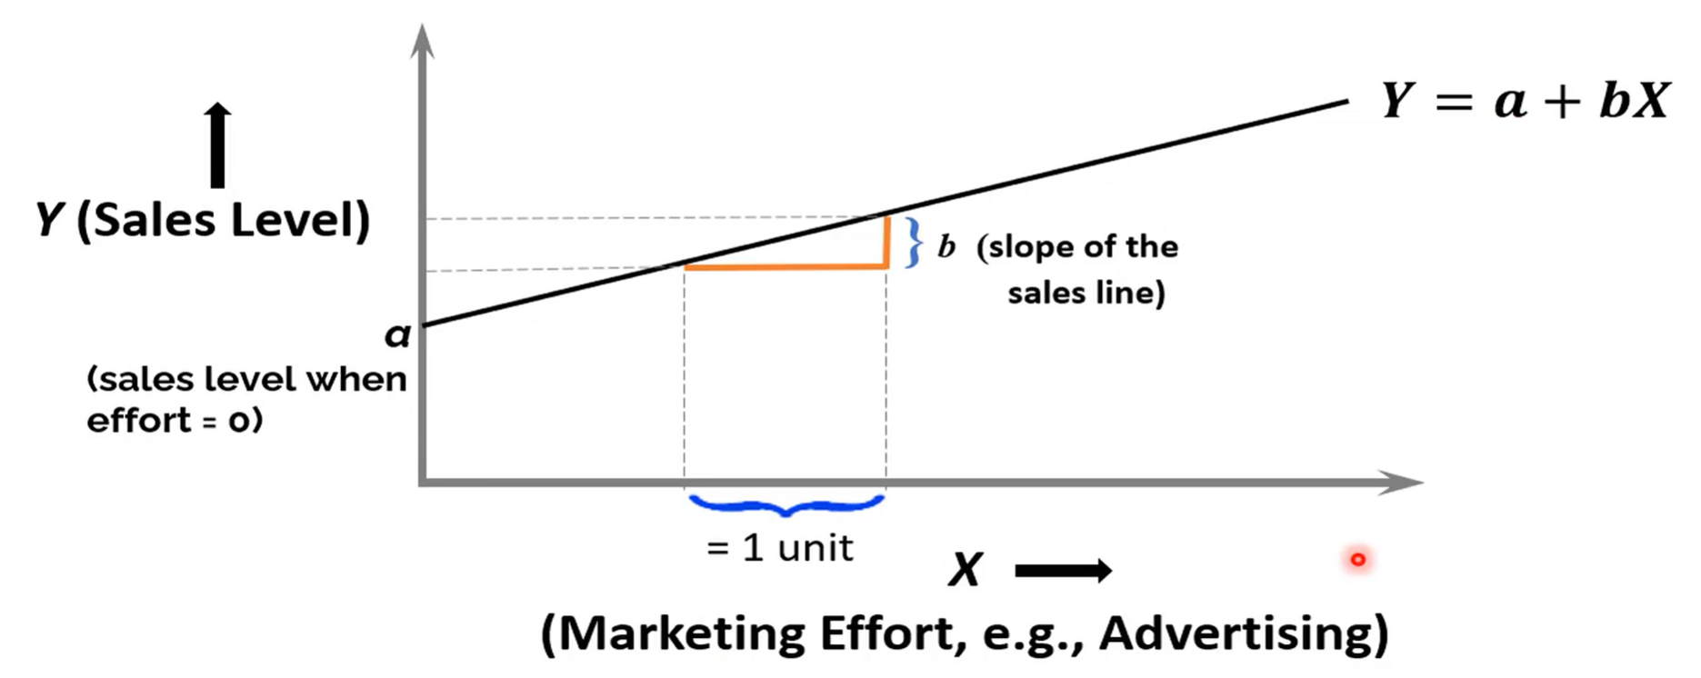
A Simple Linear Aggregate Response Model
What Are the Problems/Limitations of a Simple Linear Aggregate Response Model?

Slide 33
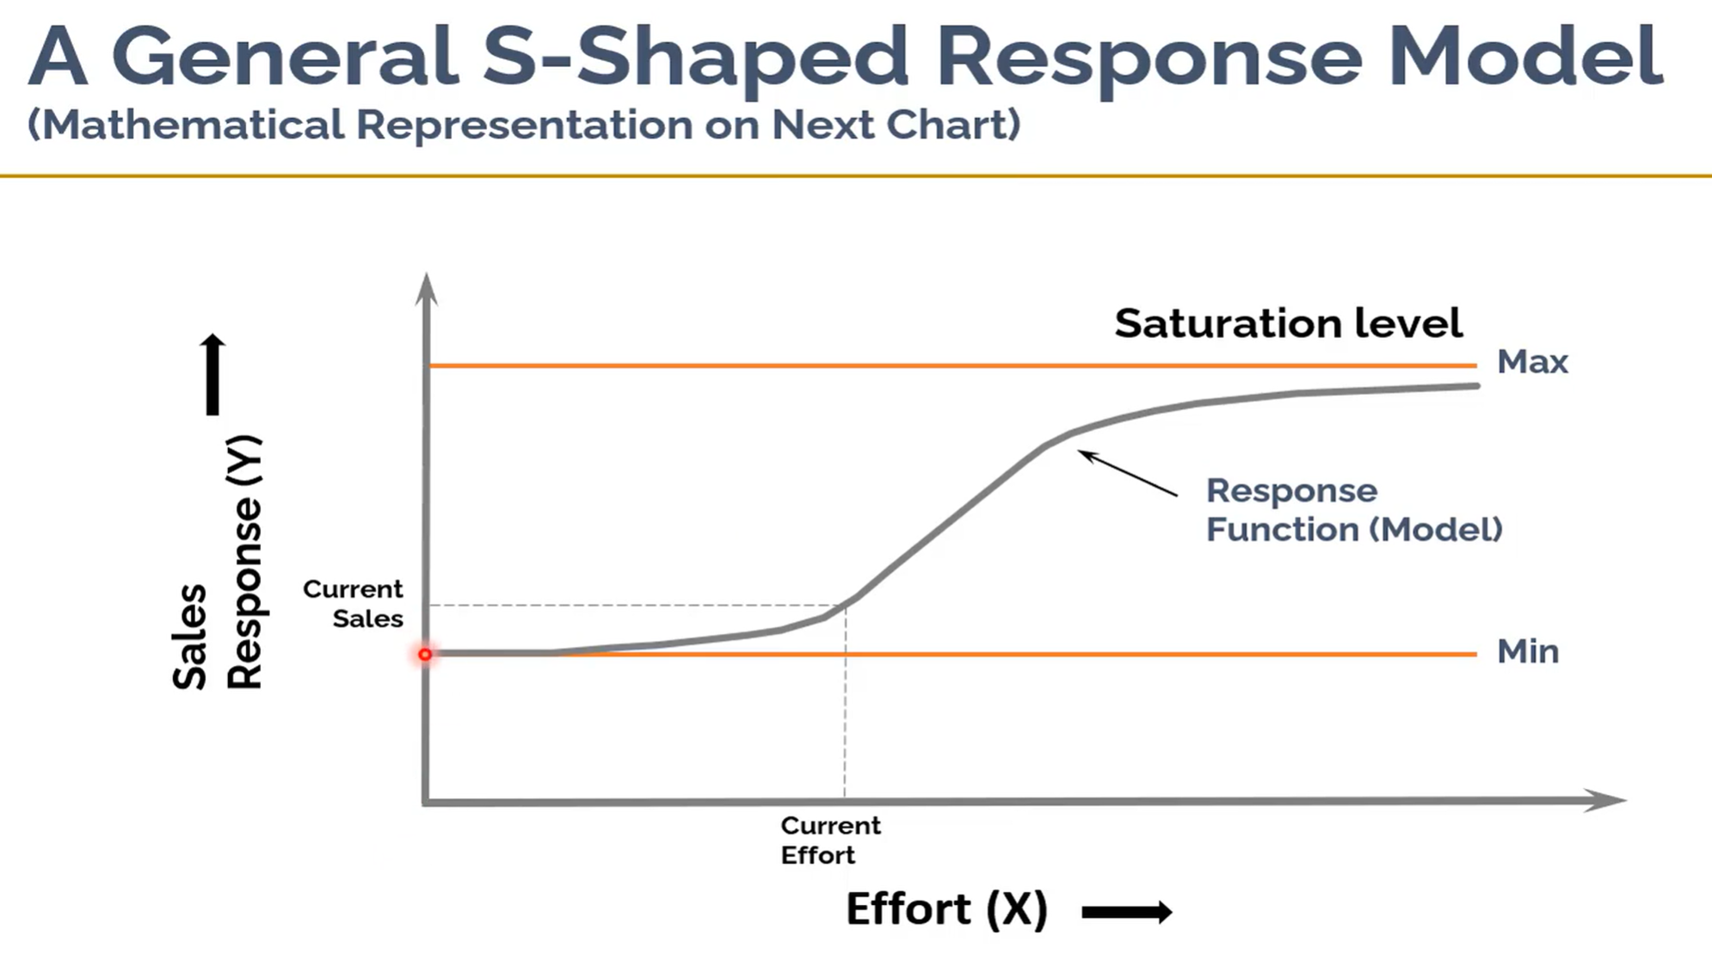

Slide 34
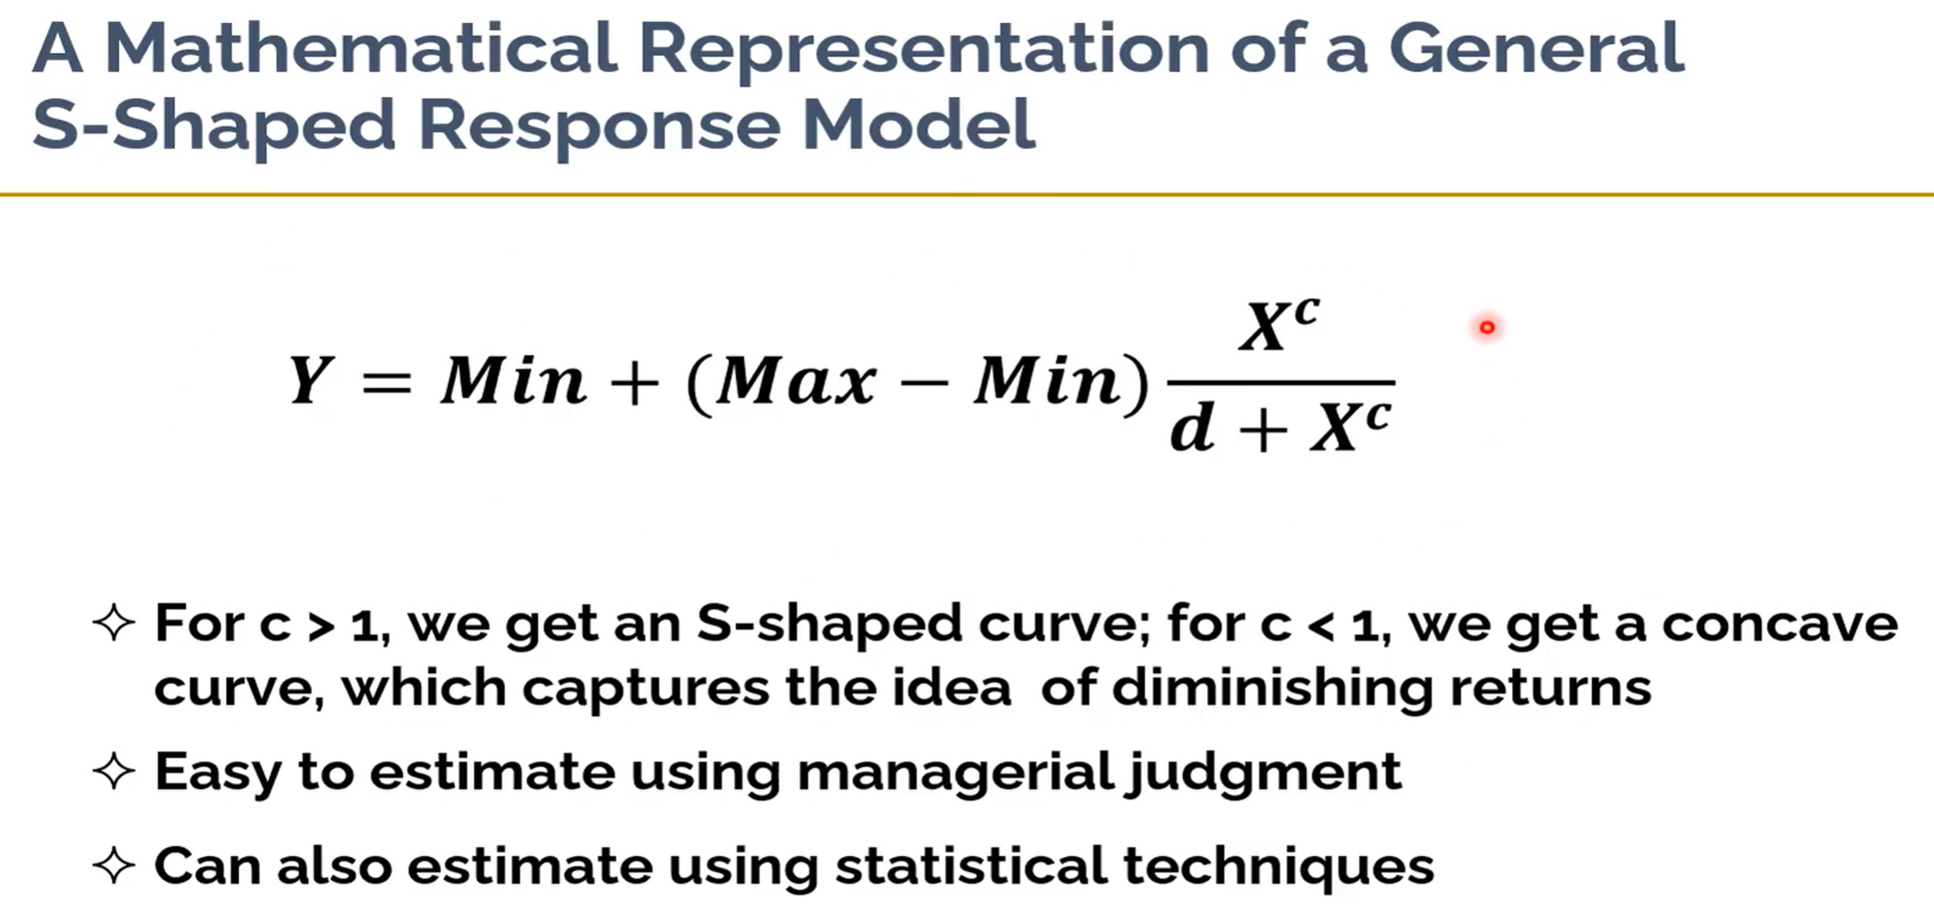
AdBudg Model

Slide 35
ADBUDG Response Model Assumptions
If advertising is cut to zero, brand share will decrease, but there is a floor (min), on how much share will fall from its initial value by the end of the period.
If advertising is increased a great deal, say to something that could be called saturation, brand share will increase but there is a ceiling (max), on how much can be achieved by the end of one period.
There is some advertising rate that will maintain initial share.
An estimate can be made by data analysis or managerial judgement of the effect on share by the end of one period of a 20% increase in advertising over the maintenance rate.
Notes:
The Adbudg model is a classic—and, while it may be too simple to implement, it provides a sound structure for thinking about response functions, carryover effects and the link between objectives and resource allocation. Use the Blue Mountain case and associated spreadsheet to show how this process works.

Slide 36
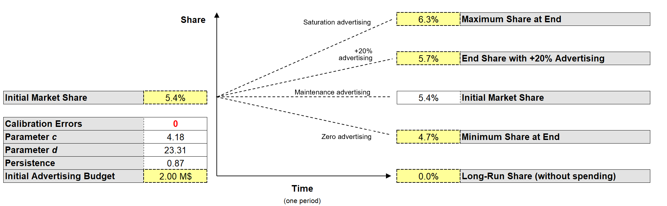
Input—Calibrating Sales Response to Advertising Function
Use managerial judgement to Calibrating
AdBudg Model's parameters (Sales Response to Advertising Function)
  Share Response = min + (max – min)(adv)^{c} / [d + (adv)^{c} ]
Check out ➔ blue_mountain_coffee_adbudg.xls
Notes:
The basic calibration screen in the Blue Mountain case require the user to implement this issue

Slide 37
Share Response vs Advertising
Max
Use the market share,
we can derive the Revenue.
Given Costs, we can calculate Profit.
Min
Maintenance
+20%
  Share Response = min + (max – min)(adv)^{c} / [d + (adv)^{c} ]
Notes:
This is the adbudg curve.

Slide 38
What Do We Know About Advertising Response?
Sales respond dynamically upward and downward, respectively, to increases and decreases of advertising and frequently do so at different rates.
Steady-state response can be concave(凹) or S-shaped and will often have positive sales at zero advertising.
Competitive advertising affects sales.
The dollar effectiveness of advertising can change over time as the result of changes in media, copy, and other factors.
Products sometimes respond to increased advertising with a sales increase that falls off even as advertising is held constant

Slide 39
Advertising
Advertising interacts with other mix elements:
Personal selling (especially for industrial products)
Branding (advertise the brand/company?)
Price (does it increase or decrease price elasticity?)
Distribution (how to match distribution coverage with advertising coverage?)
Notes:
Advertising rarely works on its own. It is good to ask the class why.

Slide 40
The End
The End

